Slide 1
 | - _QBL | , - | S,
MEN
K E ,EP G O I N 'G
WE CANT TAIC'E A,R ' 01= OUR 10W
I

Slide 2
Essential Questions
Analyze the responses of Franklin D. Roosevelt's administration to the problems of the Great Depression. How effective were these responses? How did they change the role of the federal government?
How successful were the programs of the New Deal in solving the problems of the Great Depression? Assess with respect to the following:
Relief
Recovery
Reform

Slide 3
Causes of the Great Depression
Overproduction (durable goods)
Availability of
Credit
Laissez-faire Capitalism
High tariffs
Industrial
Policy
Gov’t
Policy
Stock Market Crash
Farm Economy
Buying on Margin
Speculation
Low Prices
High Debt

Slide 4
Causes of the Great Depression
Wall Street Crash
Black Thursday and Black Tuesday
Mass Sale of Stocks
Effect of:
Buying on margin & speculation
False growth from installment plans (credit)
Overproduction
Dow Jones: 381 (Sept. ‘29) to 41 (1932)
Other Causes:
Uneven distribution of wealth
Weak Farm Economy
Government Policies
Global Economic Problems

Slide 5
Effects of the Great Depression
Economic:
GNP (value of goods and services) $104 billion (’29) → $56 billion (‘32)
Income declined 50%
20% bank failures
Unemployment to 25%
Political
End of Republican dominance
More toward larger government
Social
Affected all classes
Poverty, foreclosures, and evictions
“hobos”
“Hoovervilles,” “Hoover
blankets,” and “Hoover flags”

Slide 6
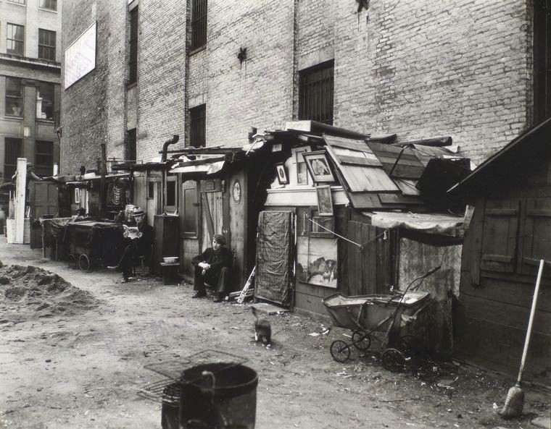
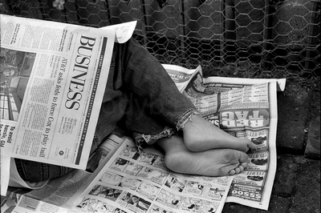
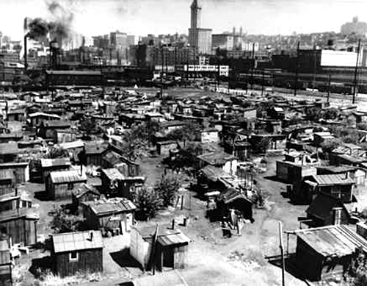
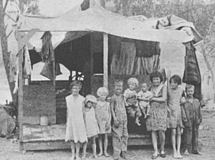

Slide 7
Hoover’s Policies
Foreign Policy
Hawley-Smoot Tariff (1930)
Highest peacetime schedule in
history (31-49%)
Result: higher tariffs from Europe & reduced trade
Debt Moratorium (1931) – suspension of international debts
Effect of Dawes Plan
Domestic Programs
Federal Farm Board – surplus held in storage to help stabilize prices
Reconstruction Finance
Corporation (RFC -1932) – emergency loans to banks, insurance companies
Despair and Protest
Farm Unrest
Bonus March (1932)

Slide 8
Election of 1932
Democrats
Franklin Delano Roosevelt
A “New Deal” for America
Repeal prohibition, aid to unemployed, and cuts in government spending
Republicans
Hoover sticks with “rugged individualism” and “trickle- down” approach
Results:
Roosevelt Garners 57% and an overwhelming electoral majority
Hoover the “lame-duck”
Impact: 20th Amendment (1933) – inauguration Jan 20th set

Slide 9
FDR
Background
Hyde Park branch of of the Boston Brahmin Delano family
Proverbial “silver spoon”
Boarding schools, Harvard, and Columbia
Hardship
Contracted polio in 1921 during vacation following 1920 VP run (Cox)
Inaugural Address
“the only thing we have to
fear…”

Slide 10
New Deal Philosophy
Fireside Chats
1st: Banking System –4 day closing
Purpose: Instill confidence
“Brain Trust” & Other Advisers
University professors as
economic advisers
Diverse Cabinet
Frances Perkins: Sec. Labor
The Three R’s
Relief, Recovery, Reform

Slide 11
First Hundred Days
The Emergency Congress
Bank Holiday
Repeal of Prohibition
Beer-Wine Revenue Act
21st Amendment (1933)
Financial Recovery and Reform
Emergency Banking Relief Act
Glass-Steagall Act
FDIC
Home Owners Loan Corporation – refinancing to prevent foreclosure
Farm Credit Administration – low interest rates

Slide 12
First Hundred Days (con.)
Relief for the Unemployed
Federal Emergency Relief Administration (FERA)
Public Works Administration
(PWA)
Civilian Conservation Corps (CCC)
Tennessee Valley Authority (TVA) controlled by government
Conservatives don’t like the government control of business – limit on their freedoms

Slide 13
Industry & Agriculture
Industrial Recovery Program
National Recovery Administration (NRA)
Regulated wages, hours, and
levels of production
Declared unconstitutional - (Schechter, 1935)
Farm Production Control Program
Agricultural Adjustment Act (AAA)
“subsidized scarcity”
Declared unconstitutional (Butler, 1936)

Slide 14
Other New Deal Programs
Civil Works Administration
(CWA)- temporary construction jobs
Securities and Exchange
Commission (SEC)
Police stock market
Federal Housing Administration
(FHA) –bank loans insured
Gold Reserve Act
Ended the Gold Standard $35 for one ounce of gold – no exchange

Slide 16
From the Left
Socialists and Communists
New Deal maintained the economic system that caused the Depression
Did not address the social
order (inequity)
Regulated and protected big business

Slide 17
From The Right
Conservative Viewpoint
Too much government intrusion
Creation of the welfare state
Unconstitutional
Socialistic
Interest Group Politics

Slide 18
The Demagogues
Father Charles E. Coughlin
Catholic Priest & Radio Host
National Union for Social Justice
Inflate currency & nationalize banks
Francis E. Townsend
Retirement pension
$200/month for 60+
Huey Long
The “Kingfish”
“Share Our Wealth”
$5,000 annually to all American families
Paid by income tax on wealthy

Slide 20
Relief Programs
Works Progress Administration
(WPA)
3.4 million employed
Construction and Infrastructure
Art and Literature
National Youth Administration
Part-time jobs for students
Resettlement Administration
Loans to tenant farmers
Federal camps for migrant workers

Slide 21
Reforms
National Labor Relations Act
(1936)
The Wagner Act
Protected collective bargaining
Rural Electrification Administration (REA)
Increase in Federal Taxes
On the Wealthy & Capital Gains
Social Security Act
Payments to:
Retired (65+, blind or disabled, dependent children and their mothers)

Slide 23
The Election of 1936
Republicans
Alfred Landon
Progressive
Realignment and the New Deal
Coalition
Roosevelt garners both old and new faces
Solid South, city machines, unions, and blue collar workers
Racial minorities, people on relief, and intellectuals

Slide 24
The Supreme Court
SCOTUS Begins Striking Down New
Deal Legislation
NRA, AAA
Court Reorganization Plan
Roosevelt proposes to add 1 justice for each justice over the age of 70 (6)
The “Court-packing” or “dictator” bill
Reaction
Congress defeats the bill (bipartisan
vote)
Aftermath
SCOTUS begins supporting New Deal legislation
Upholds Wagner and Social Security

Slide 25
Rise of Unions
Formation of the Committee of Industrial Organizations (CIO, 1936)
John L. Lewis
Broke from AFL to organized unskilled
laborers
Strikes
Automobiles
General Motors (1937)
Resulted in recognition of the United
Auto Workers Union (UAW)
Steel
Memorial Day Massacre (1937)
Republic Steel, Chicago
Fair Labor Standards Act (1938)
Minimum Wage, Maximum Hours ($.40/40hr)
Child Labor Restrictions (16+)
Upheld by SCOTUS (Darby Lumber, 1941)

Slide 26
Last Phase of the New Deal
The “Roosevelt Recession”
(1937-38)
Causes
Increased taxes led to
decreased spending
Reduced spending on relief programs
Keynesian Economics
Deficit spending
Weakened New Deal
Midterm Election reduces
Dems (1938)
Rise of Fascism in Europe

Slide 27
Life on the Farm
Foreclosures & Penny
Auctions
The Dust Bowl
Severe Drought in Great
Plains/Midwest
100,000,000 acres affected
Result of poor farming
techniques
Resettlement Administration
“Okies” & “Arkies”
The Grapes of Wrath
“Migrant Mother.” Dorthea Lange – funded by Resettlement Administration. (Nipomo, CA. 1936)

Slide 28
African Americans
Continued Influence of Jim Crow
Sharecropping, extreme poverty, lynching
Many excluded from New Deal relief programs
Improvements
Eleanor & the “Black Cabinet”
Marian Anderson Concert
Federal Council on Negro Affairs
Mary McLeod Bethune
Fair Employment Practices Committee (1941)
Pressure from A. Philip
Randolph

Slide 29
American Indians &
Mexican Americans
John Collier’s appointment to
Bureau of Indian Affairs
Inclusion in CCC & WPA
Indian Reorganization Act (1934)
Repealed Dawes Act
Returned land and sought to preserve culture
Mexican Americans
Impact of white migrants to Southwest
Repatriation: over 500,000 deported

Slide 30
Review: The Three R’s
FERA
CCC PWA/WPA CWA
FSA
NYA
AAA NRA TVA FHA
FDIC SEC SSA FLSA IRA NLRA

