Slide 1
Diplomacy and World War II
U.S. Foreign Policy & Entrance into War
1929-1945

Slide 2
Essential Questions
How, and for what reasons did United States foreign policy change between 1920 and 1941?
Prior to Pearl Harbor, to what extent was US entrance into World War II inevitable?
Notes:
Cartoon: http://www.ibhistorytopics.com/?attachment_id=105

Slide 3
Herbert Hoover’s Foreign Policy
Japanese Aggression in Manchuria
Manchukuo (1931)
Stimson Doctrine – US refused to recognize the legitimacy of any regime like Manchukuo
Latin America
Removed Troops from:
Nicaragua (1933)
Haiti (1934)
Notes:
Cartoon: https://intranet.testvalley.hants.sch.uk/moodle/mod/resource/view.php?id=17808

Slide 4
Franklin Roosevelt’s Policies
Good Neighbor Policy
Cooperation in order to avert threats
Pan-American Conferences (1933-36) – US to not intervene in Latin American affairs again; work together in the future
Cuba
Nullified Platt Amendment (1934)
Kept Guantanamo
Mexico
Oil crisis (1938) – encouraged American companies to negotiate a settlement
Economic Diplomacy
Recognition of Soviet Union (1933) – increase trade
Philippines
Tydings-McDuffie Act (1934) – independence in 1946
Reciprocal Trade Agreements – lower tariffs if agreed
Sec. State: Cordell Hull
Notes:
Cartoon: http://www.muson.info/Homepage_files/Imperialism%20DBQ.htm

Slide 5
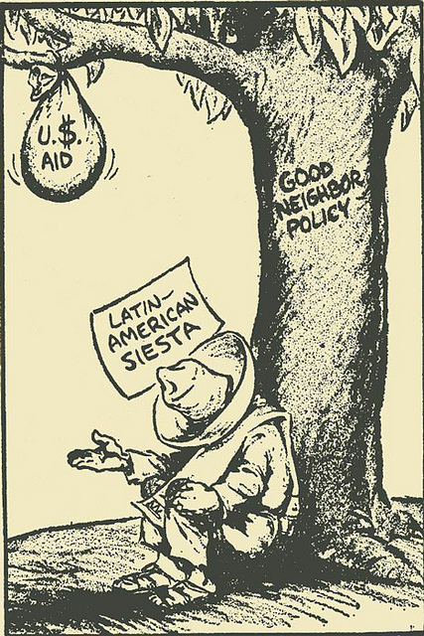
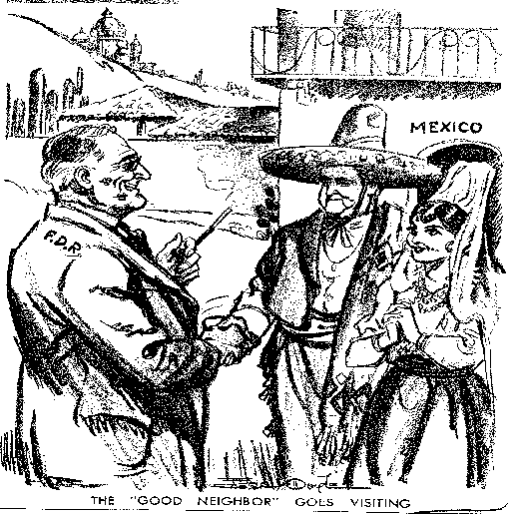
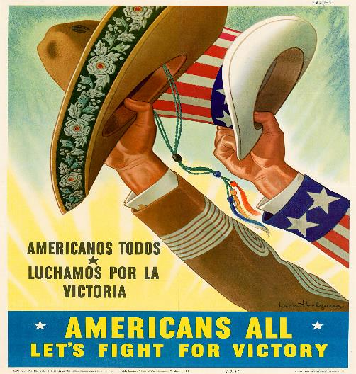
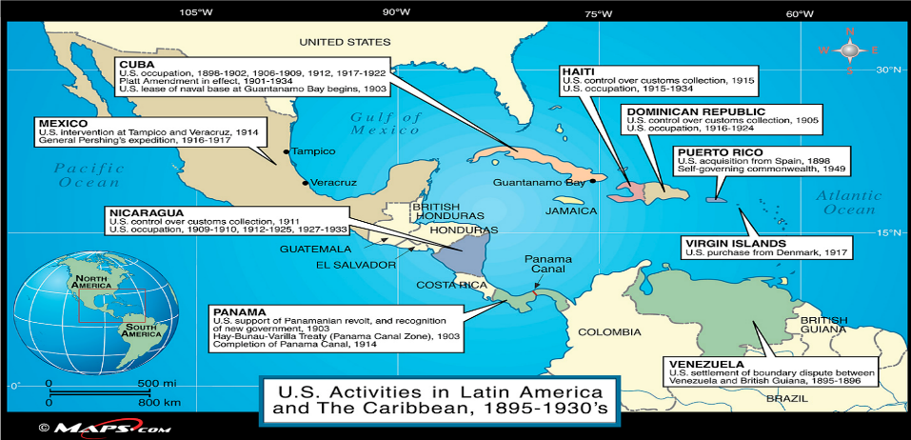
Notes:
Roosevelt meets Camacho, April 1943
1943 artist- Leon Helguera (war support) 1961 - Hugh Hutton, Philadelphia Enquirer "A Little More Effort Señor”

Slide 6
Events Abroad: Fascism & Aggressive Militarism
Italy
Rise of “Il Duce” – Benito Mussolini
Rise of Fascism – people should glorify their nation and race through aggressive show of force
Germany
Rise of “Der Fuhrer” – Adolf Hitler
Seized the opportunity presented by the depression to play upon anti-Semetic hatreds
Japan
Invasion of China for access to raw materials to gain control over what their leaders believed to be the Greater East Asia Co-Prosperity Sphere
Notes:
Suess Cartoon: http://hyperallergic.com/52792/dr-seusss-political-cartoons/

Slide 7
American Isolationists
Lesson of World War I
Nye Commission (1934)
“Merchants of Death” – US participation in the world war was to serve the greed of bankers and arms manufacturers – pushed for isolationist Congress
Neutrality Acts
1935: prohibited arms shipments & forbade Americans to sail on belligerent ships
1936: forbade loans to belligerents
1937: forbade arms shipments to Spain due to
civil war.
Spanish Civil War
Loyalists vs. Franco’s Nationalists (fascists)
America First Committee - warn against engagement with Europe
Notes:
Merchants of Death: http://www.antipasministries.com/html/file0000405.htm
Picasso’s Guernica: http://www.pablopicasso.org/guernica.jsp

Slide 8
Prelude to War
Appeasement
Ethiopia, 1935
Italian Invasion
Rhineland, 1936
German action
China, 1937
The Panay Incident – US gunboat sunk by Japanese planes in war with China; apology accepted
Sudetenland, 1938 – land in Czechoslovakia – German speaking
Munich Conference
Chamberlain’s “Peace for our time” – appease Hitler
Roosevelt’s Quarantine Speech (1937)- proposal for the United States and other democracies work together to quarantine the aggressor
Negative reaction and quickly dropped
Preparedness
Increased military spending by 2/3
Notes:
Cartoon: http://www.proprofs.com/quiz-school/story.php?title=midterm-exam_41

Slide 9
Early Causes – WWII
Hitler Annexes Austria (1938) “Anschluss”
Formation of Rome-Berlin-Tokyo Axis (Nov. 1936)
Italian Invasion of Ethiopia (1935)
1930
Spanish Civil War (1936-1939)
Franco takes power (1939)
1940
Japanese Invasion of Manchuria (1931)
German Occupation of Rhineland (1936)
Hitler Invades Sudetenland
Birth of Appeasement & Rise of Pacifism
U.S. Passes Series of Neutrality Acts
U.S. Issues Stimson Doctrine
Prompts Conference @ Munich (Sept. 1938)
Notes:
Geneva Convention 1929 – Japan signed, but did not ratify.

Slide 10
From Neutrality to War, 1939-1941
Outbreak of War in Europe
Hitler violated the Munich agreement and send troops in to occupy Czechoslovakia
Britain & France – if Poland is attacked, they will fight
German-Soviet Nonaggression Pact – Stalin & Hitler – agreed to split Poland
Invasion of Poland – Sept 1, 1939 – Start of WWII
Britain & France now at war with Germany, Italy & Japan (Axis allies)
German blitzkrieg – lightning war
Invasions of Denmark, Norway, and France
June 1940 – Britain only ally that remained free from German troops
Notes:
Map: http://jeremyrenners.blogspot.com/2009/10/world-war-europe-map.html
France: mention the “phony war” (winter) and the ineffectiveness of the Maginot Line

Slide 11
Changing U.S. Policy
Churchill-Roosevelt Relationship - $ for aid to Britain – anti-isolationist
British survival crucial to keeping US out of war
“Cash and Carry”
1939 Neutrality Act- buy US arms as long as used own ships and cash payment
Selective Service Act (1940)
1.2 million trained
Destroyers for Bases (Sept. 1940)- Carribean
Notes:
https://www.studyblue.com/notes/note/n/unit-11-quiz-1/deck/6436126

Slide 12
The Election of 1940
Roosevelt: “Your boys are not going to be sent into any foreign wars.:
Republicans
Wendell Willkie
Against Roosevelt violating the two-term tradition
Results:
Roosevelt Garners 54%
Notes:
Map: http://www.sheltonstate.edu/faculty_staff/faculty_website_directory/boening_chuck/us_history.aspx

Slide 13
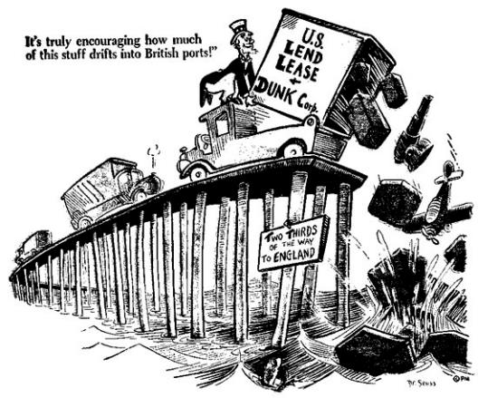
The Arsenal of Democracy
Lend money to Britain for purchase of war materials
Protect the Four Freedoms – speech, religion, from want, from fear
Lend-Lease Act (March, 1941) – end cash & carry and permit Britain to obtain all arms on credit
Atlantic Charter
Blueprint for United Nations
Secret meeting with Churchill and Roosevelt
Sound peace after war – self-determination for all people, no territorial expansion, free trade once war was over
Shoot-on-sight Policy (Sept. 1941)
Attacks on USS Greer, Kearney, and Reuben James
Undeclared naval war
Notes:
Lend-Lease Cartoon:
Norman Rockwell, Four Freedoms: http://www.elec-intro.com/cms/plus/view.php?aid=8624
Pre-war Naval History: http://www.navy.mil/navydata/nav_legacy.asp?id=142

Slide 14
Disputes with Japan
U.S. Economic Action
Rome-Tokyo-Berlin Axis formation (1940)
US cuts off steel and scrap iron to all countries in Eastern Hemisphere except Britain (aimed at Japan)
Japanese invasion of Indochina
US freezes Japanese credit and cuts off oil supply
Negotiations
Sec. State Cordell Hull – pull troops out of China-Japan refuses
Rise of General Tojo – still no compromise reached
Japan running out of time for oil – wants quick action taken
Notes:
Map: http://www.historyplace.com/unitedstates/pacificwar/timeline.htm

Slide 15
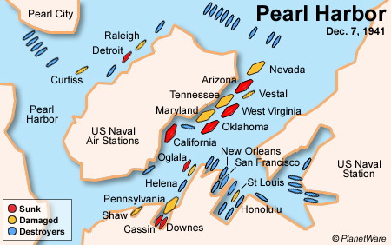
Pearl Harbor https://www.cnn.com/videos/us/2017/12/07/pearl-harbor-anniversary-orig.cnn/video/playlists/pearl-harbor/
December 7, 1941
Partial Surprise
Japanese codes broken, attack imminent
Declaration of War
December 8, 1941- War on Japan
December 11, 1941 - Germany and Italy Declare War on U.S.
Germany Invades the Soviet Union breaking nonaggression pact with Russia
Allies from 1942 – 1945 – Russia, US, Britian (Stalin, Roosevelt, and Churchill)
Notes:
Photo: http://www.britannica.com/EBchecked/topic/448010/Pearl-Harbor-attack
Map: http://www.planetware.com/honolulu/pearl-harbor-us-hi-oph.htm

Slide 16
World War II: The Home Front
America Responds to War

Slide 17
Essential Questions
In what ways and to what extent was World War II responsible for ending the Great Depression in America?
To what extent did the war effect the following groups:
Mexican Americans
African Americans
Native Americans
Japanese Americans
Women
Notes:
Image: http://discussions.mnhs.org/collections/tag/world-war-ii/

Slide 18
Mobilization
Federal Government
War Production Board (WPB, 1942)
Office of War Mobilization (OWM)
Office of Price Administration (OPA)
Rationing food, fuel
Spending & Debt Increase
GNP Grows (15%)
$250 Billion Debt
Business and Industry
Exceeding profits of the 1920s
Unemployment gone by 1944
Produced 300,000 plans, 100,000 tanks, ships holding 53 million tons
New Ships every 2 weeks
Research and Development – dev. Radar and sonar techn.
Financing the War – (100 billion in 1945 alone)
Income Tax – most Americans affected – automatic withholding began in 1944
War Bonds - $135 billion
Propaganda
Office of War Information- Posters & Newsreels
Notes:
Poster: http://www.glogster.com/makayla54/war-propaganda/g-6meejntss259v1of2muvca0
http://twistedsifter.com/2012/01/camouflage-cali-hiding-air-bases-factories-plants-netting-wwii/
Picture of Airfield and Factory, Southern CA. Original Image of airstrip, 2nd image of aerial camouflage, 3rd image from ground, showing rake of canopy to cover buildings.
Link to Newsreel: https://www.youtube.com/watch?v=QT8MEXdr6tw
Donald Duck (Disney Propaganda): https://www.youtube.com/watch?v=kzH1iaKVsBM

Slide 19
WWII Propaganda
Notes:
Propaganda: http://www.webcrawlerblog.com/history/us-propaganda-during-world-war-ii

Slide 20
WWII Propaganda
Notes:
Propaganda: http://www.tomatobubble.com/id352.html

Slide 21
The War’s Impact on Society
African Americans
Mass Migration from South
“Double V” Campaign – victory overseas and victory for equality at home
500,000 serve
Tuskegee Airmen
CORE (1942) – Congress of Racial Equality
March on Washington
A. Philip Randolph
Executive Order Issued to prohibit discrimination in government and businesses with federal contracts
Smith v. Allwright (1944) – illegal to exclude AA membership in political parties
Mexican Americans
Bracero program – farmworkers can enter without immigration procedure during growing season
Zoot Suit Riots (Los Angeles, 1943) – Mexican immigration
American Indians – 25,000 served in military, thousands never returned home due to off-reservation opportunities.
codetalkers
Notes:
Double V Logo: http://archsocialclub.com/?page_id=1326

Slide 22
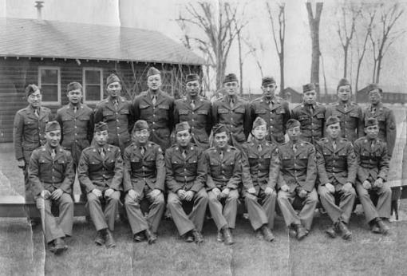
Japanese Americans
Executive Order 9066
Internment
Korematsu v. U.S. (1944) – upheld by Sup. Crt. during wartime
Notes:
9066: http://www.nps.gov/manz/historyculture/historic-documents.htm
Language School: http://honordoc.com/history.html

Slide 23
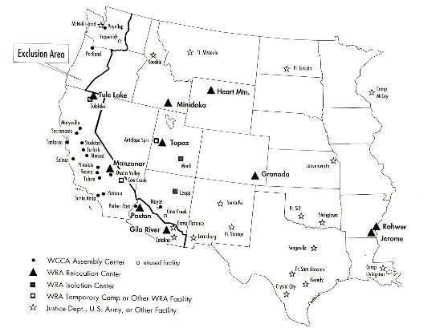
Executive Order 9066
Notes:
Japanese Internment Camps: http://www.bookmice.net/darkchilde/japan/camp.html

Slide 24
Notes:
Life Magazine: http://www.english.illinois.edu/maps/poets/a_f/foster/lifemag.htm

Slide 25
Women
200,000 serve in uniform
5 million enter workforce
24% increase in married women working
Received lower pay than male counterparts
Notes:
Rosie the Riveter: http://en.wikipedia.org/wiki/Rosie_the_Riveter

Slide 26
Election of 1944
Roosevelt runs with Harry Truman
Republicans:
Thomas Dewey
Results:
53% of Popular
432-99 Electoral
Notes:
Map: http://www.factbook.org/wikipedia/en/u/u_/u_s__presidential_election_maps.html

Slide 27
World War II: The Battlefronts
The War in Europe and the Pacific

Slide 28
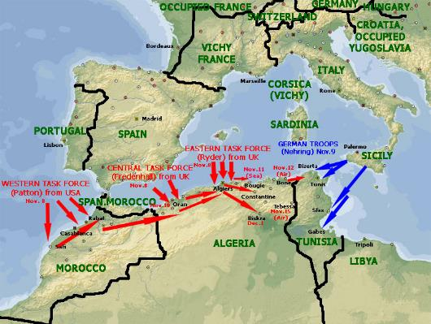
Fighting Germany
Defense at Sea, Attacks by Air
Objectives:
Overcome submarines
Bomb and raid major cities
From North Africa to Italy
Operation Torch (Eisenhower & Montgomery, 1942-43)
Sicilian & Italian Campaigns
Notes:
Map: http://www.mapshop.com/classroom/HISTORY/US/World-War-II-in-Europe.asp
Operation Torch: http://ww2-weapons.com/History/Battles/North-Africa/Torch.htm

Slide 29
D-Day and V-E Day
Operation Overlord (June, 1944) – code name for the invasion of Normandy, France
Operation Neptune- landing on Normandy and liberating France
D-Day – June 6, 1944
Battle of the Bulge (Dec. 1944) – Allies crossed border into Germany – Germany strikes back forcing Americans to reorganize and resume their advancement
German Surrender
Hitler’s Suicide (April 30, 1945)
Surrender: May 7, 1945
The Holocaust & Liberation of Concentration Camps
Notes:
Animated Version of Operation Overlord: http://www.bbc.co.uk/history/worldwars/wwtwo/launch_ani_overlord_campaign.shtml
D-Day: http://www.military-history.org/articles/d-day-plan-of-operations-on-6-june-1944.htm

Slide 30
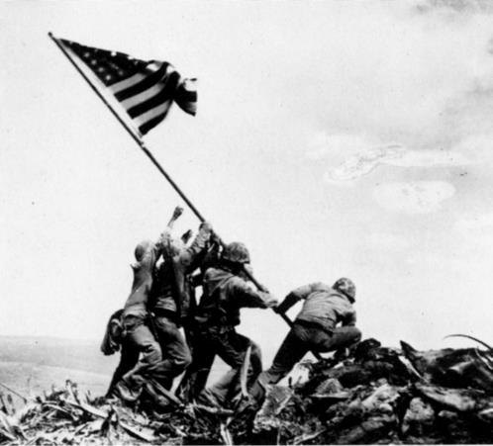
Fighting Japan
MacArthur, Nimitz, and “Island-Hopping”
Early losses for America
Bataan, Coral Sea, Guadalcanal
Turning Point, 1942 – decoding messages
Battle of Midway – June 4-7, 1942 – ended Japanese expansion
Island hopping
Major Battles:
Leyte Gulf (Oct., 1944)
Emergence of kamikazes
Okinawa – 50,000 casualties of US and 100,000 Japanese killed
Iwo Jima
Notes:
Island-Hopping: http://world-war-2.wikia.com/wiki/Island_Hopping
Iwo Jima, National WWII Museum: http://www.nationalww2museum.org/learn/education/for-students/ww2-history/at-a-glance/iwo-jima.html

Slide 31
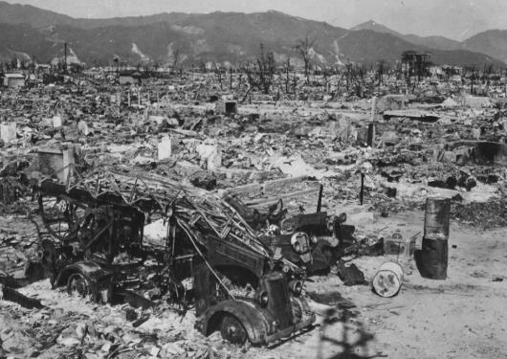
Atomic Bombs
Manhattan Project
Oppenheimer, 1942
University of Chicago
Ultimatum – or face utter destruction
Hiroshima (August 6, 1945)
Nagasaki (August 9)
250,000 dead in Japan
Japan Surrenders
September 2, 1945
USS Missouri
Notes:
Hiroshima Maps: https://radioactivemonticello.wordpress.com/2012/04/27/hiroshima-fallout-maps/
Destruction: http://www.thinglink.com/scene/523470569467805698

Slide 32
The Decision to Drop the Bomb
Arguments in Favor
Arguments Opposed
Target: Japan
Japanese character: bushido & seppuku
Prevent: long war, massive casualties
Pacific front as lesson
Target: Soviet Union
Send a message
Prevent: Soviet aggression & expansion
Massive casualties & destruction
Violated human rights
Even if Hiroshima warranted, Nagasaki was not
Weapons & the loss of human lives should not be used as diplomatic tools
Notes:
Discussion or Think-Pair-Share. Break students into pairs to brainstorm arguments for and against the dropping of the atomic bombs on Hiroshima and Nagasaki. Guiding Question: Was the United States justified in the decision to drop atomic bombs on Hiroshima or Nagasaki, and/or both?

Slide 33
Wartime Conferences
Negotiations, Peace Treaties, and the End of War

Slide 34
The Big Three
Roosevelt, Churchill, and Stalin
Casablanca – Roosevelt & Churchill agree(Jan. 1943)
Italian invasion & unconditional surrender
Teheran (Nov. 1943)
Liberation of France, Soviet Invasion of Germany and eventually join the war against Japan
Notes:
Teheran: http://en.wikipedia.org/wiki/Tehran_Conference

Slide 35
Yalta
February, 1945
Germany to be divided in four occupation zeons
Free elections for Eastern Europe
Soviets to join war against Japan – August 8, 1945 right before Japan surrendered
Foundations for United Nations – San Francisco
Notes:
Yalta Partition: http://www.etaletaculture.fr/histoire/le-blocus-et-le-mur-de-berlin-symboles-de-la-guerre-froide/

Slide 36
Potsdam
Death of President Roosevelt – April 12, 1945 (Truman)
Replacement of Winston Churchill (Attlee)
Potsdam Conference
Truman, Attlee & Stalin met in Germany – July 17- August 2, 1945 agreed on the following:
Unconditional surrender of Japan
Criminal prosecution of Nazi leaders (Nuremburg)
Notes:
Potsdam: http://commons.wikimedia.org/wiki/File:Potsdam_conference_1945-3.jpg

Slide 37
The War’s Legacy
Results of World War II

Slide 38
Costs
Deadliest War in Human History
50 million
American Losses:
300,000 dead
800,000 wounded
Debt
Spending increased debt, but little damage overall domestically
Notes:
WWII Deaths: http://www.strangemilitary.com/content/item/147731.html

Slide 39
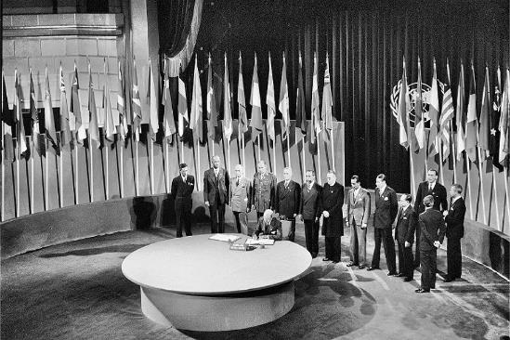
United Nations
Chartered April, 1945
San Francisco
Collective Measures
settle disputes peacefully
General Assembly
50 nations
Security Council
11 countries
5 Permanent Seats w/veto power
US, Britain, France, China, and…
USSR
Notes:
San Francisco & the UN: http://www.sfcityguides.org/public_guidelines.html?article=469&submitted=TRUE&srch_text=&submitted2=&topic=Events
Signing of the UN Charter: http://www.mfa.bg/en/events/73/4/1102/index.html

