Slide 1
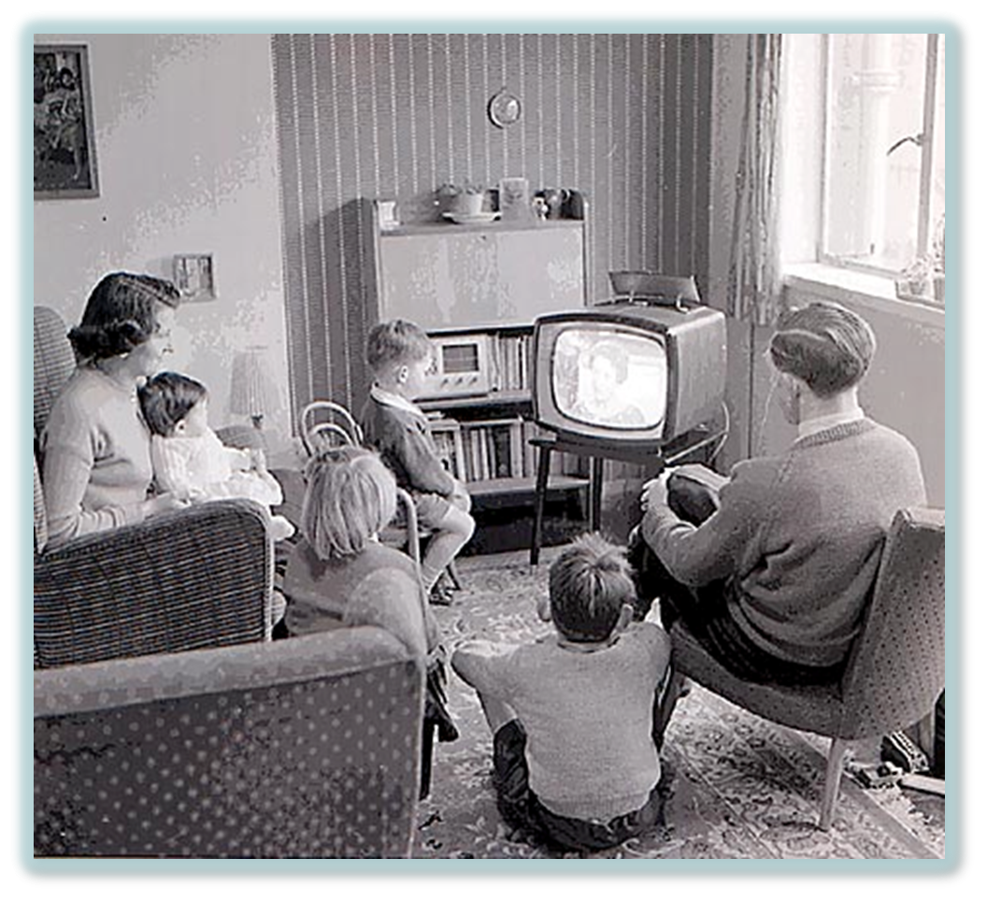
The Eisenhower Years
1952-1960

Slide 2
AP Test Tips
Evaluate the role of federal spending and the private sector in generating postwar economic growth
Summarize the arguments on the left that criticized the government for not addressing economic problems in the US
Identify and explain the role of the GI Bill and the baby boom in helping the economic boom
Evaluate the degree to which the television represented American culture in postwar years.
Recognize the ways that artists, intellectuals and teenagers rejected conformity to American culture
Compare expectations of women in the postwar years to the Cult of Domesticity popularized in the 19th century
Explain early challenges to traditional views on moral issues (birth control)
Examine the causes and effects of the migration of the middle class to the suburbs
Recognize the growth of the Sunbelt in postwar years
Compare the Great Migration of the 1920’s to the movement of African Americans in the 1950’s
Compare the policies of the federal government toward immigrants before and after the WW2

Slide 3
Essential Questions
To what extent were the 1950s a time of great peace, progress, and prosperity for Americans?
To what extent did the civil rights movement of the 1950s expand democracy for all Americans?
Compare and contrast United States society in the 1920’s and the 1950’s with respect to the following:
race relations
role of women
consumerism

Slide 4
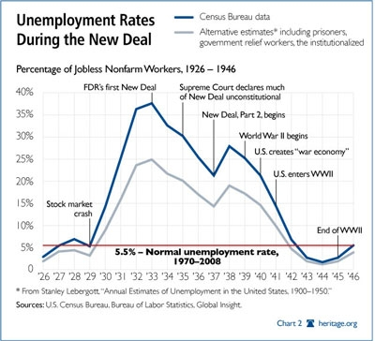
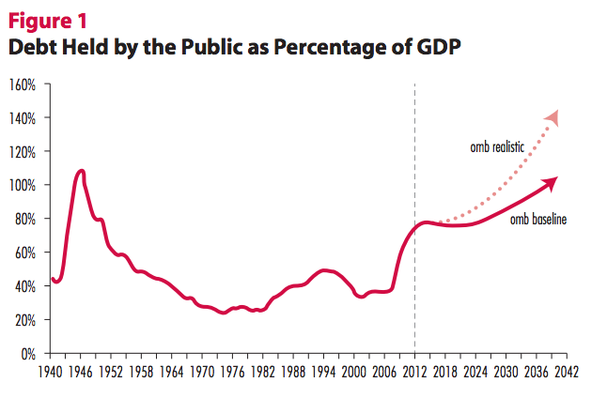
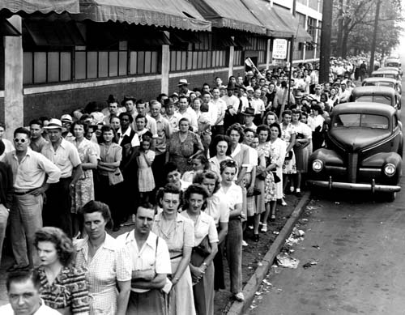
Postwar Economic Anxieties
V.E. & V.J but…
Has there been a V.A.?
Economic Scars if Great Depression remain in memory
High unemployment
Low birthrate
Early Postwar Years
Confirms predictions & repeats history
GNP drops (1946-47)
Prices rise 33%
Growth of Unions
Epidemic strikes: 4.6 million workers
Stoppages: auto & coal
Notes:
Image 1: Unemployment rates from crash to end of WWII – notice steep incline following the war.
Image 2: Compares debt to % of GDP – we were much worse off during the Depression than now.
Image 3: Unemployment line in Detroit (1945) – notice # of women

Slide 5
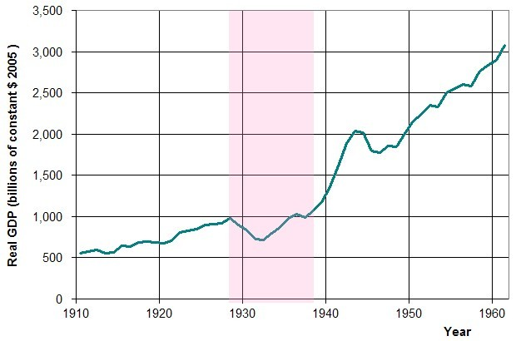
Economic Profile (1950-1970)
GNP = Doubles Each Decade
1946: $210 billion
1950: $285 billion
1960: $504 billion
1970: $1 trillion
Personal Income Increases
1950: 6%
1960: 15%
1970: 32%
6% of world’s population enjoys 40% of wealth
Middle Class doubles in size: 60% of U.S. pop.

Slide 6
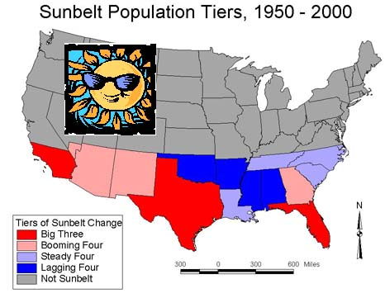
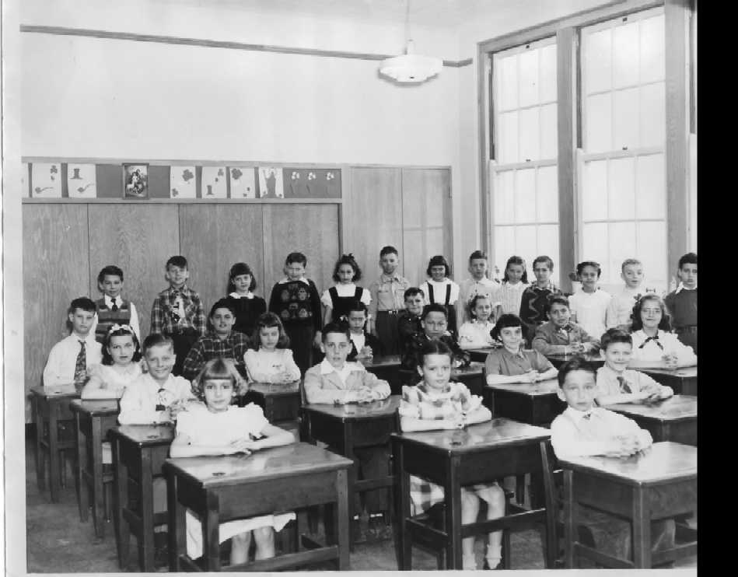
Rise of the Middle Class (by 1970…)
60% own homes
90% own a TV
Majority own car & washing machine
90% school age (6-16) attendance
By the numbers:
Electrical use (6x)
Fossil Fuels (2x)
Production (2x)
1 Farmer feeds 50 people
Rise of the Sunbelt: 30 million migrants
Notes:
Map: http://dreamchimney.com/tracks/artist_images/18090_image0_20071217_auto.jpg

Slide 7
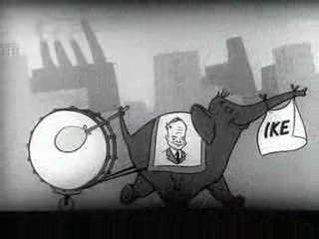
Eisenhower Takes Command
Election of 1952
Eisenhower vs. Stevenson
Eisenhower’s Promise (Korea)
Television Ads
“I Like Ike”
Results:
Eisenhower
55% popular
442-89 Electoral
Notes:
Image is Link to 1952 Eisenhower Campaign Ad: http://www.livingroomcandidate.org/commercials/1952

Slide 8
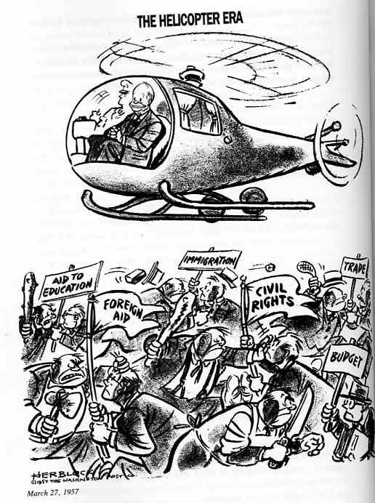
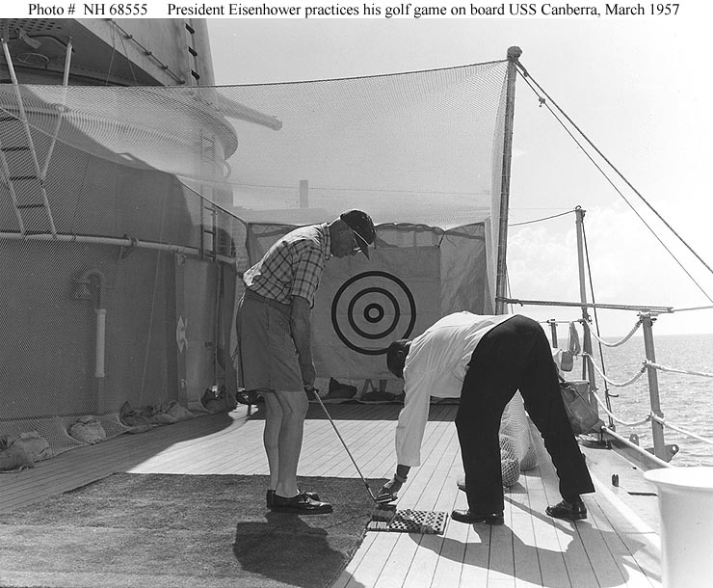
Eisenhower’s Modern Republicanism
“Conservative when it comes to money, liberal when it comes to human beings”
Cut federal budget, increase states’ rights
Increased spending on Social Security
Raised minimum wage
Department of Health, Education, and Welfare
Opposed:
Federal health care
Federal aid to education
Notes:
Cartoon: https://iaspace.pbworks.com/w/page/10288175/A2%201950s

Slide 9
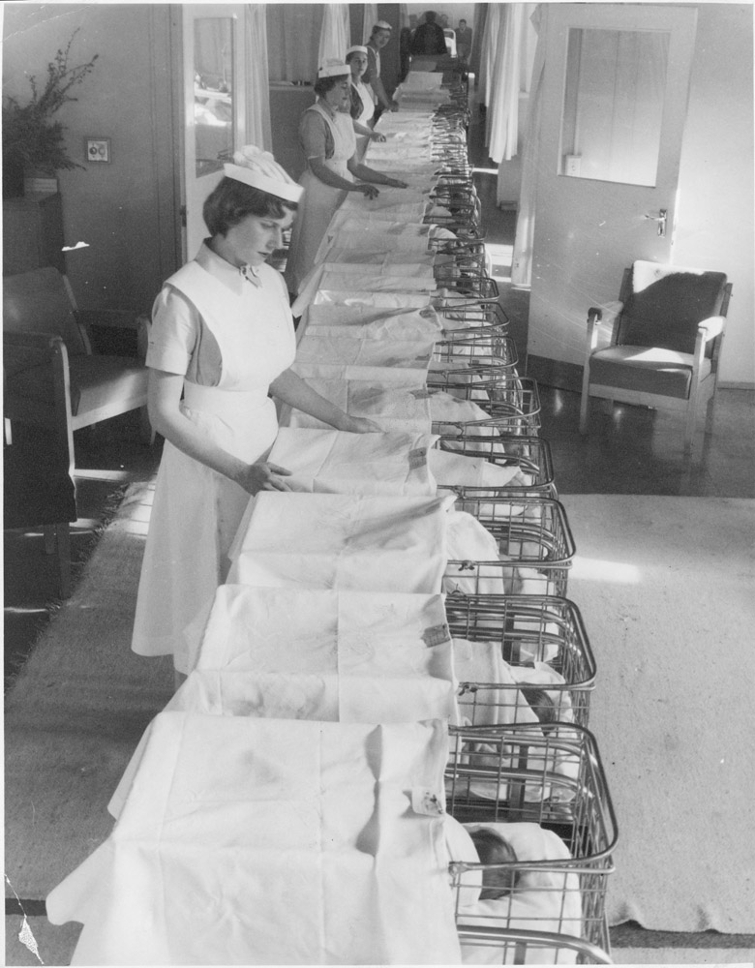
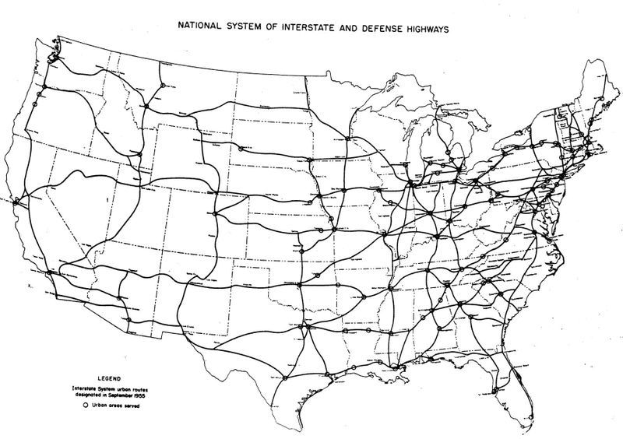
The Growing Middle Class
The Baby Boom
50 million newborn
34 million school age children
Federal Interstate Highway Act (1956)
$4.6 billion
Promoted mobility & uniformity in lifestyles
Trucking and touring industries
Growth of Defense Industries
Arms race
Space race
$22 billion in 1951
$80 billion by 1970
Notes:
Map: http://www.kurumi.com/roads/3di/1970req.html

Slide 10
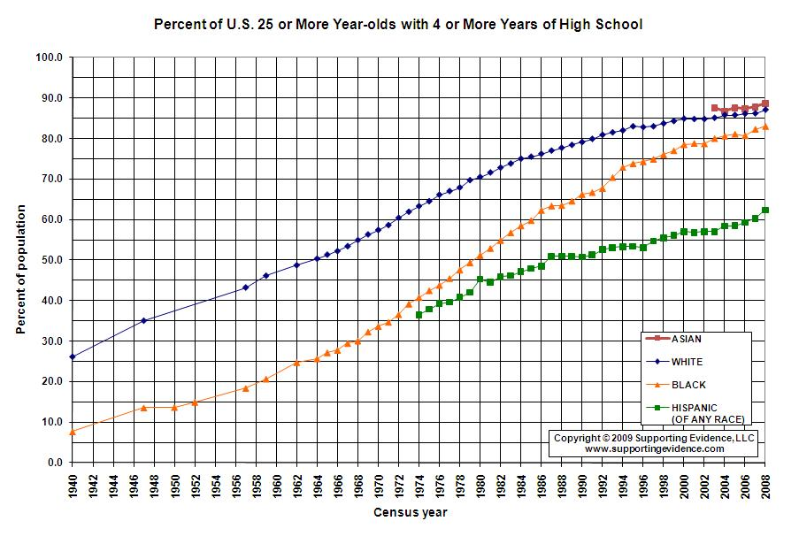
Other Causes
GI Bill & NDEA
Development of mass education: envy of the world
Trained and skilled workforce
College education for middle and working class
1.5 million in 1940
7.4 million by 1970
Notes:
Graph: http://www.winginstitute.org/Graphs/Student/High-School-Graduation-Rates/

Slide 11
POPULAR CULTURE
Consumerism, Conformity, and Rock ‘n Roll – The “Happy Days”

Slide 12
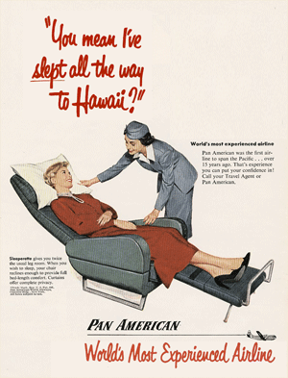
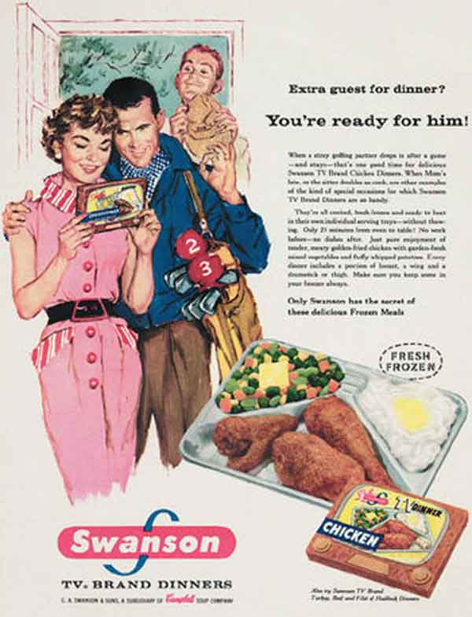
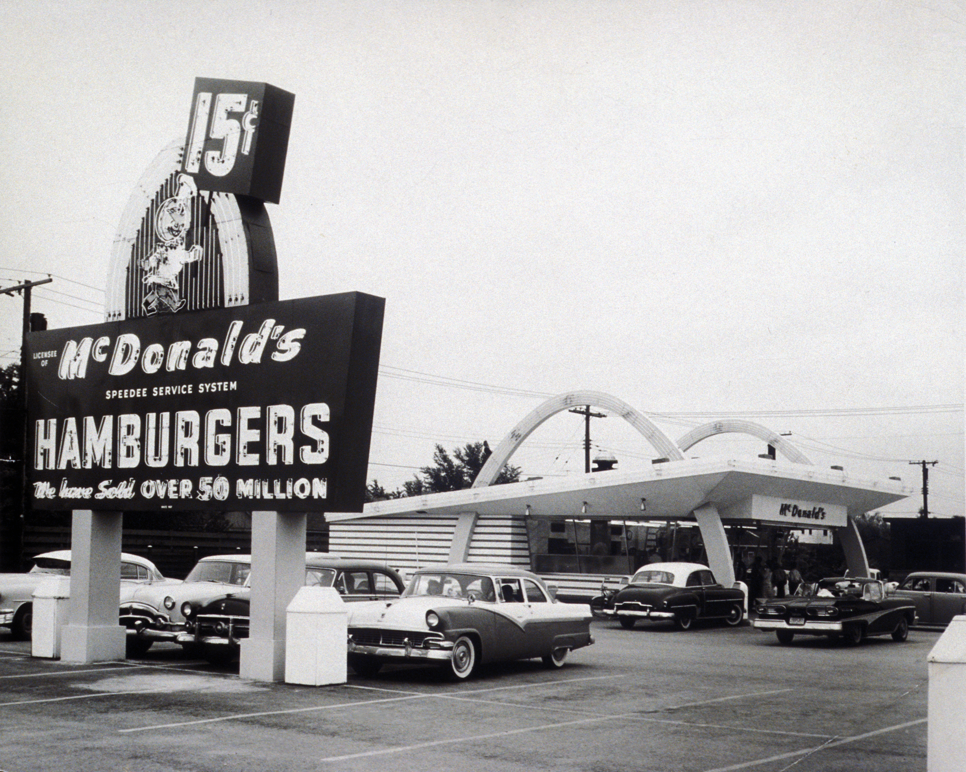
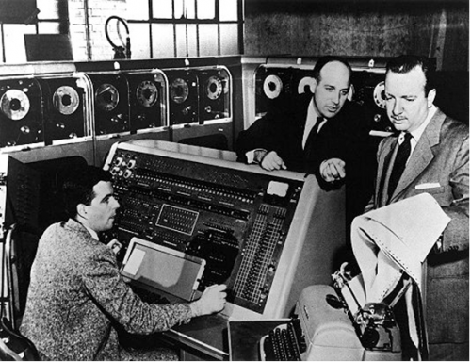
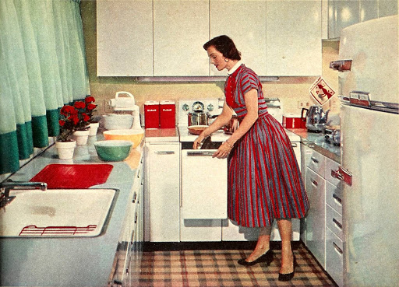
New Technology & Innovations
Computers: transistor and chip
TV and Advertising
Paperbacks and Records
Electric Kitchens: new gadgets
Automobiles: two car garages
TV Dinners & Fast Food
Air Conditioning
Credit Cards: Diner’s Club
Air Travel: Passenger Jets
Notes:
TV Dinner Ad: http://www.mortaljourney.com/2010/11/1950-trends/tv-dinners
Pan-Am Ad: https://www.pinterest.com/666dotjpg/jet-set/

Slide 13
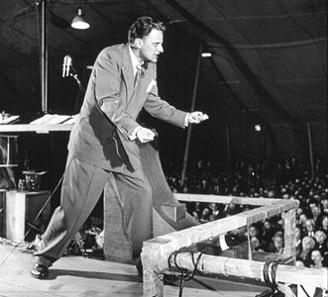
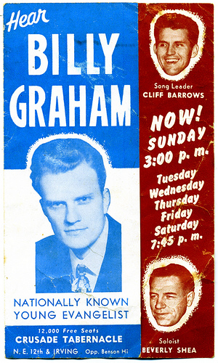
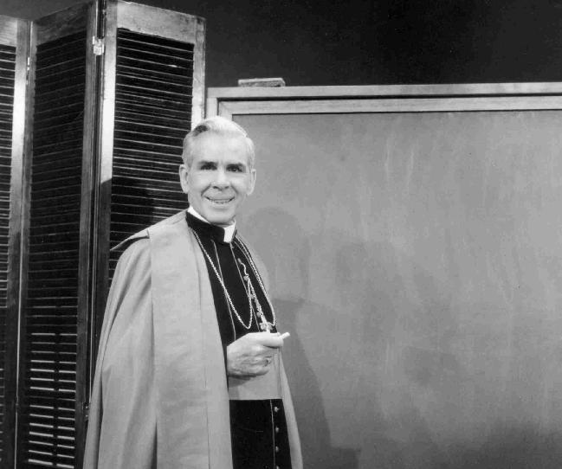
Social and Cultural Changes
Religion
Upsurge in church attendance
2x between 1945-1970
By 1960: 95% identification
Causes:
“godless” communism
New Evangelism: TV
Billy Graham
Bishop Fulton Sheen
Notes:
Picture of Fulton Sheen is a link to video.

Slide 14
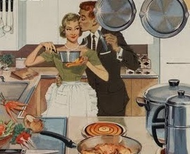
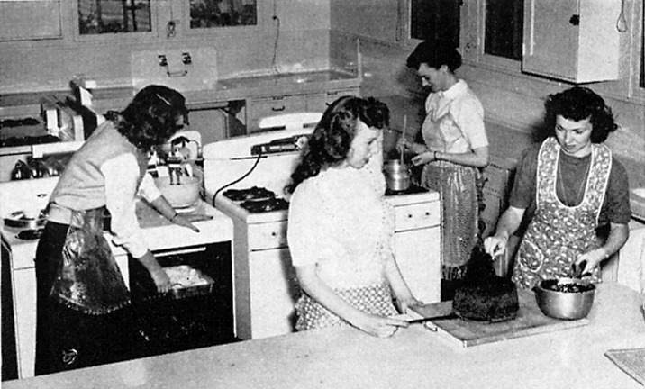
Changing Role of Women
In the workplace – 35%
Education
Home economics
Attend college…
To find husbands
2/3 do not receive degree
Appliances make housework easier
The “Housewife” Stereotype
Dr. Benjamin Spock
The “Girl Next Door”
TV: Father Knows Best, Leave it to Beaver
Sexuality
“pinups” & fashion
Playboy
Kinsey Reports
Birth Control Pill: 1960
Notes:
Last two pictures: one from a ‘50’s magazine to enforce the “ideal” housewife – the other, a modern interpretation/mockery of ‘50’s advertising catering to women w/appliances.

Slide 15
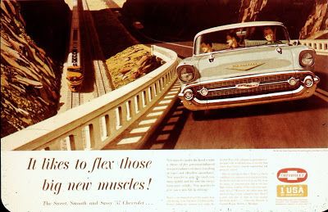
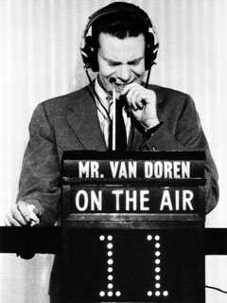
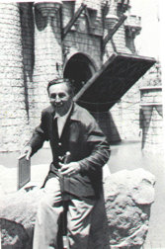
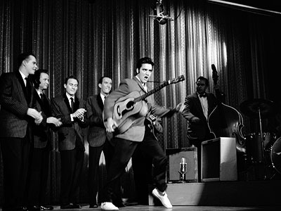
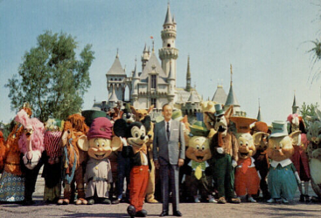
Social and Cultural Changes (con.)
Entertainment
Game Shows and Sitcoms
Rock ‘n Roll
Started w/Americans in Europe
Little Richard
Would eventually lead to the “British Invasion”
Elvis Presley
Muscle Cars & Roadsters
Disneyland: 1955
“(It is)… sung, played, and written, for the most part, by cretinous goons. My only deep sorrow is the unrelenting insistence of recording and motion-picture companies upon purveying this most brutal, degenerate, vicious form of expression.”
- Frank Sinatra
Notes:
Picture of Van Doren is a link to a full episode of “Twenty-One,” although not the Stemple vs. Van Doren match
Picture of Disney w/characters is a link to a video of the opening of Disneyland.

Slide 16
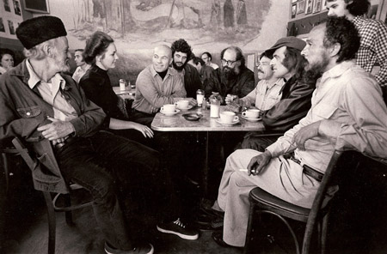
Social Critics
Literature:
White Collar (1951), The Power Elite (1956)
The Affluent Society (1958)
Failure to use wealth for good
Catcher in the Rye (1951) – struggles against conformity
Catch-22 (1961)
The “Beatniks” – group of rebellious writers and intellectuals made up the Beat Generation of the 1950s
Advocated spontaneity, use of drugs, and rebellion against societal standards
Models for the youth rebellion of the 1960s
“Rebel Without a Cause”
James Dean
Notes:
Be sure to make connections between the “Lost Generation” and the Beat Generation.
The photo at the top of this page was taken by Diana Church at the Cafe Trieste in North Beach in 1975. Guests at the table include Lawrence Ferlinghetti, Minelte Le Blanc, Peter Le Blanc, Allen Ginsberg, Harold Norse, Jack Hirschman & Bob Kaufman - http://www.litkicks.com/BeatGen

Slide 17
EISENHOWER & THE COLD WAR
Foreign Policy (1953-1961)

Slide 18
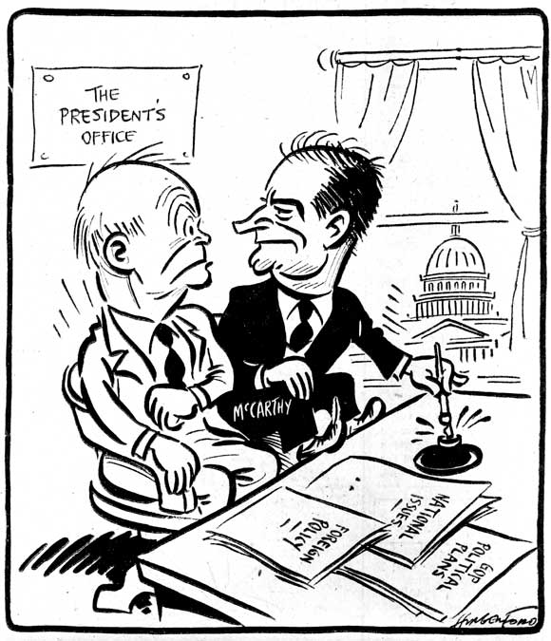
Essential Question
What were the Cold War fears of the American people in the aftermath of the Second World War? How successfully did the administration of Dwight D Eisenhower address these fears?
Notes:
Eisenhower-McCarthy Cartoon: http://www.americaslibrary.gov/aa/marshall/aa_marshall_mcarthy_3.html

Slide 19
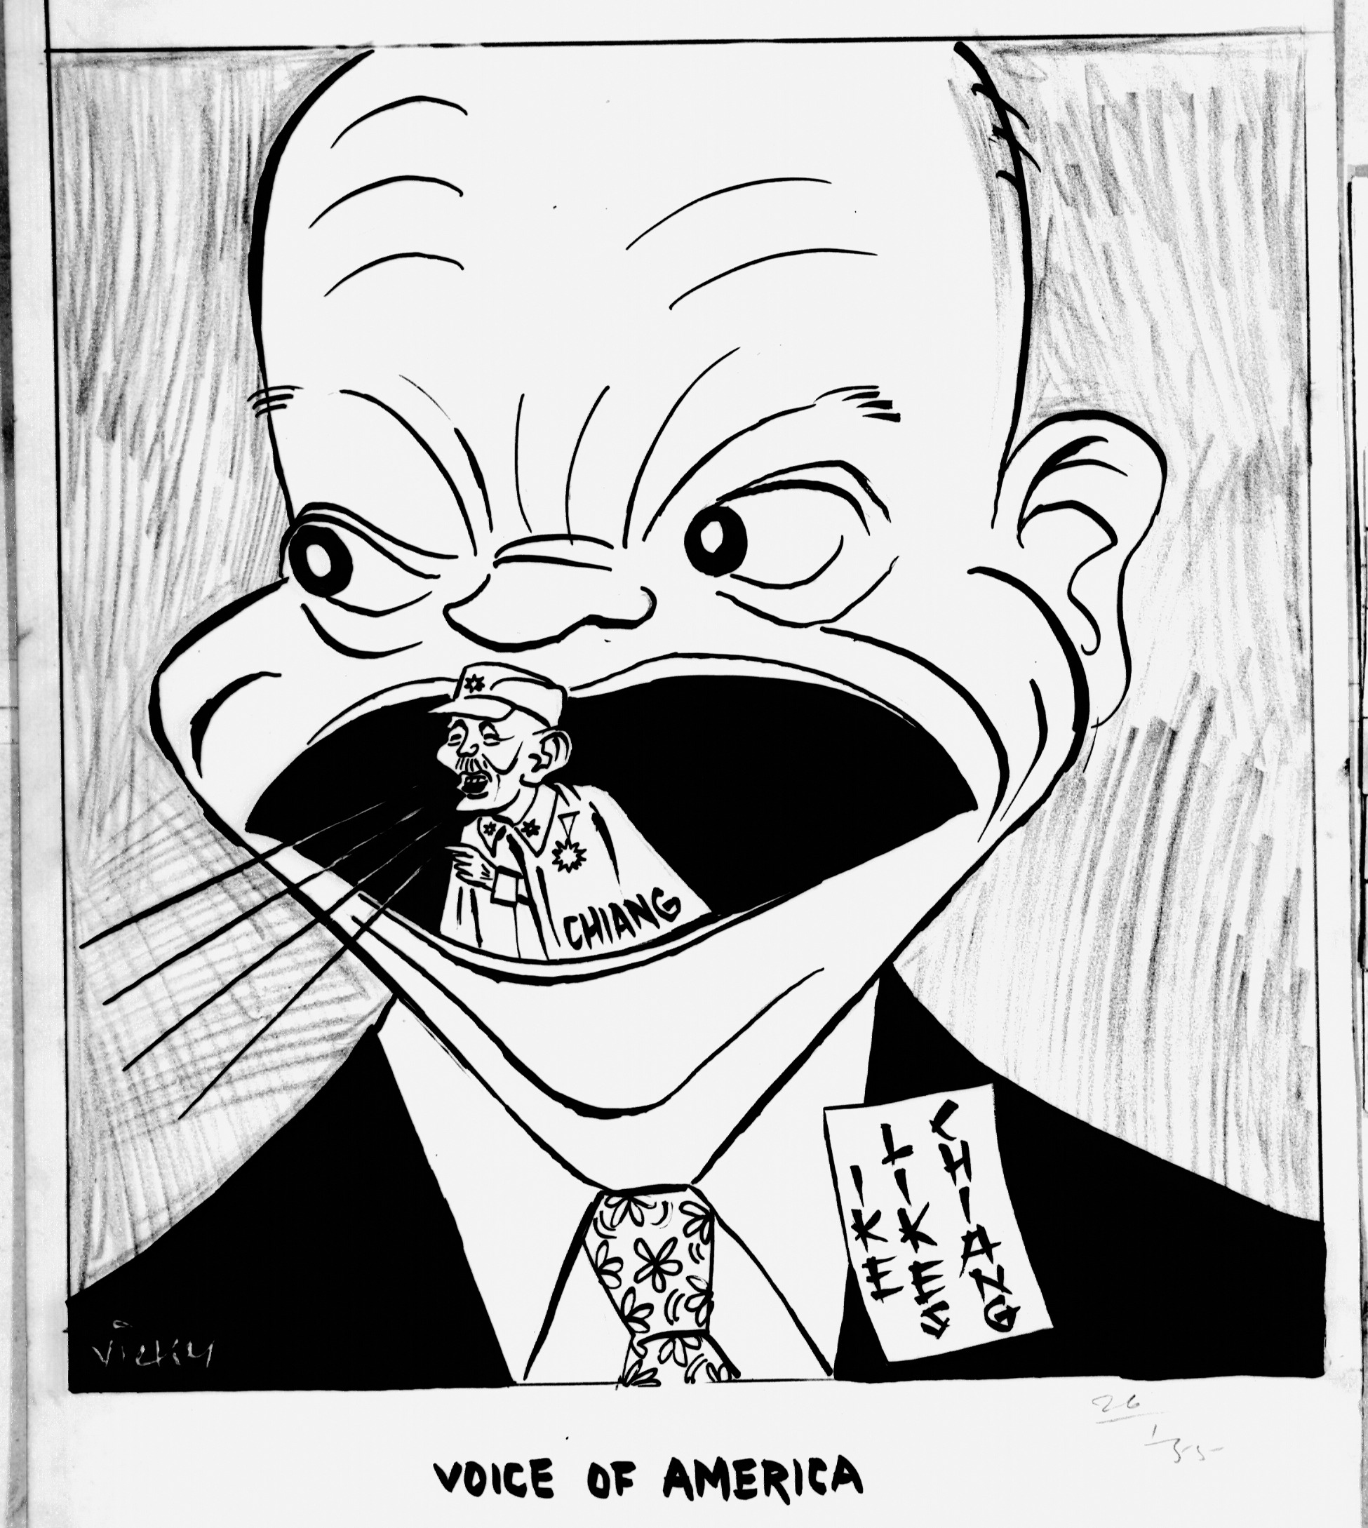
Dulle’s Diplomacy
Dulles’ Diplomacy
“New Look” Policy
Challenging Communist Nations
Liberating captive nations of Eastern Europe and encouraging the Nationalist government of Taiwan to assert itself against “Red” China
Brinkmanship
Massive Retaliation
Arms race
Spending on nuclear and air power as deterrent
Notes:
Cartoon: http://www.hrionline.ac.uk/chiangkaishek/artwork/37/

Slide 20
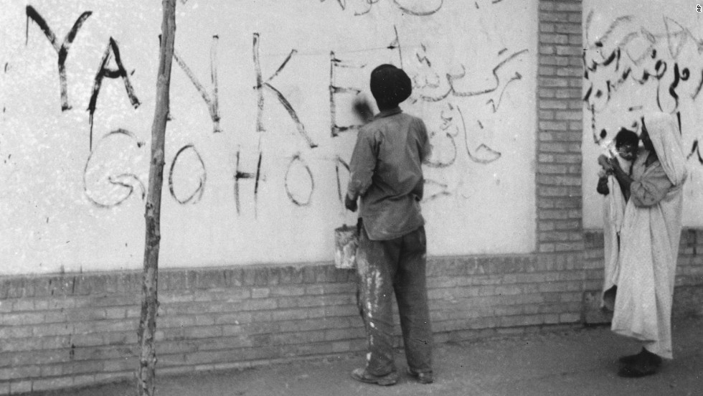
Unrest in the Third World
Decolonization
Third World countries often depended on foreign aid
Covert Action
Iran Coup d’état (1953) – overthrew government that tried to nationalize the holding of foreign oil companies
CIA installs Shah Pahlavi - monarch
Effect on oil & Middle Eastern views of America
Guatemala (1954)
CIA targets Castro
Notes:
Iranian response to 1953 coup: http://www.cnn.com/2013/08/19/world/gallery/iran-1953-coup/index.html

Slide 21
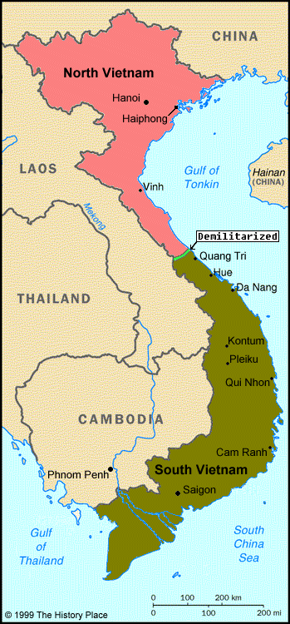
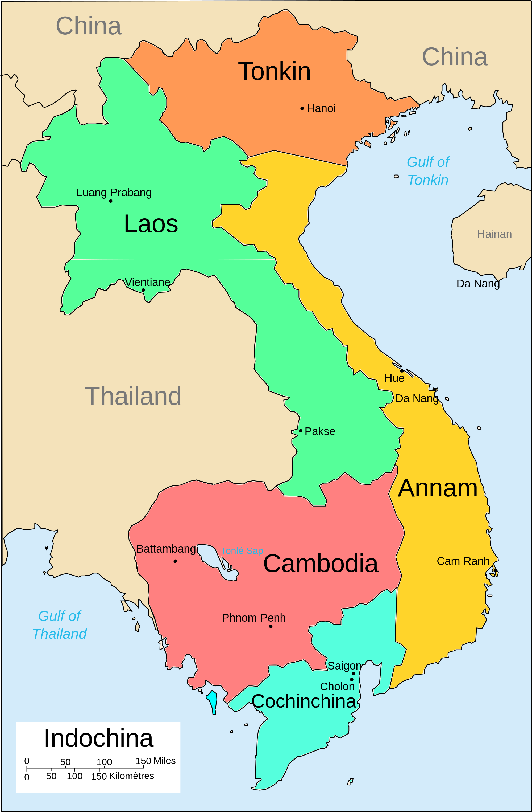
Unrest in Asia
Korean Armistice (1953)
China & Korea agree to armistice in exchange for prisoners
38th Parallel Divides
Fall of Indochina (1954)
Viet Minh Independence Movement
Battle of Dien Bien Phu – French surrendor
Geneva Conference – France agreed to give up Indochina – divided into Cambodia, Laos, Vietnam
Division of Vietnam at 17th parallel until general election could be held – but remained divided
North (Ho Chi Minh) – Communist dictatorship
South
Bao Dai replaced by Ngo Dinh Diem
U.S. gives $1 Billion in Aid
“Domino Theory”
SEATO (1954) – Southeast Asia Treaty Organization
US, GB, France, Australia, NZ, Philippines, Thailand, and Pakistan
Notes:
French Indochina: http://en.wikipedia.org/wiki/French_Indochina
N/S Vietnam: http://apocalypsenow.umwblogs.org/vietnam-war/

Slide 22
The Middle East
Israel (1948)
U.N. mandate
Suez Crisis (July, 1956)
Nasser nationalizes canal
Owned by Britain & France
Israel, Britain, and France seize canal
U.N. condemns invasion
Eisenhower Doctrine (1957)
Economic and military aid to countries threatened by communism
Lebanon (1958) – prevention of war between Christians and Muslims
OPEC and Oil (1960)
Organization of Petroleum Exporting Countries
Saudi Arabia, Kuwait, Iraq and Iran joined Venezuela
Creation of western dependence on Middle East oil, Arab nationalism, and conflict between Israel and Palestine
Notes:
Suez: http://fanack.com/en/countries/israel/in-depth/arab-israeli-wars/the-suez-crisis-of-1956/

Slide 23
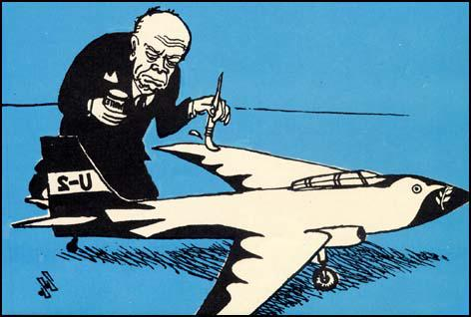
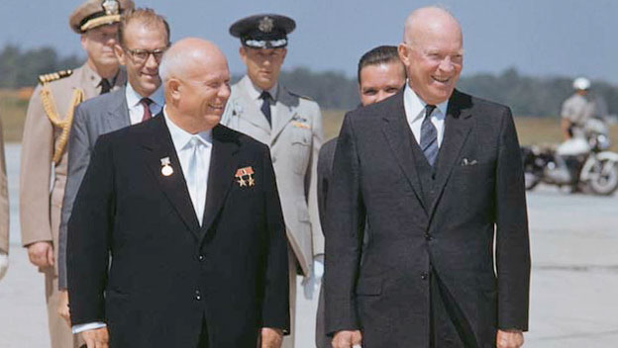
U.S.-Soviet Relations
Spirit of Geneva (1955)
Slowed Arms Race following Stalin’s Death - Khrushchev
Atoms for peace
“peaceful coexistence”
Hungarian Revolt (Oct. 1956)
Threaten to pull out of Warsaw Pact
Soviets suppress uprising
Sputnik (1957)
Space Race
National Defense and Education Act
Explorer I (1958)
Second Berlin Crisis – 6 months to remove troops or turn over to East Germany
Paris Conference (1960)
U-2 Incident – 2 weeks before planned meeting in Paris, the Russians shot down a high-altitude U.S. spy plane over the Soviet Union
Exposed the US tactic for gaining info
Denounced the US and walked out of conference – Cold War back on
Notes:
Eisenhower-Kruschev: http://www.history.com/topics/us-presidents/dwight-d-eisenhower/videos/eisenhower-welcomes-khrushchev-to-the-us
Cartoon: http://spartacus-educational.com/COLDU2crisis.htm

Slide 24
THE CIVIL RIGHTS MOVEMENT
Early Attempts to End Segregation and Gain Civil Rights for African Americans
Notes:
http://www.crmvet.org/info/pins.htm

Slide 25
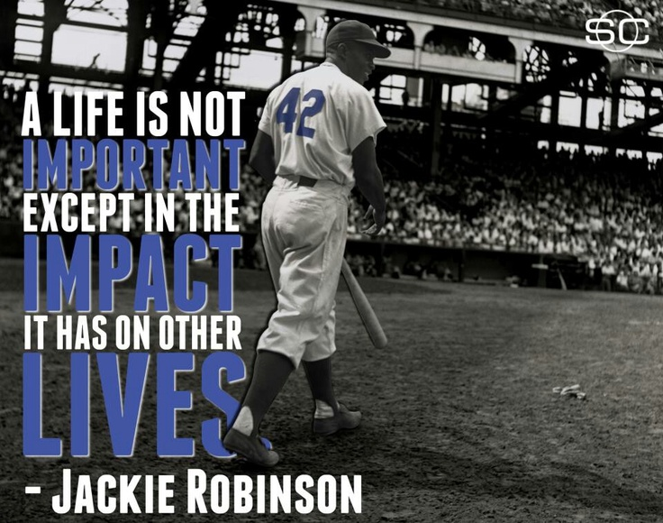
Origins of the Movement
Post-War Period
World War II
Double V Campaign – desegregation of military
Jackie Robinson (1947)
Jim Crow South
Changing Demographics
African Americans to Urban North – join Democrats
Changing Attitudes in the Cold War
Freedom & Democracy vs. Communism
Discrimination and segregation stood out as glaring wrongs that needed to be addressed
Notes:
Jackie Robinson Quote: https://plus.google.com/u/0/+Celebratequotes/about

Slide 26
Essential Question
Analyze the changes that occurred in the goals, strategies, and support of the movement for African American civil rights.

Slide 27
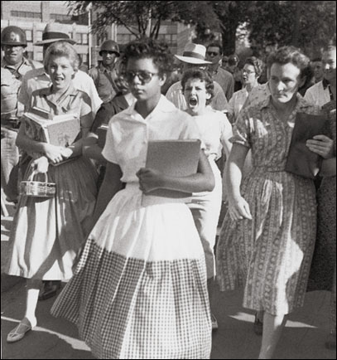
Desegregation
Early Cases:
Smith v. Allright (1944): Ends all-white primaries
Sweatt v. Painter (1950), McLaurin v. Oklahoma (1950): integrates all-white graduate schools
Brown v. Board of Education (May 17, 1954)
Warren Court overturns Plessy (1896)
“separate facilities are inherently unequal” (Brown I)
“all deliberate speed” (Brown II, 1955)
Resistance in the South
Thurmond and Russell’s Southern Manifesto – 101 members of Congress signed condemning the Supreme Court for clear abuse of power
The “Little Rock Nine” (1956) - Arkansas
Faubus vs. Eisenhower
Increase in KKK
Notes:
Elizabeth Eckford & Hazel Massery: http://en.wikipedia.org/wiki/Elizabeth_Eckford
Herblock on Eisenhower & Civil Rights: http://www.loc.gov/exhibits/herblocks-history/presidents.html

Slide 28
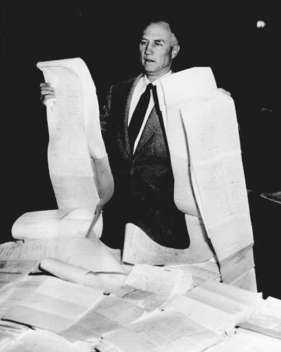
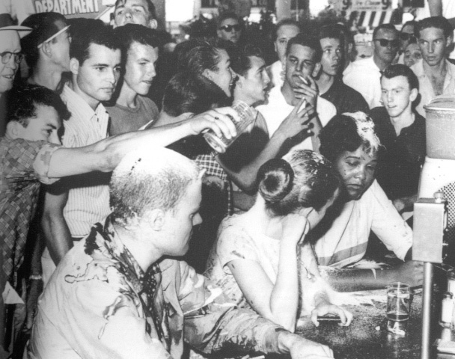
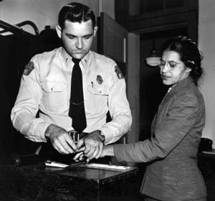
The Movement Begins
Montgomery Bus Boycott (1955-56)
Rosa Parks
Martin Luther King, Jr.
Organizations & Non-Violent Protest
Southern Christian Leadership Conference, 1957
Sit-In Movement, NC – 1960 lunch counter
Student Non-violent Coordinating Committee
Federal Legislation
Civil Rights Acts of 1957 and 1960
Created Civil Rights Commission
Gave Justice Department authority to protect rights
Notes:
Image 3: Strom Thurmond’s 24-hour filibuster in 1957

Slide 29
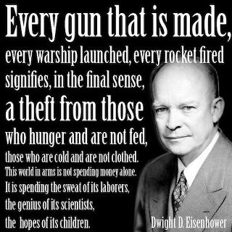
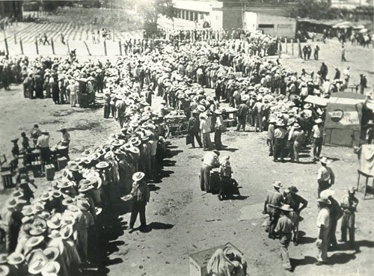
Eisenhower’s Legacy
Civil Rights
Limited action
Immigration
Operation Wetback, 1954
3.8 million deported
Notes:
Operation Wetback: http://www.frontpagemag.com/2013/dgreenfield/53-of-americans-want-illegal-aliens-deported/operation-wetback/
Quote: http://wallstreetwindow.com/ike-farewell-address
Video: Eisenhower’s Farewell: https://www.youtube.com/watch?v=CWiIYW_fBfY

Slide 30
Misconceptions
Baby Boom
Just wasn’t about having babies; there were several anomalies that created this boom:
optimism of future
GI Bill provided education and housing
More children = greater happiness and personal fulfillment
tax deductions for more children
Couples marry sooner
Suburban Life
The dream of Americans was to own the house and all the shiny new appliances
This put Americans into debt by greater numbers
Increased stress on the family
More women entered the workforce to enjoy
Discrimination continued for most minority and immigrant groups
Thus, the dream was mostly for white America.

