Slide 1

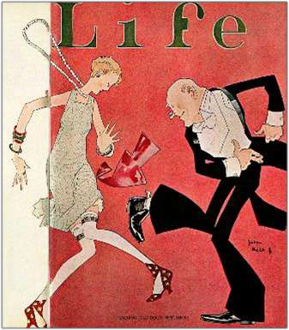


+
The United States During the “Jazz Age”

Slide 2











+
Themes of the “Roaring Twenties”
Social
Fundamentalism vs. Modernity (Religion vs. Science)
Advent of Mass Culture
Political
Isolationism
Limited Government Regulation
Economic
Consumerism
Unrestricted and Uncontrolled Expansion

Slide 3

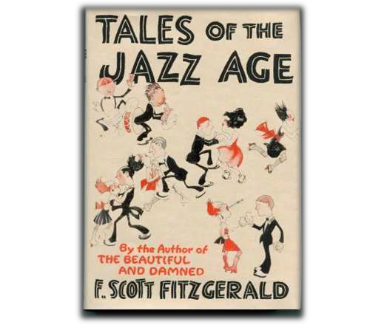

⁺ Essential Questions
The 1920’s were a period of new and changing attitudes on the one hand and traditional values and nostalgia on the other. What led to this tension between old and new AND in what ways was the tension manifested?
To what extent was American foreign policy during the 1920’s a continuation of past policy and to what extent was it a departure?

Slide 4

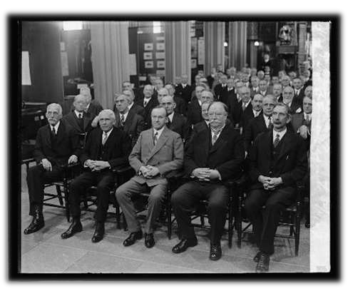
⁺ Politics: Republican Control
Business Doctrine
  Calvin Coolidge: “The business of America is business”
  Weakening of Regulatory Agencies
  Business friendly
administrations and Congress
  Sympathetic courts

Slide 5
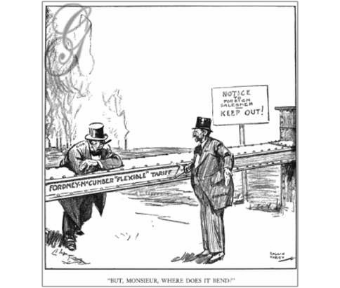
⁺ The Harding Administration
A “Return to Normalcy”
The “Ohio Gang” – Harding’s friends/past co-workers – later tied up in the financial scandals of the times
A Few Good Choices
  Sup.Crt. Justice Hughes (Sec. State), FDA Hoover (Commerce), industrialist and millionaireAndrew Mellon (Treasury), Taft (SCOTUS)
Domestic Policy
  Reduced Income Tax
  Increased Tariff (Fordney-McCumber, 1922)
  Bureau of the Budget – all government expenditures placed in a single budget for Congress to review and vote on
  Pardoned Eugene Debs – Socialist leader

Slide 6


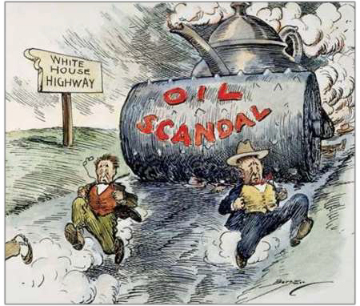
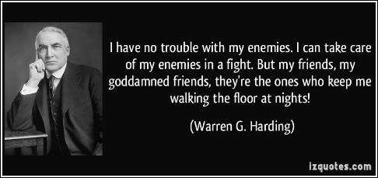
⁺ The Downfall
A Few Bad Choices
  Albert B. Fall (Interior), Harry Daugherty (Attorney General)
Scandals
  Bribery (Daugherty) – no prosecution for certain criminals
  Teapot Dome (Fall)
Death (August, 1923) – didn’t even know about most of the scandals.

Slide 7


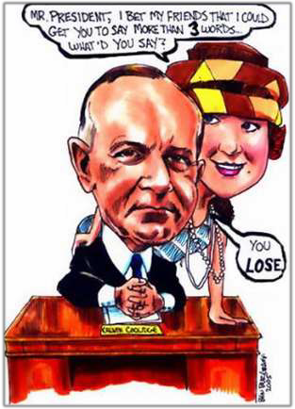
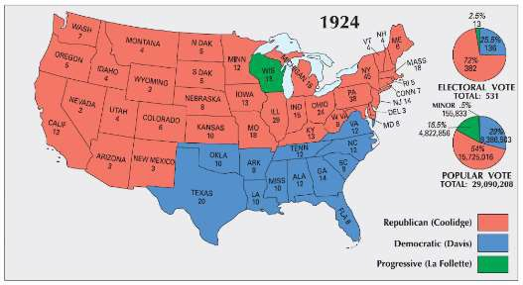
⁺ The Presidency of Calvin Coolidge
“Silent Cal” – “If you don’t say anything you be called on to repeat it”
The Election of 1924
  Coolidge (R) vs. Davis (D) vs. LaFollette (Progressive)
Vetoes and Inaction
  Cut spending – budget only
  Vetoes:
    Bonuses for WWI Vets
    McNary-Haugen (1928)- was supposed to help farmers as crop prices fell

Slide 8

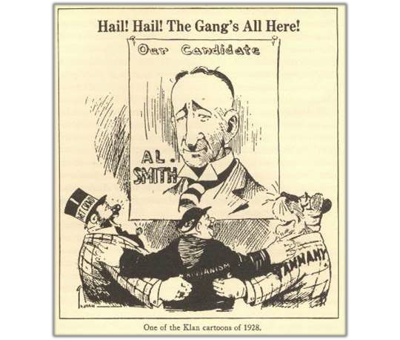
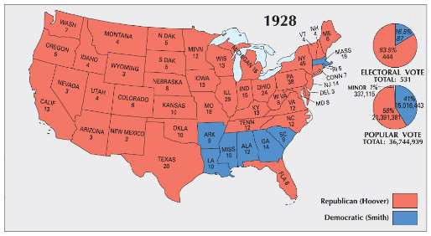


+ The Election of 1928
Herbert Hoover (R)
  Administrative roles under three previous presidents
Alfred E. Smith (D, NY)
  Catholic, wet
Hoover’s Quote Upon Receiving the Republican Nomination (August 11, 1928):
“We in America today are nearer to the final triumph over poverty than ever before in the history of any land... We have not yet reached the goal, but given a chance to go forward with the policies of the last eight years, and we shall soon with the help of God be in sight of the day when poverty will be banished from this nation.”

Slide 9



+
Effects of Government Policy and the Birth of a Consumer Culture

Slide 10


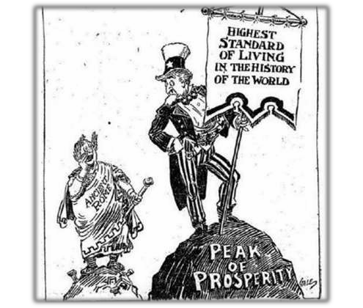
⁺ Economic Development
Characteristics:
  Immediate Post-War Recession (1921)
  Lengthy Business Prosperity (1922-1928)
    High Standard of Living
    Low Unemployment (less than 4%)
    Increased wages for middle and working classes
    Although prosperity did not extend to farmers and the working poor – early Depression
  Economic Disaster (1929)

Slide 11


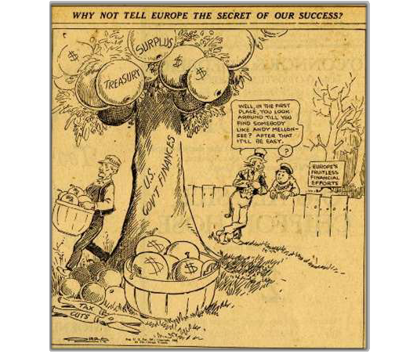
+ Causes of Business Prosperity
Increased Productivity
  Efficiency (Taylor) – scientific management
  Mass Production & Assembly Line (Ford, 1914)
Energy Technologies
  Petroleum
    Oil = 23% of energy
  Electricity (300% increase in use)
    Motors in factories, appliances in homes
Government Policy
  Corporate tax cuts, subsidies, and lax enforcement of antitrust laws
  Tax cuts for the wealthy (“Trickle-down” –
Mellon)
  Federal Reserve Policies – low interest rates & relaxed regulation of banks

Slide 12

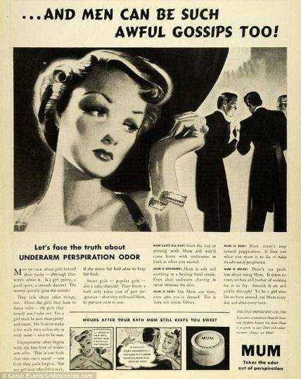

+ A Consumer Economy
New Appliances
  Refrigerators, vacuums, washing machines
The Automobile
  Industrial and Cultural Revolution
Increasing Sales
  Advertising
  Buying on Credit
    Installment Plans

Slide 13


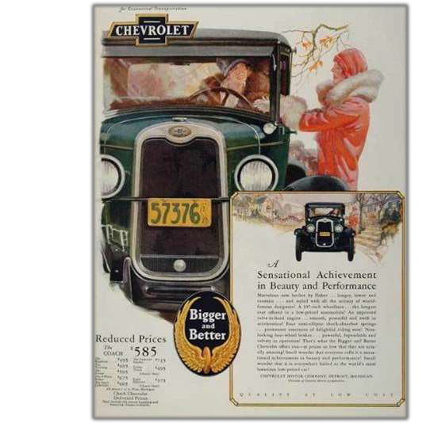

+ Impact of the
Automobile
Economic
  Affected Industries:
    Gas, Steel, Glass, Rubber, Roads & Travel
    Replaced railroads
Social
  Independence for Women and Teens
  Shopping, travel, commuting
Cultural
  Iconic
    Advent of the “Big Three”
      Ford, GM, Chrysler

Slide 14

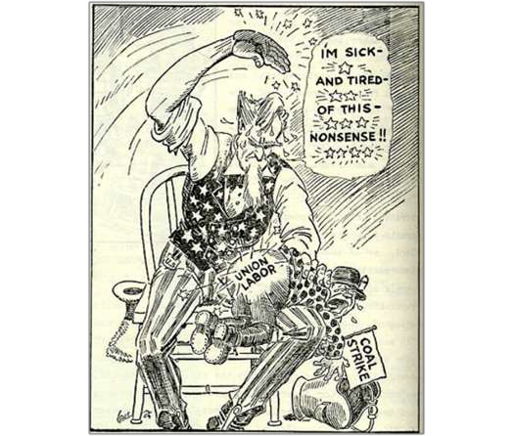
+ Economic Problems
Farm Problems
  Post War Problems – overproduction; surplus
    Massive debt
    Although new technology increased production, issues with prices and loans not addressed
Labor Problems
  Declining union membership – open shops
    Result of welfare capitalism (higher wages; benefits) and association of unions with socialism
  Ineffectiveness of strikes
    United Mine Workers (John L. Lewis) - violence
    Conservative court injunctions against strike and labor laws

Slide 15


+
Social and Cultural Developments of the “Jazz Age”

Slide 16











⁺ Causes
Advertising
Mass Consumption
Consumer Culture
Electricity
Radio & Automobile
New Technology
Sports & Film
Arts and Literature
Entertainment

Slide 17


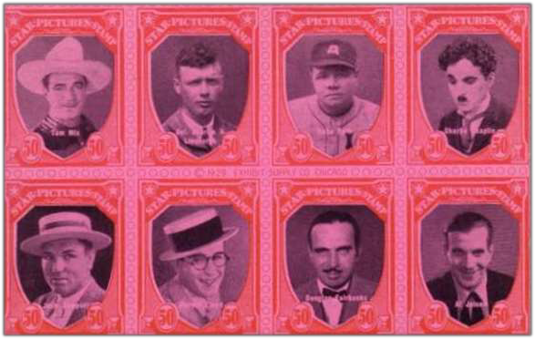
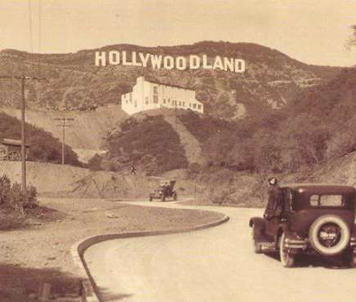
+ Entertainment
The Radio (1920)
  National Syndication
    NBC (1924)
    CBS (1927)
    Promoted Uniformity and
Advertising
Hollywood
  “Talkies” (Jazz Singer, 1927)
  “Movie Stars”
    Chaplin, Garbo, Valentino
  Movie “Palaces”
    80 million tickets weekly
Popular Heroes
  Sports: Dempsey, Ruth, Thorpe, Jones
  Aviation: Lindbergh, Earhart

Slide 18


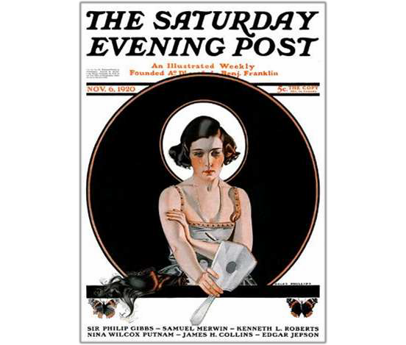
+ Gender Roles, Family, and Education
Women at Home
  Gender roles reinforced
    New appliances didn’t change role of
homemaker
Women in the Labor Force
  Following war, went back to largely clerical jobs
    Receiving lower wages than male counterparts
Revolution in Morals
  Psychology (Freud)
  Old vs. New
    Music, movies, fashion, smoking, sex
  Birth Control
  The “Flapper”
  Marriage and Divorce Rates
Education
  Importance of schooling (high school: 25%)
  Path toward assimilation for immigrants

Slide 19




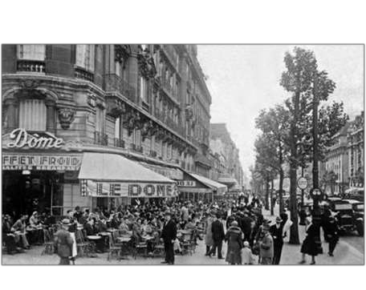
+ The Arts
Literature
  The “Lost Generation”
    American expatriates protesting mass culture/cosumerism
    Poets: T.S. Eliot, e.e. cummings, Ezra
Pound
    Writers: F. Scott Fitzgerald, Ernest Hemingway, Sinclair Lewis
      Examples: The Great Gatsby (Fitzgerald); Babbitt and Main Street (Lewis)
Art & Architecture
  Art Deco
  Artists: Hopper, Wood, Benton
Musical Theater
  Rhapsody in Blue and Porgy and Bess
(Gershwin)

Slide 20

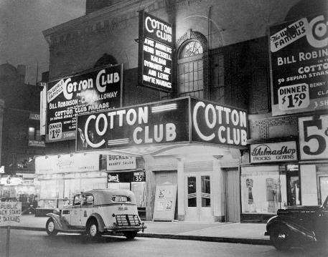
+ The Harlem Renaissance
Migration of Jazz
  South (New Orleans) → Up the River (St. Louis & Chicago) → To the City (New York)
Poets and Musicians
  Countee Cullen, Claude McKay, Langston Hughes, Zora Neale Hurston
  Duke Ellington, Louis Armstrong,
Bessie Smith, Billie Holiday
United Negro Improvement Association
(1916)
  Marcus Garvey’s “Back to Africa Movement”

Slide 21

+ Values in Conflict
Religion
  Modernism vs. Fundamentalism
  Manifestations:
    Revivalists
      Billy Sunday, Aimee Semple McPherson
The Scopes “Monkey” Trial (Dayton,
TN - 1925)
  Evolution on Trial
  Clarence Darrow - Scopes lawyer vs. WJB – expert on the Bible

Slide 22


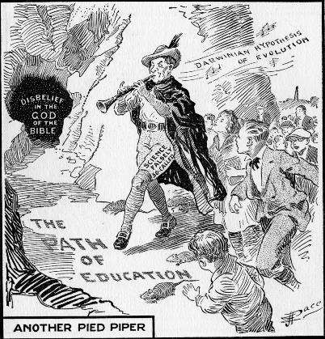
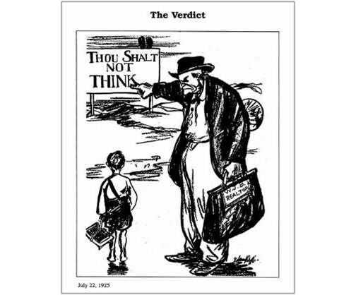
+ Views of the Scopes Trial

Slide 23


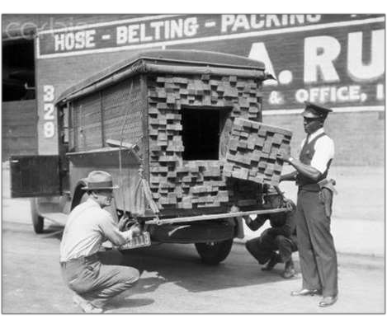
+ Prohibition
18th Amendment (1919)
  Volstead Act
Defying the Law
  Bootleggers and Speakeasies
  Organized Crime
    Al Capone
  Alcohol Consumption actually increased in cities during Prohibition
Political Discord and Repeal
  “Noble Experiment” created more problems than it solved
    Decline in overall alcoholism and alcohol-related deaths
    Increased criminal activity and other vices: prostitution, gambling, narcotics
  21st Amendment (1933)

Slide 24


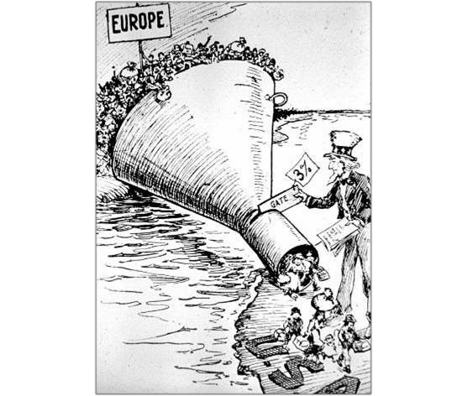

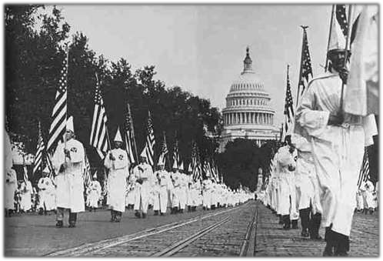
+ Nativism
Government Policies
  Emergency Quota Act (1921)
    3% of 1910 Census
  1924 Immigration Act
    2% of 1890
  National Origins Act
Sacco and Vanzetti (1921)
  Sentenced to death
Rebirth of the KKK
  Birth of a Nation (D.W. Griffith, 1915)
  Over 5 million members by 1925
  Tactics:
    Targeted “Un-Americans”
    Violence and threats
    Political influence
  Decline:
    Fraud, corruption, and vice

Slide 25



+
The Fiction of Isolation and the Emergence
of a World Power

Slide 26

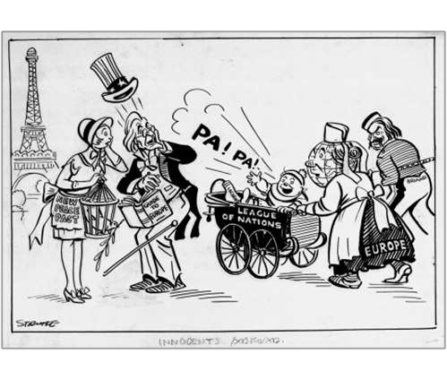
+ Disarmament and Peace
Washington Conference (1921)
  Five-Power Treaty – warships & Battleships (US, GBr, J, Fr, It)
    5:5:3:1.67:1.67
  Four-Power Treaty – respect each others territory in Pacific
    US, France, Great Britain, and Japan
  Nine-Power Treaty - United States, Japan, China, France, Britain, Italy,
  Belgium, Netherlands, and Portugal
    Respect Open Door Policy in China
Kellogg-Briand Pact (1928)
  Renounced use of force to achieve national ends
    Ineffective: permitted defensive wars and failed to provide enforcement

Slide 27


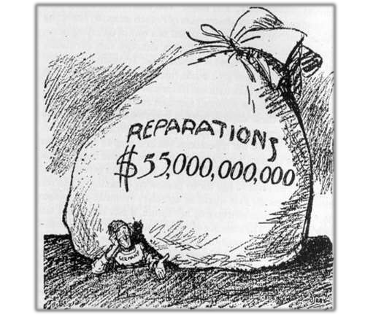
+ Business and Diplomacy
Latin America
  Morrow negotiates for US oil investors in Mexico (1927)
  Troops sent to Nicaragua and Haiti, pulled from the Dominican Republic (1924)
  US investments double from 1919-1929
Middle East
  Hughes negotiates for oil-drilling rights
Tariff Policy
  25% (Fordney-McCumber)
    European nations retaliate with own tariffs
War Debts and Reparations
  Dawes Plan – repayment of war debts for Germany

Slide 28

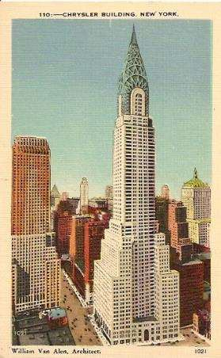
+ Legacy of the “Roaring Twenties”
New Technology and advances in the arts & entertainment lead to birth of a mass culture.
Xenophobia and disillusionment with war leads to nativism and isolation.
Consumerism and advertising, coupled with lax government regulation leads to economic boom (albeit mainly false growth).

Slide 29

















+ Understanding the 1920’s by using the Streets
of New York:
Entertainment Shopping Advertising Finance

