Slide 1
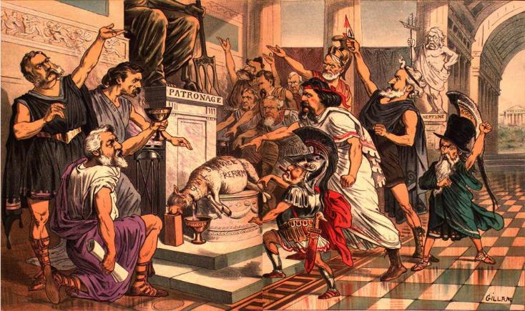
The Politics of the Gilded Age
Laissez-faire, Bossism, Spoils Reform, Populism, and the “Forgettable” Presidents
(1877-1900)
Notes:
Image - Puck, “The True Meaning of Republican Harmony”: http://xroads.virginia.edu/~ma96/puck/toons.html

Slide 2
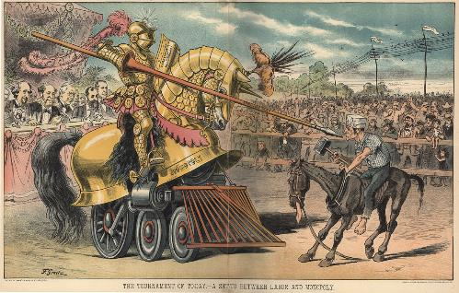
Essential Question
“The politics of the Gilded Age failed to deal with the critical social and economic issues of the times.” Assess the validity of this statement.
Topics to consider:
Laissez faire policies
Political corruption
Socio-economic disparities
Racial inequality
Plight of farmers & laborers
Notes:
https://timpanogos.wordpress.com/tag/gilded-age/

Slide 3
Two Party System?
Republicans:
Democrats:
“Waving the Bloody Shirt”
Gold Standard
High Tariffs
Union Pensions
Gov’t Subsidies
Limits on Immigration
Makeup:
Bi-Metalism
Low Tariffs
Higher Farm Prices
Less Government Aid
Pro-Immigration (N)
Makeup:
Reformers, African-Americans
Wealthy: Industrialists, Bankers, Bonanza Farmers
Northerners, Upper Midwest
States Rights
Solid South and West
Laborers, Small Farmers, Immigrants
Wealthy: Planters
Weak Platforms
Spoils System/Patronage
Weak Presidents
Strong Congressional Presence

Slide 4
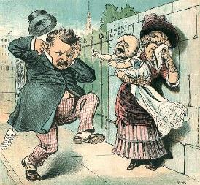
Presidential Elections
Election of 1880
James Garfield (R) vs. Winfield Hancock (D)
11 weeks in he was shot and killed by a Rebulican who felt he was supposed to be given a job.
Chester Arthur’s (R) Presidency
Reforms spoils system – civil service , improves Navy, questions protective tariff
Was not re-nominated by the Republican party
Election of 1884
Grover Cleveland (D) defeats Blaine (R)
First democrat in office since 1856 (James Buchanan)
Notes:
Electoral Maps: http://periodicpresidents.com/research/election-maps/1884-election-map/
Cleveland cartoon: http://en.wikipedia.org/wiki/United_States_presidential_election,_1884

Slide 5
Political Issues
Civil Service Reform
Pendleton Civil Service Act (1881)
The Money Question
Economy depended on circulation
Problem: increasing gap between rich and poor
The Farmer’s Plight – wanted more easy or soft money in circulation – borrow $ at lower interest rates and pay off their loans with inflated dollars
Gold standard – caused the depression
Hard Money vs. Greenbacks – allow the use of paper money and gold as it would hold its value against inflation.
Results:
“Crime of ‘73” – silver demonetization -
Specie Resumption Act (1875) – Gold Only
Sherman Silver Purchase Act of 1890 – increased coinage of silver; too little to satisfy farmers
Rise of Third Parties
Greenback Labor Party – focus on paper money not backed by gold or silver
Populists – focus on silver to help farmers
The Tariff – provided more than half of federal revenue
Domestic & International Implications – famers losing overseas sales, low farm prices and profits due to surplus
Political Machines
Notes:
http://fineartamerica.com/featured/anti-greenback-cartoon-granger.html

Slide 6
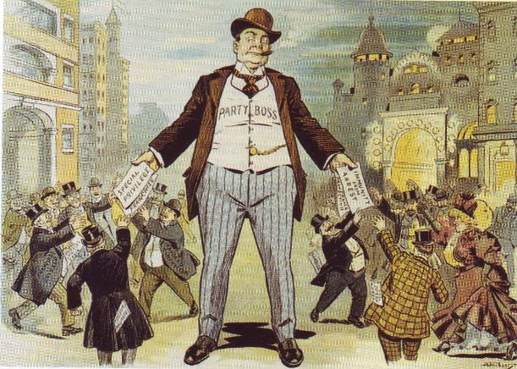
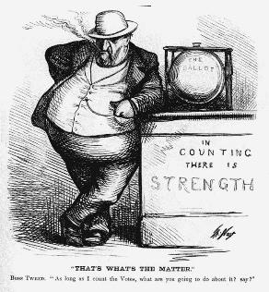
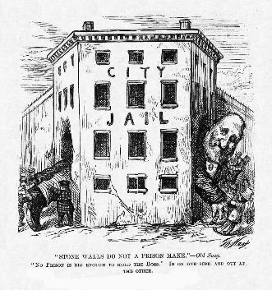
Bossism/Political Machines
Problems with Maintaining Cities
Urbanization outpaced government
Infrastructure, building permits, police, fire, etc.
Bureaucracy was not big nor strong enough
Rise of Political Machines
Tammany Hall & Boss Tweed
Cartoons of Thomas Nast
Notes:
Bossism: http://claver.gprep.org/fac/sjochs/Images/boss.jpg
Tweed 1: http://en.wikipedia.org/wiki/William_M._Tweed
Tweed 2: http://www.authentichistory.com/1865-1897/1-reconstruction/3-tweed/index.html
Follow up with HW or class activity analyzing the cartoons of Thomas Nast

Slide 7
Presidential Elections - Part II
Election of 1888 – protective tariff
Harrison (R) defeats Cleveland
The “Billion Dollar Congress”
Increases Tariff (McKinley, 1890) – 48% tax
Increases Soldiers’ Pensions
Sherman Anti-trust Act, Sherman Silver Purchase Act – outlaws combinations in restraint of trade
Immigrants move to Democratic Party
Election of 1892
Cleveland defeats Harrison due to the high tariff
Panic of 1893
Overexpansion of RR’s & industry – stock market crash
Cleveland wants repeal of Sherman Silver Purchase Act
J.P. Morgan loans $65 million – Americans believed
Government was just a tool of the eastern bankers
Coxey’s Army – demand $500 million to be spent on social
welfare
arrested for trampling grass
Election of 1896 – issues of silver vs. gold
Populist Election – William Jennings Bryan
Combined w/Cleveland’s use of troops during the Pullman Strike, Americans become disenchanted w/gov’t as a tool of the rich
Notes:
Billion Dollar Congress: http://kids.britannica.com/comptons/art-72122/Cartoon-reflecting-the-belief-that-US-President-Benjamin-Harrison-and
Election of 1892 Cartoon: http://www.indiana.edu/~libsalc/cartoons/1892.html

Slide 8
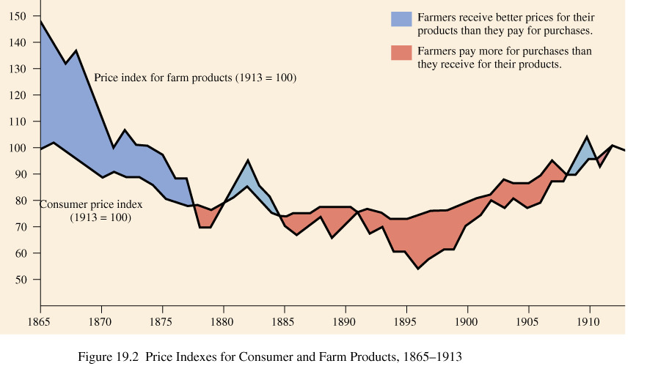
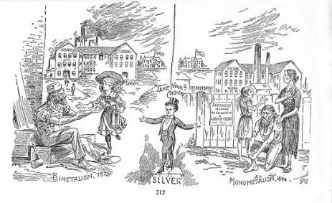
Populism - Causes
Inequities in the new industrial order
Inequities in the new agricultural order
Political corruption and ineptitude
Lack of political power by farmers
Transformation of America to an urban society
Increased world markets and competition
Deflationary gov’t policies
Rise of the Grange and Farmers’ Alliances
Notes:
http://en.citizendium.org/wiki/Populist_Party

Slide 9
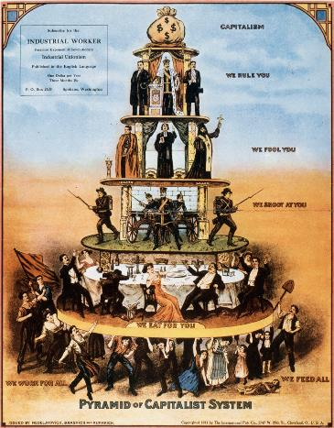
The Populist Party
Organized in 1890 in Cincinnati
held first convention in 1892 in St. Louis
tried to unite workers and farmers: Knights of Labor
nominated James Weaver (Greenbacker) for President
Leadership:
Thomas Watson, Ignatius Donnelly, & “More Hell” Mary Elizabeth Lease
Tenets: The Omaha Platform
Political:
Direct election of senators
Initiative, referendum, recall
Economic:
Unlimited coinage of silver
Graduated income tax
Public ownership of railroads, telegraph, and telephone
Loans and warehouses for farmers
Eight-hour workday
Notes:
http://earthlymission.com/the-pyramid-of-the-capitalist-system/

Slide 10
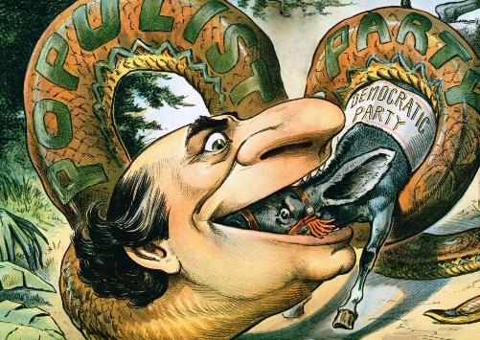
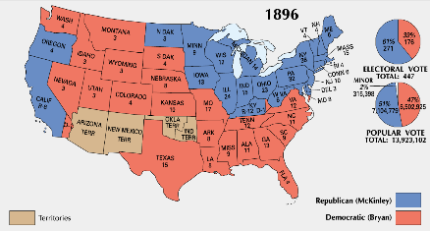
Election of 1896
Populists merge with Democrats and run William Jennings Bryan
McKinley runs for the Republicans
Populists run on platform of 16:1
Notes:
Cartoon: http://en.wikipedia.org/wiki/William_Jennings_Bryan
Map: http://imgarcade.com/1/election-of-1896/

Slide 11
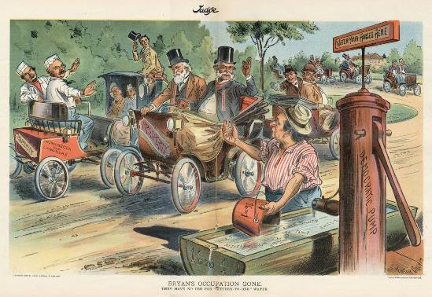
End of the Populist Movement
McKinley Presidency
Maintain Gold Standard
Gold discovered in Alaska → Inflation
Economic Prosperity
Dingley Tariff (46%)
Results of the Movement:
The political death knell of rural America
highlighted the problems of farmers
Rise of urban influence
Presaged the Progressive Era: reform politics
Important influence of third parties
Birth of modern politics
impact of media
Notes:
http://elections.harpweek.com/1900/cartoons/bryansoccupationTPQC12w.jpg

