Slide 1
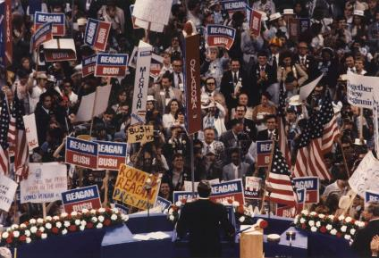
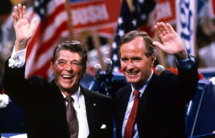
A Conservative Resurgence
The United States from 1980-2000
Notes:
1980 RNC image 1: https://en.wikipedia.org/wiki/Republican_Party_presidential_primaries,_1980
1980 RNC image 2: http://neilleifer.com/ptags/1980-republican-national-convention/

Slide 2
The Rise of Conservatism
Political Figures:
Barry Goldwater – 1964 defeated
Nixon & Ford – steady shift from liberalism of the 1960s
Response/Opposition to:
Big Government
New Deal Liberalism
Feminism
Gay Rights
Welfare
Affirmative Action
Sexual Permissiveness
Drug Use
Gun Control
“Liberal” SCOTUS Decisions
All were seen as undermining family and religious values, week ethic, and national security
Notes:
Cartoon: http://www.cartoons.org.nz/cartoons/welfare-state

Slide 3
Leading Issues
Taxpayers’ Revolt
CA’s Prop 13 – sharp cut in property taxes
Laffer Curve
Inspiration for tax cuts – increase govt revenues
Conservative Religious Revival – Moral decay
The Televangelists
60-100 million viewers weekly
Moral Majority – financed campaigns to unseat liberal members of Congress
Campaign for return of prayers and teaching of creation in public schools
Pro-Life Movement in response to Roe v. Wade
Elimination of Racial Preferences
U.C. Regents v. Bakke (1978) – Affirmative Action – no setting quotas – starts campaign to end all preferences based on race and ethnicity
De-Regulation of Business
Notes:
Prop 13 Cartoon w/description of current status: http://www.santamonicapropertyblog.com/senators-dare-to-tamper-with-prop-13/
Time Falwell Cover: http://content.time.com/time/covers/0,16641,19850902,00.html

Slide 4
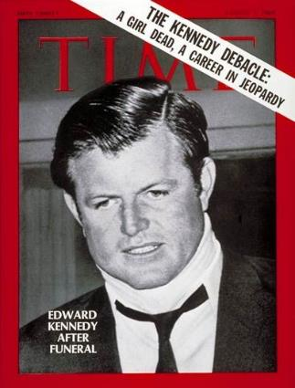
Ronald Reagan and the Election of 1980
Background:
Actor, SAG President, Governor of California
Campaign
Democratic Squabbles:
E. Kennedy vs. Carter
Memories of Chappaquiddick
Republican Attacks
“Are you better off now than four years ago?
Results:
Reagan:
51% popular, 91% Electoral
The “Reagan Revolution”
Demographic shift to Republican party
Notes:
Map: http://kc-johnson.com/history-3442-the-1980-election/1980-presidential-election-map-picture/

Slide 5
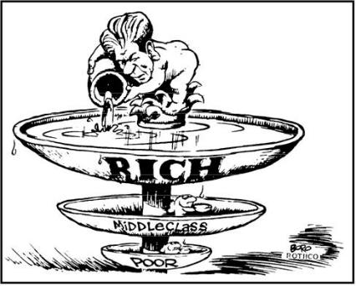
The Reagan Revolution
Iranian Hostage Crisis Ends (Jan. 20, 1981)
Supply Side Economics - Reaganomics
“Trickle Down Theory”
Tax cuts, reduction in govt spending, more investments = more jobs and increase in production
Federal Tax Reduction
Economic Recovery Act (1981) – 25 % , invest in IRA’s,
Spending Cuts
$40 billion – food stamps, student loans, mass transporation – increase in military spending
Deregulation
PATCO Strike – decline in labor unions
Notes:
Cartoon: http://thecompanion.in/serious-thoughts-after-watching-in-time/
PACO Strike, with description: https://historyrat.wordpress.com/2012/10/14/reagan-and-the-patco-strike-broken-promises/

Slide 6
Recession & Recovery
The “Reagan Recession”
Bank failures
11% Unemployment
“Reaganomics” ends recession, but increases wealth gap
“Yuppies”- young, urban professionals
Social Issues
SCOTUS Nominations – conservative judges
Sandra Day O’Connor, Scalia, Kennedy
Rehnquist = Chief Justice
Restrict Affirmative Action & Limit Scope of Roe - restrictions on abortion

Slide 7
The Election of 1984
Republicans:
https://www.youtube.com/watch?v=Vx2Ik1Rckss
Democrats
Jesse Jackson & the “Rainbow Coalition”
Walter Mondale & Geraldine Ferraro
Only two groups still voting Democrat – African Americans and those earning less than $12,500 a year
Results: - every state except Minnesota
Electoral Tally: 525 to 13
Notes:
“It’s Morning in America” – Link to ad: http://www.livingroomcandidate.org/commercials/1984/prouder-stronger-better#4085
Cartoon: http://apushrshs.wikispaces.com/Political%20Cartoons%201980s-2004
Rainbow Coalition Button: http://i.ebayimg.com/00/s/NTAwWDQ3Mw==/z/B5kAAOSwDNdV6JAP/$_1.JPG

Slide 8
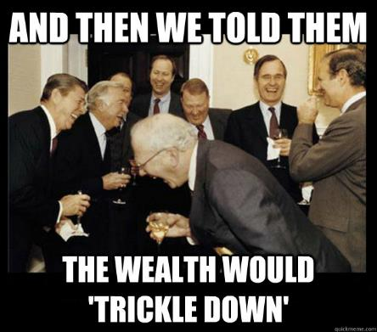
Economic Legacy
Budget & Trade Deficits
$200 billion deficit per year
Debt: $900 billion (1980) → $2.7 trillion (1988)
Tax cuts increased consumption…
Of foreign goods
Trade deficit = $150 billion per year
1985 – US debtor nation
1985 Gramm-Rudman-Hollings Balanced Budget Act (1985)
Impact of Reaganomics
Legacy of social spending cuts and increased military spending
Proliferation of the national debt
Notes:
Time Cover: http://content.time.com/time/covers/0,16641,19810921,00.html
Meme: https://theprogressivecynic.com/2015/02/09/reaganomics-or-rigonomics-the-right-wings-nonfactual-economic-ideology/

Slide 9
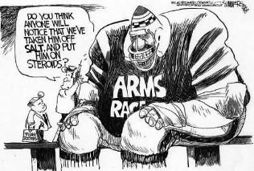
Foreign Policy
Renewing the Cold War – spending for defense and aid to anti-communist forces
Military Buildup
B1 program, SDI – lasers and particle beams, Pershing II
Central America
Nicaragua (1979-1985) – aid to contras
Boland Amendment – cut off aid
El Salvador (1979-1985) – 40,000 civilians died
Grenada (1983) – pro-Cuban to pro-American
Iran-Contra Scandal – selling of US antitank and anti-aircraft missiles
Iran-Iraq War (1979)
Reagan denial use of funds diversion
Lebanon, Israel, and the PLO
Israeli invasion (1982) of Lebanaon to stop PLO
Beirut Bombing (1983) – suicide squad hit embassy – 63 dead
Notes:
SDI: http://www.globalsecurity.org/space/systems/sdi.htm
Cartoon: http://deadspin.com/5958173/a-brief-history-of-sports-in-political-cartoons
Pan-Am 103: http://topics.nytimes.com/top/reference/timestopics/subjects/a/airplane_accidents_and_incidents/pan_am_flight_103/index.html

Slide 10
Improved U.S.-Soviet Relations
Mikhail Gorbachev (1985)
Glasnost – openness – end political repression
Perestroika – restructure the Soviet economy by introducing some free-market practices
Wanted to end arms race & deal with the deteriorating economy
INF Treaty (1987) – remove and destroy all intermediate range missiles
1988 – start pullout of troops from Afghanistan
Pressure on Iraq and Iran to stop fighting
“… tear down this wall!”
Notes:
https://www.youtube.com/watch?v=YtYdjbpBk6A

Slide 11
Assessing Reagan’s Policy
Military Buildup
Pro: Ended Cold War
Con: Debt
End of the Cold War
Most responsible?
Kennan
Nixon
Reagan
Gorbachev
The “Reagan Revolution”
Extreme Popularity
Changed the face of politics
Notes:
Did Reagan Win the Cold War?:http://www.salon.com/2006/01/25/gaddis/

Slide 12
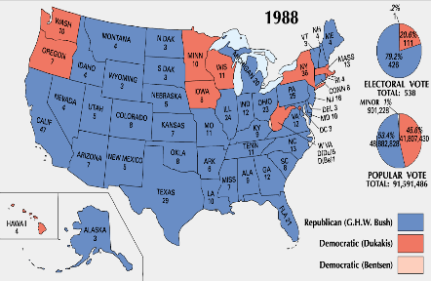
The Election of 1988
Background:
1986 midterms saw Democrats take control of both houses
Massive deficits and debt gave Democrats strength
Candidates:
Michael Dukakis & Lloyd Bentsen
George H.W. Bush & Dan Quayle
Impact of the Campaign:
Bush attacks Dukakis on Foreign Policy & Crime
“Read my lips…No new taxes”
Notes:
Photo: http://bostonlocaltv.org/blog/2012/10/election-season-1988/
Map: http://www.philipcaruso-story.com/222-election-of-1988/
“Dan Quayle” is a link to the Vice-Presidential Debate – “you’re no Jack Kennedy”: https://www.youtube.com/watch?v=iQ5CIkSlUFI
“Foreign Policy” is a link to the “tank” ad: http://www.livingroomcandidate.org/commercials/1988/tank-ride#4119
“Crime” is a link to the Willie Horton ad: http://www.livingroomcandidate.org/commercials/1988/willie-horton#4123

Slide 13
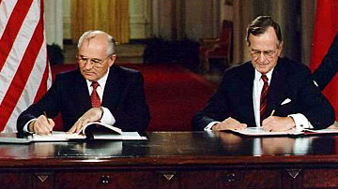
The End of the Cold War
Tiananmen Square (1989)
Prodemocracy demonstration
Collapse of Satellites (1989-1992) – Gorbachev no longer supports communist governments in E. Europe
Poland (Walesa)
Hungary, Czechoslovakia, Bulgaria, & Romania
East Germany
Collapse of Berlin Wall (1990) https://www.youtube.com/watch?v=fK1MwhEDjHg
Yugoslavia, Bosnia & Herzegovina
End of the Soviet Union
START I (1991) – reduction of nuclear warheads to under 10,000
Gorbachev → Yeltsin (1991)
START II (1992) – reduction to 3000 each as well as economic assistance to the troubled Russian economy
Notes:
Tiananmen, Goddess of Democracy: http://bhoffert.faculty.noctrl.edu/HST265/12.ARoadIsMade.html
START Signing: http://www.atomicarchive.com/History/coldwar/page25.shtml

Slide 14
Foreign Policy
Panama
Operation Just Cause (1989)
Manuel Noriega – put a stop to the drug pipeline to the US
Persian Gulf War (1990-91)
Operation Desert Storm
Saddam Hussein invades Kuwait (oil)
Threat to Western oil sources
500,000 Americans with 28 other nations
5 weeks of air strikes and invasion of Iraq – 100 hours on ground – Iraq concedes
Notes:
Operation Just Cause: https://en.wikipedia.org/wiki/United_States_invasion_of_Panama

Slide 15
Domestic Issues
Nomination of Clarence Thomas to replace Thurgood Marshall
Taxes and the Economy
Democratic Congress proposes tax hikes - $133 billion
Political Inertia
Struggles w/Congress
ADA (1990)
Notes:
Clarence Thomas: http://www.salon.com/2010/10/27/anita_hill_clarence_thomas/

Slide 16
Election of 1992
Background:
Anti-incumbent mood
27th Amendment (1992)
Partisan Politics on Capitol Hill
Democrats:
William Jefferson Clinton
An Independent Billionaire:
H. Ross Perot
Results:
Clinton wins w/less than 43% of the popular vote
Electoral tally: 370 to 168
Notes:
Debate image: http://popcultureblog.dallasnews.com/2014/11/george-w-bush-says-perot-cost-41-a-second-term-i-just-cant-prove-it.html/

Slide 17
Clinton’s First Term (1993-1997)
Goals:
Economic Stimulus
Campaign Finance Reform
Environmental Legislation
Health Care Reform
Results:
Senate Republicans use filibuster against all proposals
Compromise:
“Don’t ask, don’t tell.”
Accomplishments:
Family Medical Leave Act
“Motor-Voter” Law
Brady Bill – 5 day waiting period for handguns
Spending Cuts and Tax Increases - $255 b in spending cuts; $241 b in tax increases
NAFTA- free trade with Canada & Mexico
Notes:
Cartoon: http://www.pbs.org/wgbh/americanexperience/features/teachers-resources/clinton-guide/

Slide 18
A Republican Revolution
1994 Midterms
“Contract with America”
Newt Gingrich
Results/Reactions:
Gridlock: 1995 shutdown
Oklahoma City Bombing (1995)
Balanced Budget (1998)
Impact of tech boom, Baby-boomer income, spending cuts, and tax increases – first federal surplus since 1969
Notes:
Contract With America: http://content.usatoday.com/communities/onpolitics/post/2010/01/gingrich-offers-new-contract-with-america/1

Slide 19
Election of 1996
Republicans:
Bob Dole/Jack Kemp
15% tax cut proposal
Reform: Ross Perot
Results:
Less than 50% voter turnout
Electoral tally: 379 to 159
Notes:
“Bob Dole” – Link to SNL skit: http://www.nbc.com/saturday-night-live/video/cold-opening-nightline/n10863
Map: http://clinton.procon.org/view.resource.php?resourceID=004025

Slide 20
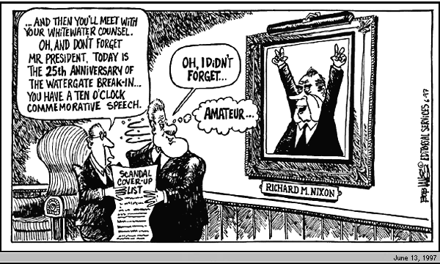
Clinton’s Second Term (1997-2001)
Economic Prosperity
Tech & Stock Boom
3.9% Unemployment
The Politics of Impeachment
Divided Government
Allegations, Investigation, and Impeachment
Whitewater, Travelgate, Filegate
Lewinsky
Independent prosecutor: Kenneth Starr
Clinton’s possible perjury
1998 Midterms → Dems gain House
Clinton escapes removal by Senate
Notes:
Time Cover: https://www.youtube.com/watch?v=xHlt1W83JFU
Picture is a link to the Clinton grand jury deposition – “definition of ‘is’ is…”: https://www.youtube.com/watch?v=xHlt1W83JFU
Cartoon: http://www.cnn.com/ALLPOLITICS/1997/12/24/toons.97/

Slide 21
Foreign Policy
Secretary of State: Madeleine Albright
Peacekeeping:
Somalia (1993) – civil war- humanitarian efforts
Haiti (1994) – restore elected president
Northern Ireland (1998) – free from British power
Europe
Formation of EU (2002) – 15 countries establish usage of the euro by 2007, 27 European nations
Russia
Yeltsin → Putin
Notes:
Synthesis – 20 Years After Somalia: https://horseedmedia.net/2014/01/11/somalia-20-years-black-hawk-us-military-advisers-back-somalia/

Slide 22
Assessing Clinton’s Legacy
Partisanship
Struggles w/Congress
Impeachment
Globalization
WTO – trade agreements, trade rules enforced, settle disputes
IMF – International Monetary Fund – loans and supervise the economic policies of poorer nations with debt troubles
G8 – Canada, France, Germany, Italy, Japan, Russia, UK, US – largest industrial powers
Notes:
WTO Protest Seattle, 1999: http://www.herinst.org/BusinessManagedDemocracy/government/trade/millennium.html

Slide 23
American Society in 2000
Demographics
Nearly 300 million
Expansion in West and South
Political shift
Suburban expansion
Immigration
Immigration Reform and Control Act (1986)
Illegal immigration
27% of population growth of the ’90’s
Largest growing population: Hispanic
Aging and the Family
The “Graying” of America
Decline of Traditional Family
Income and Wealth
Home ownership 67%
Huge increase in per capita income
Extreme Wealth Gap: 5% control half of all income
Notes:
Graph: http://www.msnbc.com/rachel-maddow-show/welcome-the-new-gilded-age

