Slide 1
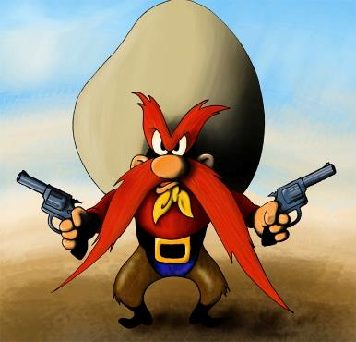
The Last West and the New South
1865-1900
Notes:
Yosemite Sam: http://images5.fanpop.com/image/photos/30900000/Yosemite-Sam-warner-brothers-animation-30976315-800-766.jpg

Slide 2
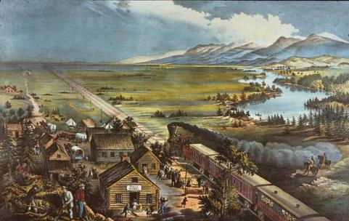
Essential Questions
To what extent did the natural environment shape the development of the West beyond the Mississippi and the lives of those who lived and settled there? How important were other factors?
Analyze the ways in which technology, government policy, and economic conditions changed the American frontier in the period 1865- 1900.
Notes:
Image: http://amhistnow.blogspot.com/2013_09_01_archive.html

Slide 3
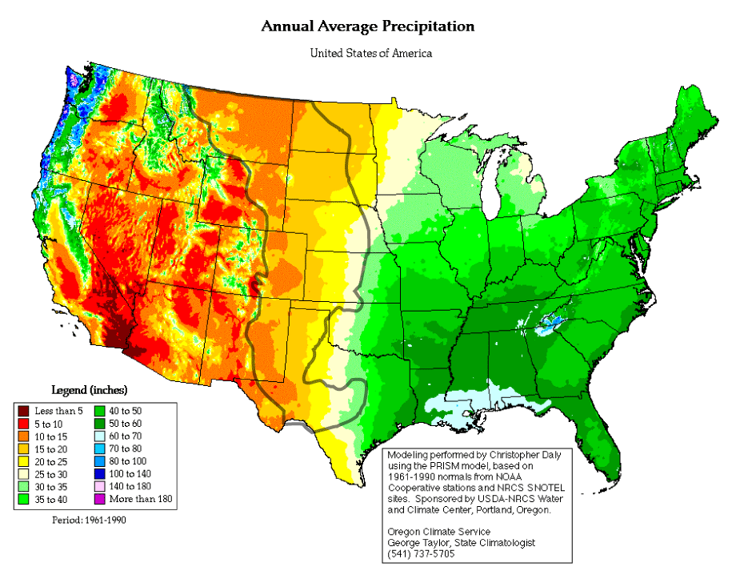
Post War Expansion
Regions of settlement:
  Great Plains
  Rocky Mountains
  Western Plateau
  “Great American Desert”
    Less than 15 inches of rainfall annually
Impact on American Indians
  Loss of land
  Changes to way of life
  The buffalo
Notes:
Precipitation Map: http://oceanworld.tamu.edu/resources/environment-book/dustbowlandaftermath.html

Slide 4
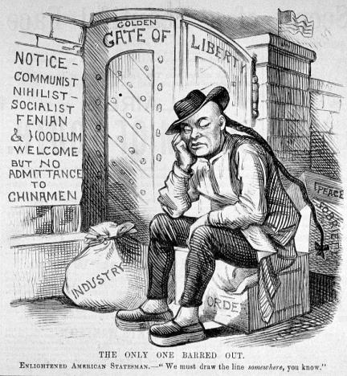
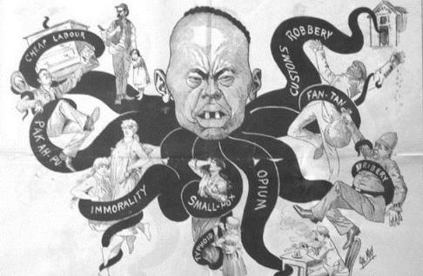
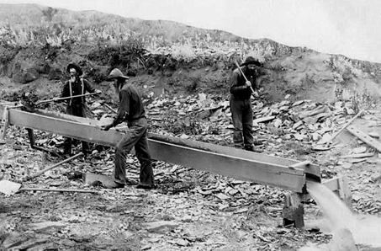
The Mining Frontier
Pike’s Peak, CO (1859) – gold – 100,000
Comstock Lode (1859)
  $340 million in gold and silver
Homestead Mine
  Black Hills, Dakotas
  Billion Dollar Mine
Boom Towns
  Homestead, SD
  Virginia City, NV – Mark Twain
  by the early 1860’s all easily extractable gold and silver gone (placer mining)
    Ghost Towns
  San Francisco, Sacramento, Denver remain as urban centers
Big business takes over
  dynamite introduced in 1870’s
Impact:
  Social: Nativism
  Political: Chinese Exclusion Act
  Economic: Gold vs. Silver, Inflation → Populist Movement
Notes:
Placer Mining: http://www.miningartifacts.org/South-Dakota-Mines.html
Two Views of Chinese Immigration & The Exclusion Act
Image 1: http://phdsandpigtails.com/2014/01/19/timeline-u-s-citizenship-law/
Image 2: http://en.wikipedia.org/wiki/Chinese_Exclusion_Act

Slide 5
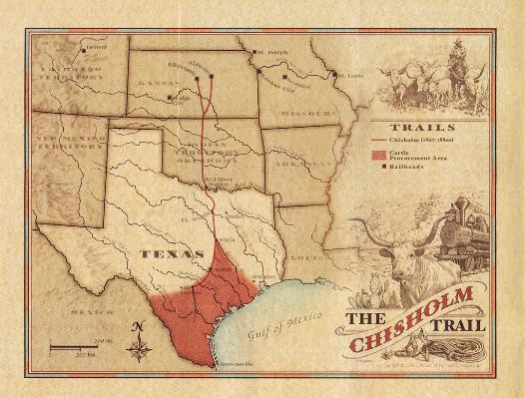
The Cattle Frontier
Texas as the Model
  Mexican tools and clothing
  Longhorn Cattle
    thrived on dry, grassy plains
Rise of Beef Trusts
  disappearance of buffalo, soaring population increase, invention of refrigerated car → huge rise in demand
  Chicago & St. Louis as centers
    antebellum: $3-5 for cattle
    postbellum: $30-50 for cattle
  Abilene, KS – cattle drives
    Chisholm and Goodnight-Loving Trails
      The “Long Drive”
The Open Range
  2/5 of Texas used for cattle grazing
    branding
Decline
  Invention of Barbed Wire
  Winter of ‘85-’86 (85% losses)
  Drought of ‘86 & Winter of ‘87
Notes:
Chisholm Trail: http://www.chisholmtrailride.org/chisholm-trail-history

Slide 6
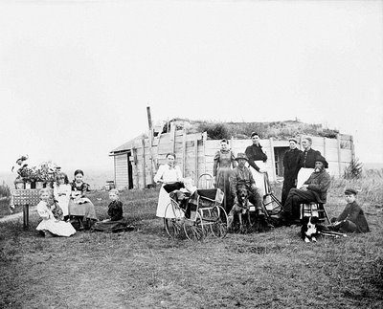
The Farming Frontier
Homestead Act (1862)
  160 free acres to families
    Req’s:
      Must be actively farmed for 5 years, and must have residency established for at least 6 months
  Over 500,000 families settled on homesteads
Problems and Solutions
  Severe weather, lack of water, cold weather, high rate of pestilence and disease
  Inventions/innovations
    Barbed wire
    Windmills
    Dry-farming techniques – used the moisture that was available
    Dams and irrigation
  Falling crop prices and rising costs led to many failures
Notes:
Homestead Family: http://www.slowmuse.com/?attachment_id=2941
From Prior Presentation, based on The American Pageant:
Homestead Act (1862)
160 acres of land
requirements:
21 years old or head of family
American citizen -- or applicant
must build on land and reside there for 6 months
land must be farmed actively for 5 years
Results:
80 million acres to some 6000,000 claims
Problems:
meeting requirements
building, equipments, supplies: above $1,000 initial cost
staying on land in the middle of nowhere
limited to no experience
climate and conditions of Great Plains
Fraud: speculators
portable homes
Cooperative Living
settlers needed to work together
Search for Water
collect rainwater
open source
“Prairie Fever” - typhoid
Self-Sufficient Homesteads
men planted and then went East to find jobs
women produced clothing, soap, etc. and tended to home
children
community became necessary to survive
Conditions
“soddies”
back-breaking labor/plowing
harsh climate
lack of rain
flooding
disease & pestilence
caused 18,000 to give up in 1891 alone
The Exodusters:
Cooperative Living
settlers needed to work together
Search for Water
collect rainwater
open source
“Prairie Fever” - typhoid
Self-Sufficient Homesteads
men planted and then went East to find jobs
women produced clothing, soap, etc. and tended to home
children
community became necessary to survive
Conditions
“soddies”
back-breaking labor/plowing
harsh climate
lack of rain
flooding
disease & pestilence
caused 18,000 to give up in 1891 alone
Women on the Frontier:
Women allowed to file claims for land
Family Life
solitude
remained on homestead to prevent squatters
Organization
women worked together
formed first prairie governments
Suffrage
Syracuse and Argonia, KS
all female town council
first female mayor
Wyoming grants suffrage (1869)
Utah
women granted suffrage (1870), repealed by Congress (1885)
statehood in 1896
outlawed polygamy

Slide 7
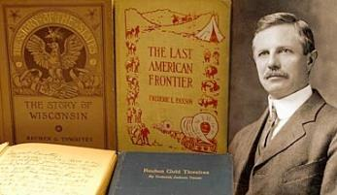
The Closing of the Frontier
Opening of the Oklahoma Territory (1889)
  The Land Rush
    “boomers” and “sooners” rush to settle
    End of the “frontier”
Turner’s Frontier Thesis (1893)
  Views – settling on the frontier was a social leveler, breaking down class distinctions, fostered social and political democracy
  Reaction – would the United States be condemned to follow the patterns of class division and social conflict like Europe?
  Effects/Lasting Impact – large movement to cities and industrialized areas. Era of the western frontier was coming to a close, but the dominance of rural America was also on a decline.
Notes:
Map: http://www.lib.utexas.edu/maps/united_states/us_terr_1870.jpg
Turner Thesis: http://ronanshonorsushistoryii.mrsronansclasses.com/Mrs._Ronans_Honors_U.S._History_II/Turners_Frontier_Thesis__Reading_%26_Questions.html
From Prior—
Fate of the Indian Territory
70 Nations forced into Oklahoma
post Civil-War settlement
poor farmers rush in from South
government seizes 2 million acres for settlement (1889)
Boomers and Sooners
April 22, 1889 “Opening”
10,000 in first day
Oklahoma Territory Created (May 2, 1890)
Turner Thesis:
Buffalo Bill’s Wild West Shows
traveling acts
train robberies
shootouts
Annie Oakely, Sitting Bull
even did tours of Europe
The 1893 Chicago Exposition
Frederick Jackson Turner embraced stereotype
the frontier created/embodied America
led to oversimplification of stereotype
“Cowboys and Indians”
To what extent was the Turner Thesis true?
To what extent is it still true today?
How did the settling of the homesteads change the social and political landscape of the United States?

Slide 8
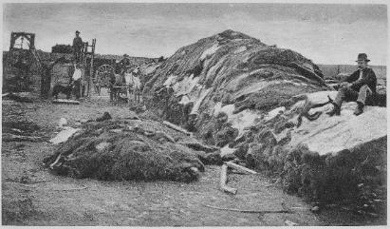
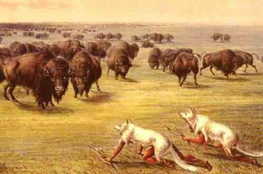
American Indians in the West
Roughly 2/3 of the remaining western tribes lived in the Great Plains
  Impact of horse
  Reliance on buffalo
Reservation Policy
Indian Wars
  Sand Creek
  Fetterman Massacre
  Little Big Horn
  Meeker Massacre
  Wounded Knee – marked the end of Indian Wars
Assimilationists
  A Century of Dishonor (Helen Hunt Jackson, 1881) – advocate for formal education, job training, and conversion to Christianity
  Dawes Severalty Act (1887) – designed to break up tribal organizations; 160 acres per family – US citizenship granted to those who stayed on the land for 25 years and adopted the habits of civilized life.
    47 million acres
Notes:
Plains Indians: http://www.bookunitsteacher.com/indians/reports4/plains2.htm
Results of buffalo hunting: http://commons.wikimedia.org/wiki/File:%22Rath_%26_Wright's_buffalo_hide_yard_in_1878,_showing_40,000_buffalo_hides,_Dodge_City,_Kansas.%22_-_NARA_-_520093.jpg
From Prior – Native Cultures Destroyed:
Wars forced Indians back to Reservations
as land was lost, along went their culture
The Buffalo
food, shelter, clothing, fuels, tools
hunted by RR companies
later targeted by settlers
clear range
use for hides
sport
encouraged by gov’t
$8 a ton
over 32 million killed in the late 1860’s alone
Bureau of Indian Affairs
manage supplies
ensure Natives’ rights
role of treaties
Helen Hunt Jackson
exposes broken promises of government
Support
Gave rise to Indian’s Rights Movement
activists not united
many still viewed Indians as savages that need to be “civilized”
Criminal Code of 1884
outlawed Native religions
Dawes Severalty Act (1887)
free land to male-headed families
Indian Training & Industrial School
forced Indians to farm
Attempts at assimilation
ended up selling to speculators

Slide 9
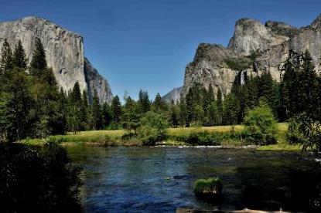
The Conservation Movement
Growth of State Parks and Creation of National Parks
  Yellowstone (1872), Yosemite (1890)
  Creation of Forest Reserves and the Federal Forest Service (Schurz – SecState)
    33 million acres protected under Harrison & Cleveland
  Forest Reserve Act 1891
  John Muir and the Sierra Club (1892) – preserve national areas from human interference
Notes:
http://en.wikipedia.org/wiki/Yosemite_National_Park

Slide 10
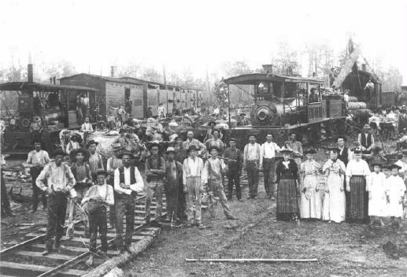
The New South
Economic Progress
  Steel (AL), Lumber (TN), Tobacco (VA), Textiles (GA, NC, SC)
  Expansion of Rails
Continued Poverty
  Most growth due to northern financing
  Lack of education, limited skills
  Weak political leadership
Agriculture
  Limited Diversification
    New Crop Rotation – Peanuts, Sweet Potatoes, Soybeans (G.W. Carver)
  Plight of poor farmers
    Rise of Southern Farmers’ Alliances (segregated)
Notes:
http://www.southbear.com/hometowns/laurel/laurel_history/industrialization.html

Slide 11
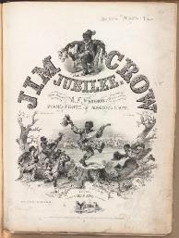
Segregation & The Rise of Jim Crow
Effects of Redeemer Governments
  Democrats who came to power in the South after Reconstruction – redeemers – supported by businesses and white supremacists
Discrimination and the Supreme Court
  Civil Rights Cases (1883)
    Congress couldn’t regulate intrastate and private commerce including issues with discrimination
  Plessy v. Ferguson (1896)
    “Separate but equal”
    Led to rise of “Jim Crow” laws
Loss of Civil Rights
  Demise of black voter registration
    Literacy tests, poll taxes, and grandfather clauses
  Vigilante “justice”
    Lynching
Response to Segregation
  International Migration Society – help with emigration from Africa
  Pap Singleton’s “Exodusters” – when African Americans moved to Kansas and Oklahoma
    Ida B. Wells
    Booker T. Washington
      Tuskegee, Negro Business League
      Up From Slavery
    W.E.B. DuBois
      NAACP
      “Talented Tenth”
      Souls of Black Folk
Notes:
http://commons.wikimedia.org/wiki/File:Jim_Crow_Jubilee_(Boston_Public_Library).jpg

Slide 12
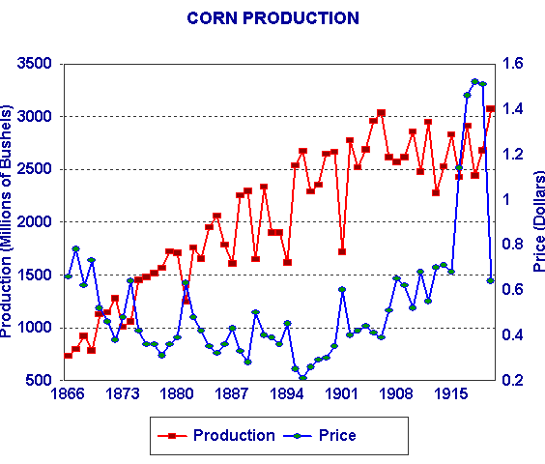
Farm Problems: North, South, and West
Changes in Agriculture
  Industrialization enters into the fields
Falling Prices
  Competition from abroad
  Impact on loans & mortgages
Rising Costs
  Costs associated w/selling, buying equipment, and taxes
Notes:
http://voteview.com/rtopic2.htm

Slide 13
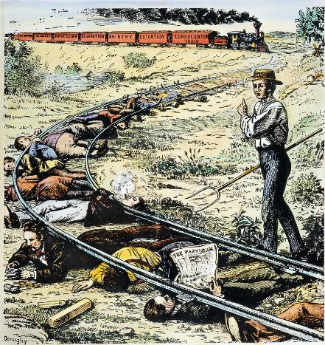
Fighting Back
National Grange Movement
  Patrons of Husbandry (Oliver Kelley, 1868)
  Formation of farmer’s cooperatives
  Push for “Granger Laws”
    Target railroads
Interstate Commerce Act (1886)
  Effect of Wabash case
    Overturned Munn v. Illinois (1877) -- States can’t regulate railroads (interstate)
  Creation of the ICC
Growth of Farmers’ Alliances
  Over 1 million members in regional alliances by 1890
  Ocala Platform (1890)
    Tenets:
      Direct election of Senators, lower tariff rates, graduated income tax, federal banking system
    Would later become part of the Omaha Platform & the Populist movement
Notes:
http://fineartamerica.com/featured/granger-movement-granger.html

Slide 14
Short Answer Review
The farmers of the United States are up in arms. They are the bone and sinew of the nation; they produce the largest share of its wealth; but they are getting, they say, the smallest share for themselves. The American farmer is steadily losing ground. His burdens are heavier every year and his gains are more meager; he is beginning to fear that he may be sinking into a servile condition. He has waited long for the redress of his grievances; he purposes to wait no longer”
Washington Gladden, minister, Forum, November, 1890
Briefly explain an event from the Gilded Age that supports that the farmers were “up in arms.”
Briefly explain what evidence would support the statement about farmers in this era that “His burdens are heavier every year and his gains are more meager.”
Explain what the writer most likely had in mind when he states, “he is beginning to fear that he may be sinking into a servile condition.”
Notes:
Additional Docs: http://www.gilderlehrman.org/history-by-era/populism-and-agrarian-discontent/resources/farmers-revolt

