Slide 1
Territorial and Economic Expansion
Western Expansion
1830-1860

Slide 2
Essential Question
Evaluate the extent to which western expansion contributed to maintaining continuity as well as fostered change with regard to growing sectional tensions between the North and South in United States from 1800 to 1850.

Slide 3
Image Analysis
Notes:
Image: http://www.webpages.uidaho.edu/~rfrey/images/422/gast-hi-res.jpg
Analysis from Henretta, Chapter 13: http://bcs.bedfordstmartins.com/WebPub/history/henrettaAH6e/Instructor%20Resources/Instructors%20Manual/IRM%20%20Ch.%2013%20(189-202).pdf
-- John Gast’s 1872 “American Progress” -- Ask students to explain/identify what they see. The painting has three horizontal planes - foreground, middle ground, and background - and each tells a separate story. Foreground: Pioneers and miners chasing Indians away to create trails. Middle ground: Lady Liberty (Columbia) leads the way to progress (schoolbook and telegraph wire) while the Indians flee from trains. Background: Steamships, railroads, and conestoga wagons; note: “Overland Mail” stagecoach and Pony Express Rider. The painting is also divided into two vertical planes: The brighter and developed East and the darker, undeveloped West (Notice the change as Columbia passes). Other distinctive features: Pacific Ocean in West and New York City with Brooklyn Bridge -- which was not yet complete at the time of the painting -- in the East.

Slide 4
War for Texas Independence
1823 Mexican Independence from Spain
Recruitment of Americans
Stephen Austin begins migration to “Texas”
Requirements:
No slavery
Convert to Catholicism
*ineffective
Whites and slaves outnumber Mexicans
Revolt and Independence
Santa Ana installs military dictatorship in Mexico (1834)
Sam Houston Declares the Lone-Star Republic (1836)
Santa Ana does not recognize the independence
War
Annexation?
Tyler vs. the Senate (1844) – denied in Senate
Notes:
Image: http://www.texashistorypage.com/Origin_of_the_Lone_Star_Flag.html

Slide 5
Boundary Dispute in Maine
Maine vs. New Brunswick
Aroostook War (1838-39) – “battle of the maps”
Canadian vs. American Lumberjacks
Poor relationship with British
Webster-Ashburton Treaty of 1842
Settled boundary of the Minnesota territory – iron rich Mesabi range on the US side
Notes:
Image: http://www.u-s-history.com/pages/h297.html

Slide 6
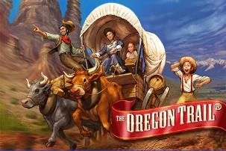
Overland Trails
Oregon Trail
Mormon Trail
Santa Fe Trail
California Trail
Notes:
Map and link to interactive map: http://www.the-map-as-history.com/demos/tome07/02d-westward_trails-oregon_demo.php
Image: http://www.gamingbus.com/2011/05/20/zynga-sued-over-oregon-trail-trademark/

Slide 7
Boundary Dispute in Oregon
England vs. the United States
British Claims: Hudson Fur Company
American Claims: Robert Gray (1792) → Lewis & Clark (1805) → Astor’s fur trade post (1811)
Missionaries and Farmers of the 1840’s (the Whitmans)
“Oregon Fever”
Notes:
Image: http://en.wikipedia.org/wiki/Oregon_boundary_dispute#mediaviewer/File:Oregoncountry.png

Slide 8
Polk the Expansionist
Election of 1844
Issues:
Texas Annexation
Oregon Dispute
Slavery in new territories
Polk vs. Clay
“Fifty-four forty or fight”
Notes:
Image: http://upload.wikimedia.org/wikipedia/commons/9/9d/1844_Electoral_Map.png

Slide 9
Fates of Texas and Oregon
Lame-duck Tyler annexes Texas
Joint resolution passed in both houses (51%)
Polk left to deal w/fallout
Polk Compromises on Oregon w/Britain (1846)
Extend 49th Parallel
Notes:
Image: http://www.ohwy.com/history%20pictures/maps/texan-independence.jpg

Slide 10
Mexican-American War
Border dispute: Nueces vs. Rio Grande
Polk sends Slidell
Buy California & New Mexico - $25 million
Settle disputed border
Causes of War
Zachary Taylor’s army attacked in “no man’s land.”
11 killed
War approved
Military Campaigns
Kearney in NM and CA
Fremont in Northern CA (sympathetic Vallejo – 1846)
The “Hero of Buena Vista,” Taylor (1847)
Scott from Vera Cruz to Mexico City (1847)
Notes:
Image: http://www.robinsonlibrary.com/america/unitedstates/1783/1846/graphics/battles.gif

Slide 11
Consequences of the War
Treaty of Guadelupe-Hidalgo (1848)
Mexico recognizes Rio Grande as southern border of Texas
US takes CA & NM. US pays $15 million to settle American claims against Mexico.
Ramifications for Slavery
Wilmot Proviso – forbid slavery in all new territories; failed in Senate
Increased Tension: N vs. S
Notes:
Image: http://mrriveraushistory.blogspot.com/2014/02/2414-treaty-of-guadalupe-hidalgo.html

Slide 12
Expansion & Continued Sectionalism
Regional Views of Manifest Destiny

Slide 13
Manifest Destiny to the South
Foundations of Southern Views:
Dissatisfaction w/territorial gains from the Mexican War (not enough)
Desire to Expand Further
Attempts at Expansion:
Ostend Manifesto (1852)
Offered $100 million to purchase Cuba
Pierce sends diplomats to Belgium for secret deal– leaked
Clayton-Bulwer Treaty (1850) – canal through Central America on hold
Gadsden Purchase (1853) – New Mexico & Arizona - $10 million
Notes:
Image: http://explorepahistory.com/displayimage.php?imgId=1-2-1AE4

Slide 14
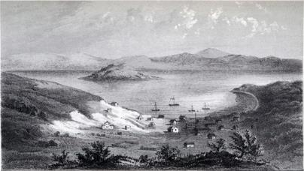
The Western Frontier
California Gold Rush (1848-50)
1848 population = 14,000
1860 population = 380,000
Chinese immigration expands
Farming Frontier
Availability of Cheap Land
Preemption Acts (1830’s) – squatters then purchase for cheap
Urban Frontier
Impact of the RR’s
San Francisco, Denver, Salt Lake City
Notes:
Image 1 (San Francisco before the Gold Rush, 1848): http://upload.wikimedia.org/wikipedia/commons/4/46/SanFranciscoharbor1851c_sharp.jpg
Image 2 (San Francisco, 1851): http://upload.wikimedia.org/wikipedia/commons/4/46/SanFranciscoharbor1851c_sharp.jpg
Suggested clip: Ken Burns’ The West – Emporium of the Pacific

Slide 15
The Expanding Economy
Impact of Industrialization
Factories & mills spread
New technologies
Sewing Machine (Howe)
Telegraph (Morse – 1844)
Expansion of Railroads
Privately owned, financed by merchants, farmers, and state governments
US Land Grant to Illinois Central (1850)
United Commercial Interests from East → West & North → South
Expansion of Foreign Commerce
Regularly Scheduled shipping
Boom in whaling
Improvements in steam ships
Opening of Asian markets –Perry Opens Japan (1854)
Notes:
Image: http://upload.wikimedia.org/wikipedia/commons/thumb/c/c9/Chicago_Central_and_Illinois_Central_route_map_1996.png/300px-Chicago_Central_and_Illinois_Central_route_map_1996.png

Slide 16
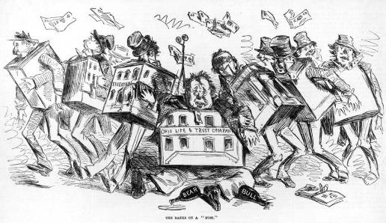
Impact of Expansion
Sectionalism Intensifies
Socially:
Expansion of Slavery vs. Abolitionist Movement
Politically:
State vs. Federal Power
Territories: Free vs. Slave
Economically:
Industry vs. Agriculture
Population Shifts & Growth
Overland Trails and Expansion
Panic of 1857
Inflation as result of CA gold
Western speculation
Drop in value of farm goods (Crimean War)
5,000 businesses fail
South not as affected (Southern views of Northern industry – “King Cotton”)
Notes:
Image: http://urbanfarmcollective.com/uncategorized/the-food-bubble-how-wall-street-starved-millions-and-got-away-with-it/

