Slide 1
Promise and Turmoil
The 1960’s

Slide 2
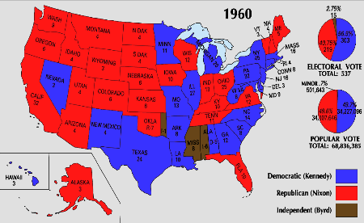
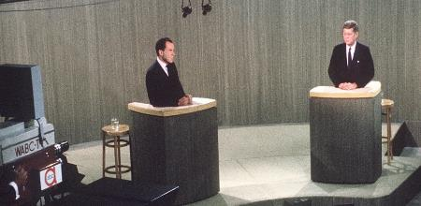
John F. Kennedy’s New Frontier
The Election of 1960
Nixon
Quaker, from CA
Kennedy
Catholic, from MA
Campaign
First Televised Debates
Results
Kennedy wins popular by just over 100,000
303 to 219
Notes:
Debate: http://www.history.com/topics/us-presidents/kennedy-nixon-debates
Map: http://kc-johnson.com/history-3442-the-1960-election/

Slide 3
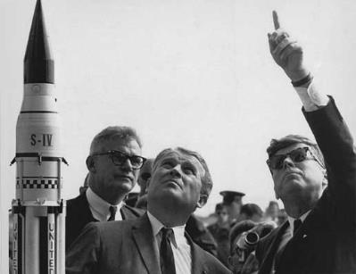
Domestic Policy
A New Frontier
Federal Aid for:
Education, health care, urban renewal, civil rights
Not a lot of support from Congress
Economics:
Tax cuts, defense and space spending
Moon Speech – end of the decade US would make landing
Notes:
New Frontier Speech: http://infinite-frontier.blogspot.com/2009/02/kennedys-new-frontier-speech.html

Slide 4
Foreign Policy
Latin America
Peace Corps (1961)- aid to developing countries
Alliance for Progress (1961) – land reform and economic development in Latin America.
Bay of Pigs Invasion –use of Cuban exiles to overthrow Fidel Castro w/CIA
Exiles forced to surrender because Kennedy would not send troops
Strengthened Cuba with more aid from Soviet Union
Soviet Union
Kennedy and Khrushchev meet 1961 – demands US pull out of Berlin, Kennedy refuses
Berlin Wall
“Ich bin ein Berliner” – “ Freedom has many difficulties and democracy is not perfect, but we have never had to put up a wall to keep our people in… As a free man, I take pride in the words – “I am a Berliner”
Torn down in 1989 by rebellious East Germans
Cuban Missile Crisis (1962) -Russians were building underground sites in Cuba for launching missiles that could reach the US in minutes
Naval blockade of Cuba until weapons were removed; will remove if no further invasion of Cuba and to later remove U.S. missiles from Turkey
Flexible Response – increased spending on nonnuclear arms and mobile military forces instead of nuclear
Notes:
Bay of Pigs: http://mrortlieb.weebly.com/cold-war-in-the-1960s.html
Berliner Speech: http://en.wikipedia.org/wiki/Ich_bin_ein_Berliner
Berliner – Play on “jelly doughnut” translation

Slide 5
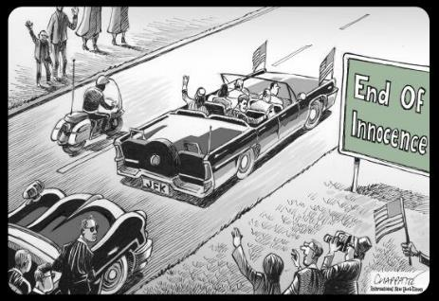
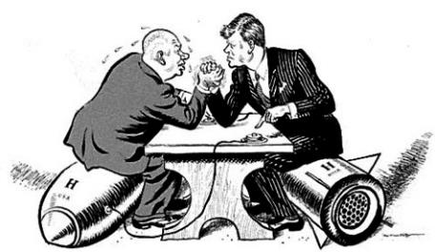
Kennedy Legacy
Assassination in Dallas (November 22, 1963)
Warren Commission – Lee Harvey Oswald
In Retrospect
“Ask not what your country can do, but what you can do for your country”
Foundations for Civil Rights
Notes:
Cuban Missile Crisis: http://teachinghistory.org/nhec-blog/23484

Slide 6
Key Questions
What was the role of the U.S. in Latin America during the Cold War? (Cuban Missile Crisis, Bay of Pigs)
What objectives guided the U.S. foreign policy in the so-called Third World during the Cold War?
Notes:
Cuban Missile Crisis: http://teachinghistory.org/nhec-blog/23484

Slide 7
Lyndon Johnson’s Great Society
The “Zenith” of Liberalism*
* From the AP Framework – don’t shoot the messenger
Notes:
Commentary on new standards—include discussion of use of “zenith”: http://www.burtfolsom.com/?p=2901

Slide 8
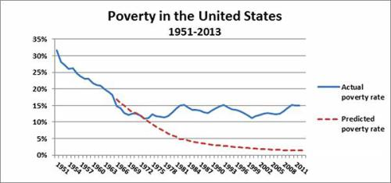
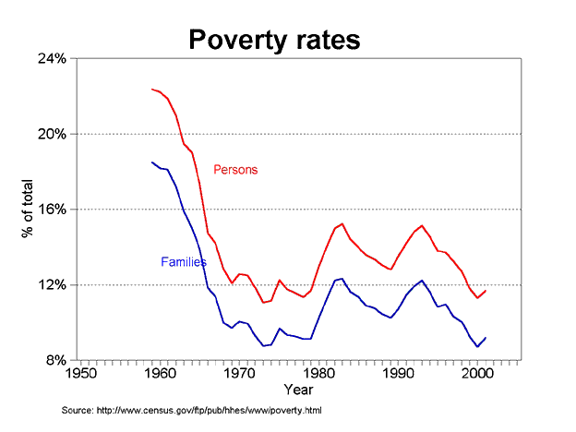
Essential Question
To what extent were efforts to use federal power to end racial discrimination, eliminate poverty, and address other social issues while attacking communism abroad, effective?
Notes:
How to use statistics-
Graph 1: http://www.americanhistoryusa.com/5-liberal-falsehoods-of-american-history/
Graph 2: https://thedrpete.wordpress.com/tag/great-society/

Slide 9
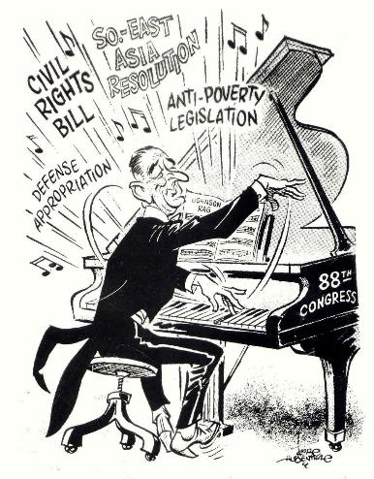
LBJ – Great Society
Texas Democrat
Goal: expand reforms of New Deal
First Actions:
Expand:
Kennedy’s Civil Rights Bill
Income Tax cut – increase in jobs, consumer spending, economic expansion.
Notes:
Cartoon: http://www.glogster.com/hannahray15/apush-johnson-s-great-society/g-6ksmfcl0nh2289d783g7ga0

Slide 10
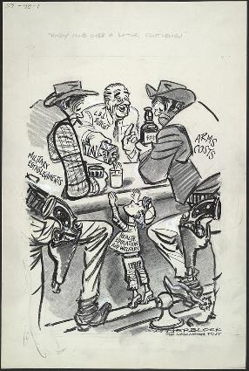
War on Poverty
The Other America (Harrington, 1962)
40 million still living in poverty
Response: Unconditional war on poverty
Office of Economic Opportunity (1964)
Head Start, Job Corps – vocational ed, literacy programs and legal services
Costs:
Social/welfare programs – reduced number of American families living in poverty
Vietnam…will force cut backs in this area.
Notes:
Criticism: http://vicepresidents.com/blog/2012/10/10/historic-lyndon-b-johnson-political-cartoon/

Slide 11
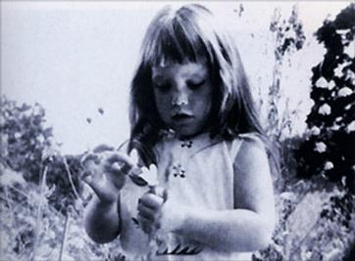
Election of 1964
Johnson vs. Goldwater
Expansion vs. Ending Welfare State
Impact of Campaign Ads
Results:
Johnson: 61% of pop.
Democratic sweep of Congress (filibuster-proof Senate) – in a position to pass economic and social reforms originally proposed by Truman in the 1940s
Notes:
Daisy Girl Image: http://theinspirationroom.com/daily/2008/lyndon-johnson-picks-a-daisy/
Link to Campaign Ad: http://www.livingroomcandidate.org/commercials/1964/peace-little-girl-daisy#3983

Slide 12
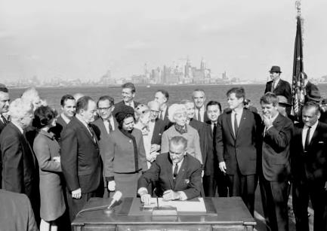
Great Society Reforms
Welfare
Food Stamp Act (1964)
Medicare & Medicaid (1965)
Child Nutrition Act (1966)
Other Programs
ESEA (1965)
Immigration Act (1965) – abolished quotas
Expanding Government
DOT
HUD
Notes:
Johnson Signs Immigration Act of 1965 on Ellis Island: http://immigrationinamerica.org/594-immigration-and-nationality-act-of-1965.html
Note Humphrey (L) and Edward and Robert Keenedy (R)

Slide 13
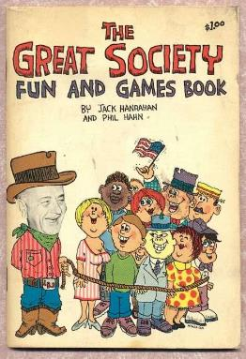
Evaluating the Great Society
Liberal Perspective
Foundation of welfare
Addressed needs of previously ignored groups:
Poor, disabled, elderly
Conservative Perspective
“tax and spend”
Birth of modern welfare state
Overexpansion of government
Notes:
Image: http://tomatobubble.com/id378.html

Slide 14
Key Questions of LBJ’s legacy
How did LBJ’s Great Society express his liberal ideas?
Evaluate the impact of federal legislation designed to address social and economic inequality
Evaluate the response of Conservative critics of the Great Society
What new roles did the federal government assume under the Great Society initiatives, and how did they extend the New Deal?
Notes:
Image: http://tomatobubble.com/id378.html

Slide 15
Civil Rights and Conflict
The Movement Expands

Slide 16
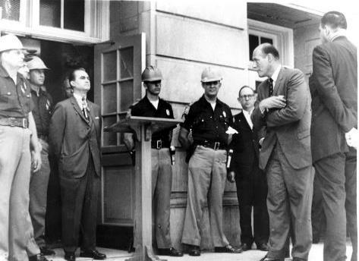
Events
De Jure vs. De Facto Segregation
Alabama & Mississippi
State vs. Federal Government
James Meredith & Ole Miss (1962)
George Wallace & University of Alabama (1963)
Notes:
Wallace @ Alabama: http://www.alabamacivilrights.ua.edu/tuscaloosa/album.html

Slide 17
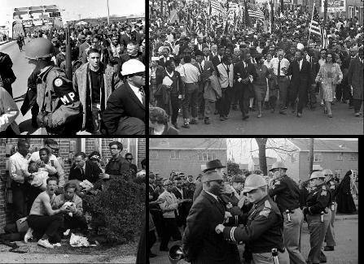
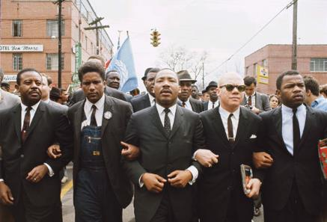
The Leadership of MLK Jr.
Letters from a Birmingham Jail (1963) – movement to support tougher civil rights laws
March on Washington (1963)
200,000 blacks and whites
“I Have a Dream” – end racial prejudice
March to Montgomery (1965)
Selma & “Bloody Sunday” – Voting Rights Act of 1965
Notes:
Image 1, Selma: http://www.history.com/photos/martin-luther-king-jr/photo8
Image 2, Bloody Sunday: https://www.remember.com/memories/selma-to-montgomery-march-(bloody-sunday-1965)/10002841

Slide 18
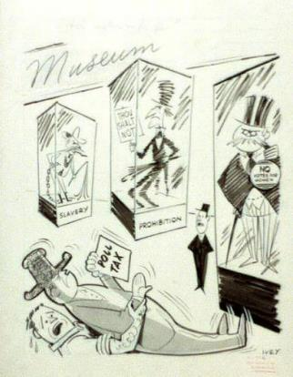
Legislation
Civil Rights Act of 1964
Segregation illegal in public facilities
Equal Employment Opportunity Commission
No discrimination based on:
Race, religion, sex, or national origin
24th Amendment (1964)
Abolish poll tax
Voting Rights Act of 1965
Banned literacy tests
Federal marshalls enforce voting rights
Notes:
Cartoon: http://www.americaslibrary.gov/jb/modern/jb_modern_polltax_1_e.html

Slide 19
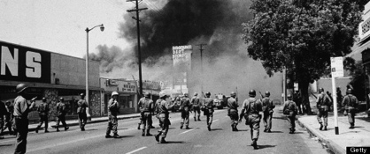
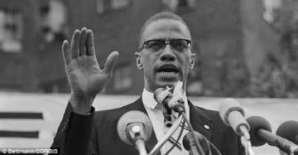
Radical Movement
Black Muslims and the Nation of Islam
Elijah Muhammad
Nationalism, separatism & self-improvement
Malcolm X
Use of black violence to counter white violence
Assassinated in 1965
Race Riots and Black Power
SNCC & CORE
Stokely Carmichael – advocated “black power” and racial separatism
Black Panthers
Huey Newton – various violent activities
Watts Riots (1965) – 6 day riot after arrest of a young black motorist, 34 killed, 700 buildings destroyed
Notes:
Malcolm X: http://www.dailymail.co.uk/news/article-2329045/Malcolm-Xs-grandson-Malcolm-Shabazz-buried-NY-cemetery.html
Watts Riots: http://www.huffingtonpost.com/2013/06/23/rena-price-dead-woman-whose-arrest-triggers-watts-riots_n_3486647.html

Slide 20
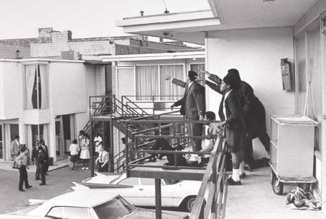
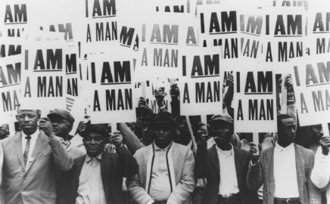
Murder in Memphis
King receives Nobel Prize (1964)
Nonviolence comes under fire
Lorraine Motel (April 4, 1968) – assassination of MLK, Jr.
Ensuing Violence and Riots – 168 cities riot, 46 died
Notes:
Memphis Strike: http://www.lawyersgunsmoneyblog.com/2012/04/this-day-in-labor-history-april-4-1968
Lorraine Motel: http://midliferoadtrip.tv/the-national-civil-rights-museum/

Slide 21
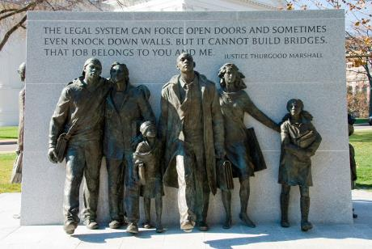
Impact of Civil Rights Movement
Achieved Federal Legislation
Racism Continues
w/King’s Death, Movement becomes more radical/violent and begins to lose support
Movement Became model for other social movements:
Combatting Social Injustice
Student Movements of the Vietnam-Era
Notes:
Virginia Civil Rights Memorial: http://www.virginiamemory.com/online_classroom/shaping_the_constitution/doc/virginia_civil_rights_memorial

Slide 22
Key Questions of Civil Rights
Understand the impact WW2 had on the growth of the civil rights movement.
How did the growth of the black middle class assist the civil rights movement?
Explain the origins of civil rights groups that support immigrant groups
Describe the role the Supreme Court had in supporting greater racial equality in the U.S.
Compare the methods and goals of civil rights leaders in the 1950’s
Compare the impact of the Civil Rights Act of 1964 and the Voting Rights Act of 1965
Explain the divergent views of the civil rights movement that emerged after 1965
Notes:
Image: http://tomatobubble.com/id378.html

Slide 23
Social, Cultural, and Political Unrest
The Changing Roles and Views of American Government and Society During the 1960’s

Slide 24
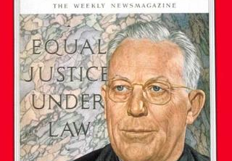
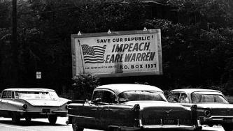
The Warren Court
Focus on Individual Rights
Criminal Justice
Mapp v. Ohio (1961) – illegally seized evidence
Gideon v. Wainwright (1963) – counsel provided for indigents
Escobedo v. Illinois (1964) – inform person of arrest
Miranda v. Arizona (1966) – right to lawyer being present
Freedom of Expression & Privacy
Yates (1957) & Brandenburg (1969) – radical speeches protected by 1st amendment – unless clear and present danger
Engel v. Vitale (1962) – no prayer, bible reading in public schools
Griswold v. Connecticut (1965) – state could not prohibit the use of contraceptives by adults
Notes:
Time Magazine Cover, 1953: http://content.time.com/time/covers/0,16641,19531221,00.html
Billboard: http://www.latimes.com/news/mlk_j69oh8nc-photo.html

Slide 25
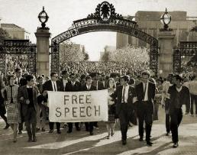
The Student Protest Movement
Students for a Democratic Society & The Port Huron Statement (1962)
Tom Hayden
Call for universities to make decisions through participatory democracy – students wanted a voicec
The “New Left” – those who supported these ideas
Free Speech Movement
Berkeley, CA (1964) – demand an end to the university restrictions on student political activities
Drinking on campus
Dorm visits by opp sex
The Vietnam War and the Teach-in Movement – hundreds of campuses shut down or disrupted by antiwar protests
Notes:
Free Speech Movement, Savio, and Berkeley: http://www.lib.berkeley.edu/MRC/FSM/fsmchronology1.html

Slide 26
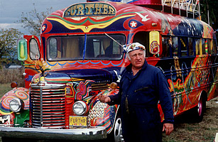
The Counterculture
Art
Pop Art & Op Art
Andy Warhol
Music
Woodstock & Altamont
Joan Baez, Bob Dylan, Janis Joplin
Hallucinogenic Drugs
LSD
Sexual Revolution
Notes:
Warhol: http://artasiapacific.com/Magazine/82/TheLittleCanThatCould
Ken Kesey: http://content.time.com/time/specials/packages/article/0,28804,2088972_2088978_2088962,00.html

Slide 27
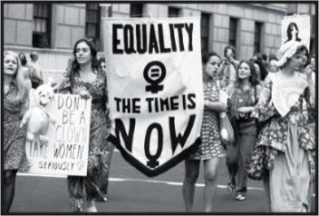
The Women’s Movement
The Feminine Mystique (Friedan, 1963) – encouraged women to seek full time professional careers as well as fulfilling housewife roles
NOW (1966) – National Organization for Women
Campaign for Equal Rights Amendment
Passage, not ratification (1972)
Fear of threatening the traditional roles of women.
“Glass-ceiling” – barrier to advancement in the working world, by women
Notes:
NOW: https://sites.google.com/a/peddie.org/60s-e-period-2012/fighting-for-our-rights/the-women-s-rights-movement

Slide 28
Key Questions of unrest
How did the Kinsey report trigger early challenges to traditional views on moral issues?
Identify the causes and explain the impact of the resurgence of feminism in the 1950’s (Freidan’s Feminine Mystique)
Recognize the ways that artists, intellectuals and teenagers rejected conformity in American culture.
Notes:
Image: http://tomatobubble.com/id378.html

Slide 29
The Conflict in Vietnam
US Involvement in Indochina to 1969

Slide 30
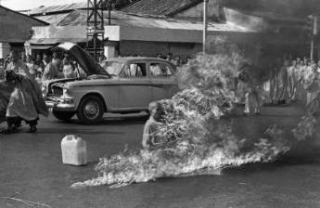
Early Stages
Buildup Under Kennedy
Adopted domino theory
Increased number of military “advisors” who trained South Vietnamese army and guarded weapons and facilities
“Strategic Hamlets” – fortified villages
Overthrow of Diem due to little support by the people
Gulf of Tonkin Resolution (1964)
“all necessary measures” to protect US interests in Vietnam
Basically a declaration of war but by the President not Congress
DILEMMA of LBJ – How can he stop the defeat of weak and unpopular government in South Vietnam without making it an American war?
Notes:
Self-immolation in protest to Diem’s gov’t: http://en.wikipedia.org/wiki/Th%C3%ADch_Quảng_Đức

Slide 31
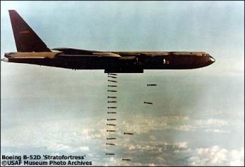
Escalating the War
Operation Rolling Thunder (1965)
NVA & Vietcong
540,000 troops by 1969
William Westmoreland
Chemical Warfare
Napalm & Agent Orange – herbicides used to get rid of jungles and forests to be able to fight
Controversy
Hawks (support) vs. Doves (civil war)
Dean Rusk & Robert McNamara
Impact of Student Protest Movement
Rise of Eugene McCarthy – Minnesota – antiwar advocate who challenged LBJ in the 1968 election
Notes:
Operation Rolling Thunder: http://vietnamwarproject1961-1969.wikispaces.com/Operation+Rolling+Thunder

Slide 32
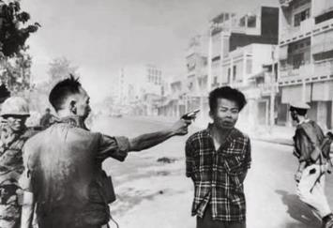
1968
Tet Offensive (January)
Vietcong – surprise attack on every capital and American base in SV
US counterattacked and recovered lost territory
Americans saw it as a setback
Political victory in demoralizing the American public
De-escalation & Attempts at Peace in Vietnam – limit bombing of North Vietnam and negotiate peace – would not run for re-election
MLK (April) and RFK’s (June) Assassinations
Prague Spring (August) – freedom in Czechoslovakia until Soviet forces stepped in
Notes:
Kronkite’s Stalemate Speech: https://facultystaff.richmond.edu/~ebolt/history398/cronkite_1968.html
Execution of Vietcong Guerilla: http://www.worldsfamousphotos.com/2007/03/18/execution-of-a-viet-cong-guerrilla-1968/

Slide 33
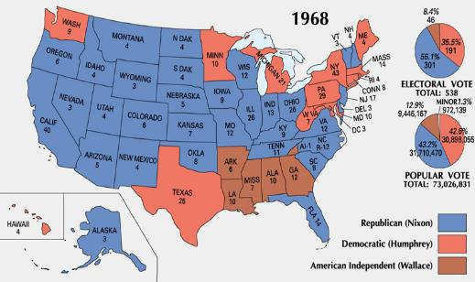
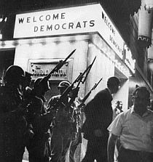
Election of 1968
Democratic Convention in Chicago
Richard Daley
Rioting
Dems choose Humphrey (pro-Civil Rights, pro-War)
White Backlash & George Wallace
American Independent Party (AIP)
Republicans
Richard Nixon & Spiro T. Agnew
Results:
Conservative backlash
Nixon 301 to 191
Notes:
National Convention: http://www.pophistorydig.com/topics/1968-presidential-racedemocrats/

Slide 34
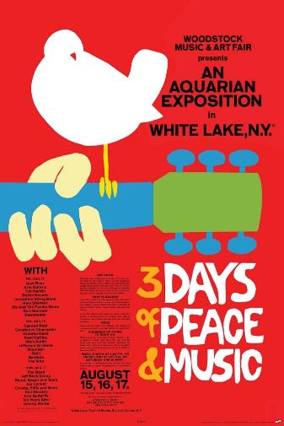
Legacy of the 1960’s
Reaction to 1950’s
Liberal movements
Counterculture
Expansion of Civil Rights
Growth of Government
Welfare
Defense/Military
Notes:
Woodstock Poster: http://ecx.images-amazon.com/images/I/81ryzsl8ssL._SL1500_.jpg

Slide 35
Key Questions of Vietnam
Explain the role of Vietnam War in the expanding power of the President
How did American reactions change over time with regard to Vietnam
How did the counterculture challenge American culture in the 1960’s
Notes:
Image: http://tomatobubble.com/id378.html

