Slide 2


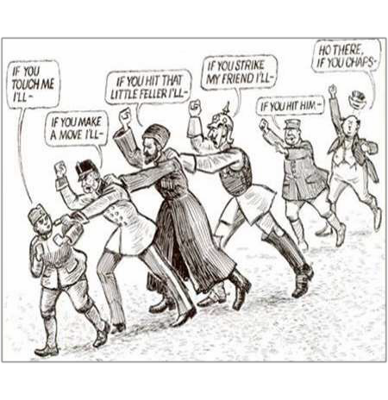
Timeline of Immediate Causes
1941
Sarajevo, June 28: Gavrilo Princip assassinates Austrian Archduke Ferdinand
Vienna, July 23: Austria issue ultimatum to Serbia and invades (26th)
St. Petersburg, July 31: Russia mobilizes against Austria
Berlin, August 1: Germany declares
war on Russia
Berlin, August 3: Germany declares war on France and invades Belgium
London, August 4: Great Britain declares war on Germany

Slide 3


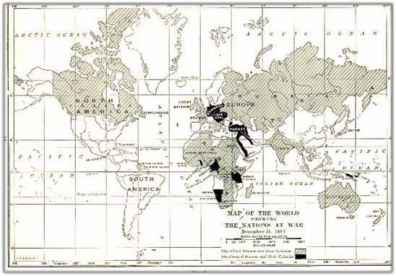





Underlying Causes of WWI
Militarism
Alliances
Nationalism
Imperialism
Assassination

Slide 4

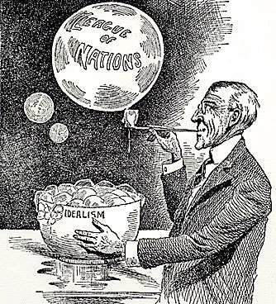
Essential Questions
Assess the relative influence of the following in the American decision to declare war on Germany in 1917.
German naval policy
American economic interests
Woodrow Wilson’s idealism
Allied propaganda
America’s claim to world power
What were the effects of the Great War on United States’ foreign and domestic policies?

Slide 5

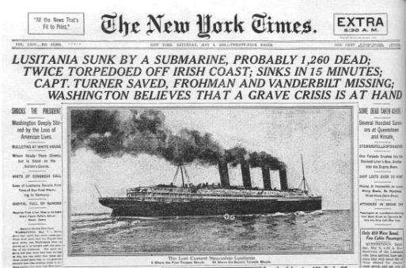
US Foreign Policy
Progression
Neutrality → war for peace →  victorious world power → alienated & isolated
Factors Testing Neutrality
  Submarine Warfare
Lusitania
Arabic and Sussex
Economic Ties
Great Britain and France
Germany
Public Opinion
Ethnic Influences – supported neutrality, support of homeland though
British War Propaganda
  Cutting of the transatlantic cable

Slide 6
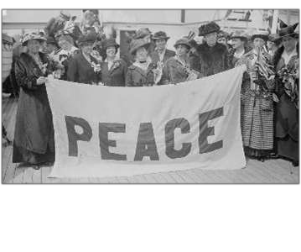


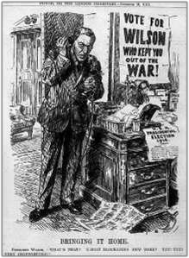
The War Debate
Pro-War vs. Pacifist
Preparedness
  National Defense Act (June, 1916) – increase in the size of the military
  Construction of 50 New Warships
Opposition to War until 1917
  Populists, Progressives, and Socialists
    W.J. Bryan, Jane Addams, Jeannette Rankin
Election of 1916
  Wilson “Kept us out of war.”
  Wilson vs. Hughes
Peace Efforts
  Attempts at mediation rebuffed
  January, 1917: “peace without victory”

Slide 7


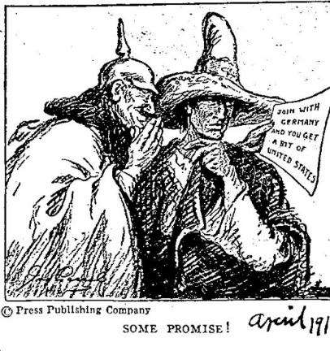
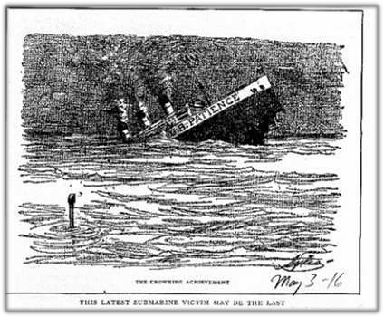
Decision for War
Unrestricted Submarine Warfare
  German announcement (January 31, 1917)
  U.S. breaks diplomatic ties
Immediate Causes
  Zimmerman Telegram (March 1, 1917)
  Russian Revolution (March 15) – republic
  Renewed Submarine Attacks
Unarmed American merchant vessels sunk
Declaration of War
  April 2, 1917
“Warfare against mankind”
“World must be made safe for democracy”

Slide 8



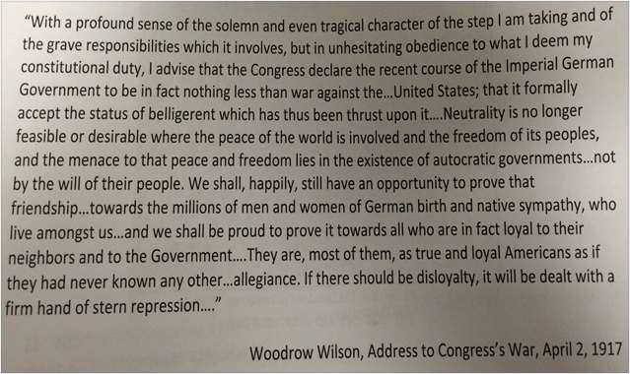
Declaration of War

Slide 9

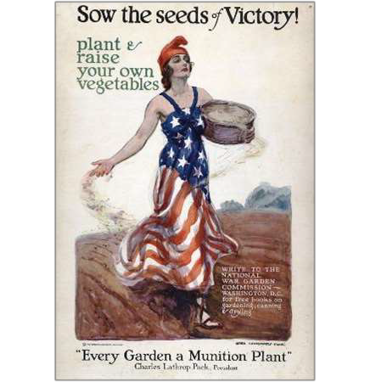
Mobilization
Industry and Labor
  War Industries Board (Bernard Baruch) – control over raw materials and prices
  Food Administration (Herbert Hoover)
    Conservation and “Liberty Gardens”
  Fuel Administration (Harry Garfield) – save coal, daylight savings kicks in, nonessential factories closed
  Railroad Administration (William McAdoo)
    Esch-Cummings Act – public control of railroads to coordinate traffic and promoted standardized railroad equipment
  National War Labor Board (Taft) – wages up, 8 our day, increase in union membership
Finance
  Increased income and corporate taxes, excise tax on luxuries, and loans: Liberty Bonds

Slide 10

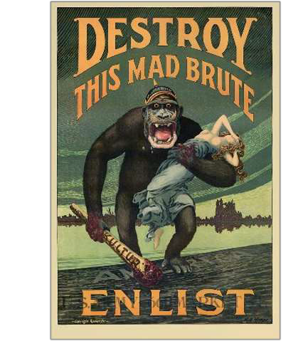
Public Opinion and Civil Liberties
Propaganda
  Creel Committee (CPI) – Committee of Public Information
  American Protective League
    “Hate the Hun”
      Ban on all things German and/or substitute names: “liberty: cabbage, measles, hound”
Espionage and Sedition Acts
  Target: subversives and “disloyals”
    Socialists, anarchists, southern and eastern Europeans.
  Schenck v. United States (1919)
    “Clear and present danger” (Holmes)
    In response to Red Scare

Slide 11

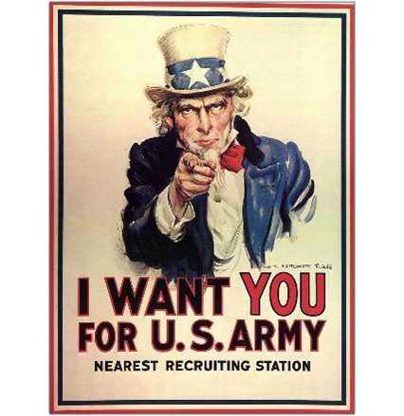
Training for War
Selective Service Act (1917)
  All men 21-30
  9.5 million registered
  2.8 million drafted
  2 million volunteers
African Americans
  400,000 served
  Segregated units
  Few saw combat
    369th Regiment crossed to French lines & even received the Croix de Guerre

Slide 12

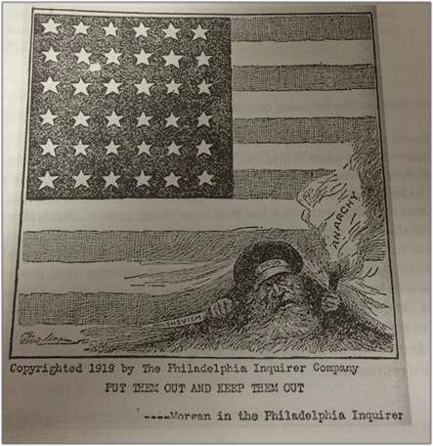
Effects on
American Society
Economic
  Full Employment
  Cooperation of Labor Unions
  Government Subsidies
Social
  Women
    More jobs available
    Efforts toward war: industry, war bond
effort
    Contributions eventually lead to ratification of the 19th Amendment
  Migration of Mexicans and African Americans
    “Great Migration”
  Nativism

Slide 13

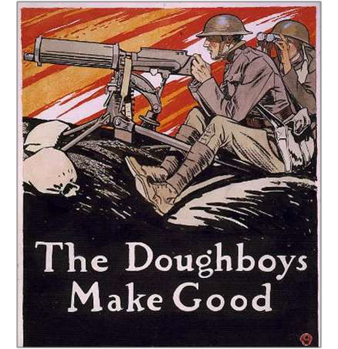
Fighting the War
Trench Warfare
  Two-front war
New Technology
  Machine guns, hand grenades, chemical warfare (mustard and chlorine gas)
Naval Operations
  Convoy system to break blockade
American Expeditionary Force
  John J. Pershing – Western Front
Armistice (November 11, 1918)
Results:
US Deaths: 112,432 (49,000 combat-related)
  Impact of Spanish Influenza

Slide 14

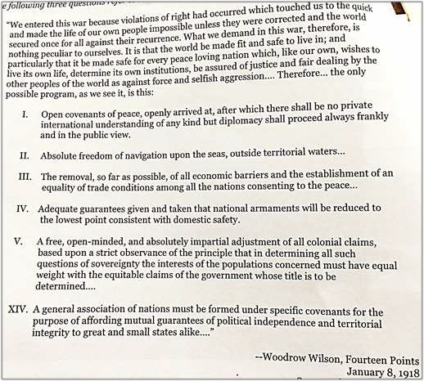
Making the Peace
Wilson’ Fourteen Points
  Recognition of freedom of the seas
  End to secret alliances
  Reduction of national armaments
  An impartial adjustment of all colonial claims
  Self-determination for the various nationalities
  Removal of trade barriers
  A “general association of nations…”
The Treaty of Versailles
  The “Big Four”
  Germany disarmed and stripped of colonies, accept French occupation of Rhineland, pay billions in reparations to Britain and France
  Central powers territories ceded and divided.
    Led to ethnic tensions
  Signers would join League of Nations under auspices of the controversial Article X

Slide 15

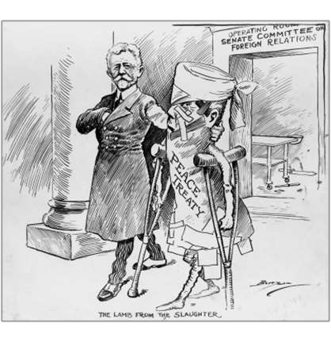
The Battle for Ratification
Increased Partisanship
  Republicans vs. Democrats
Opponents: Irreconcilables and
Reservationists
  Wilson vs. Lodge
Wilson’s Western Tour and Breakdown
Rejection of the Treaty
  Peace not officially made until 1921
  US never ratifies treaty nor joins League of Nations

Slide 16

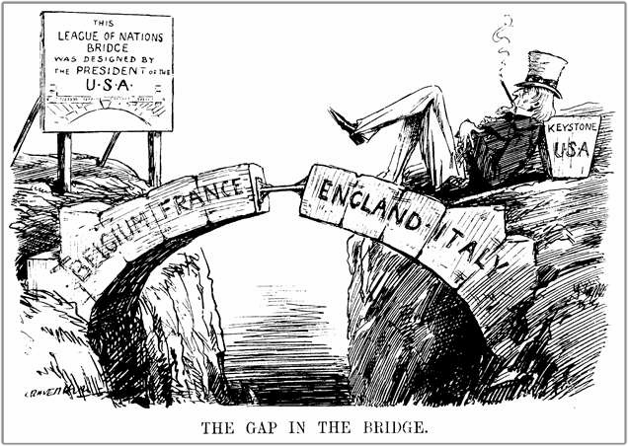
Image Analysis

Slide 17

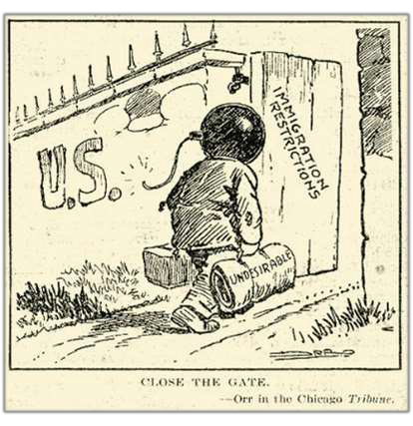
Postwar Problems
Demobilization
  Industry: convert to consumer goods
  Women and African Americans pushed out
of jobs
  Controls and subsidies removed: Boom →
Bust
  Farm prices fall
  10% unemployment
The Red Scare
  Impact of Bolshevik Revolution
  Palmer Raids
    Root out “subversives”
Labor Conflict
  Strikes of 1919
Race Riots
  St. Louis and Chicago

Slide 18

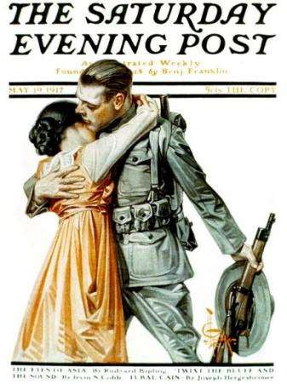
Legacy of World War I
Social:
  Temporary role changes for African Americans and Women
  Increased Nativism and Xenophobia: Red
Scare
Economic
  Temporary government controls of industry
and cooperation of labor and business
  Brief recession, followed by period of unprecedented growth
Political
  Ushered in age of lax government regulation
and interference in the economy
  Diplomatic: isolation coupled with disarmament policies and intervention in Latin America

