Slide 1

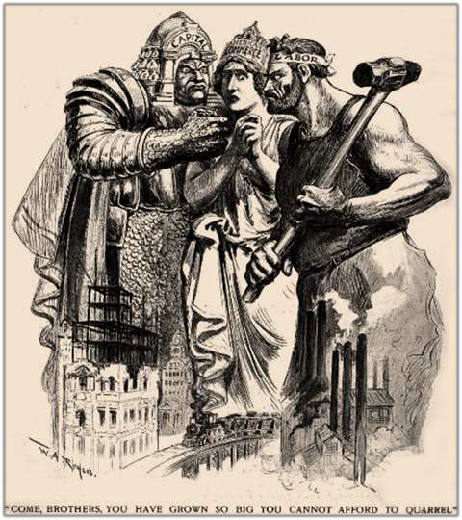






The Progressive Era
Political, Social, and Economic Reform
(1901-1917)

Slide 2



Essential Questions
How successful were progressive
reforms with respect to the following?
  Industrial conditions
  Urban life
  Politics
Evaluate the effectiveness of Progressive Era reformers and the federal government in bringing about reform at the national level. Analyze the successes and limitations of these efforts.

Slide 3




























 | POLITICAL
• | Expanded Suffrage
• | Decline of Political
 | Machines
• | Increased Party
 | Influence
• • • | SOCIAL Expanded Workers’ Rights Assimilation of Immigrants Civil Rights Movement
 | ECONOMIC
• | Conservation
• | Business Regulatio | n
• | Consumer Protecti | on
• | Reformed Banking
 | System

Slide 4

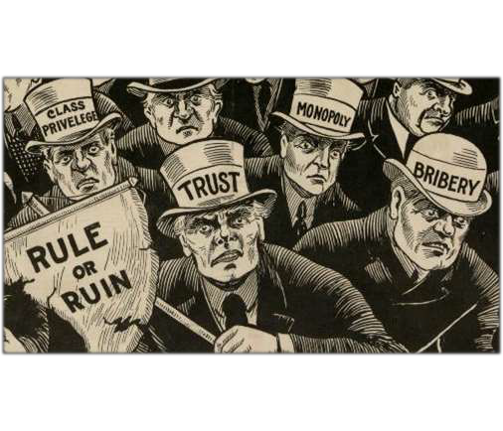










Origins of Progressivism
Political Movements:
  Greenback Labor Party,
Populists
Social & Economic Concerns
  Wealth Gap
  Working Conditions
  Immigration
Model of State Reforms

Slide 5

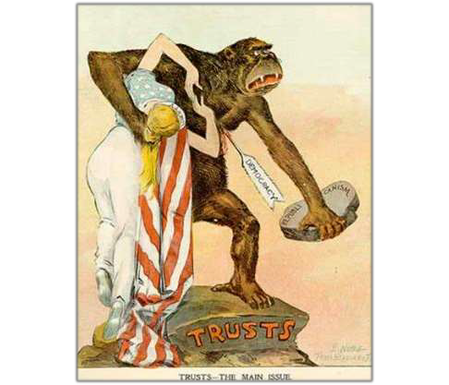
Attitudes and Motives
The Progressives
  Varied interests w/varied concerns
  Goal: correct social and economic
ills.
Rise of the Middle Class
  “Not a minority movement, rather a majority mood”
  Urban Middle Class
o Elemental to economic growth
  Professional Class
Religious
  Social Gospel Movement –Protestant churches preacher about creating a code of social responsibility of caring for less fortunate and honesty

Slide 6
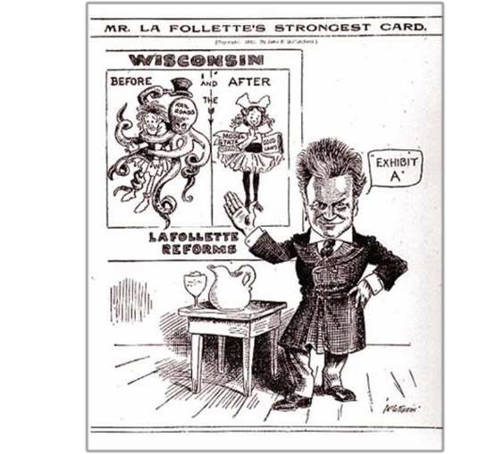

Manifestations
Leadership:
  Prominent Politicians
    Roosevelt, LaFollette, Bryan, and Wilson
Philosophy
  Democratic values, honest government, just laws
  Pragmatism:
Practical approach – experimentation w/laws
  test them in action until they find something that would produce a well-functioning democratic society
Scientific Management
o F.W. Taylor’s Principles of Scientific Management – use of a stopwatch to time the output of factory workers
- thought this should be applied to the government workers to increase efficiency and get rid of political bosses and corruption

Slide 7


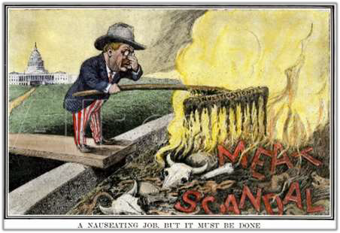
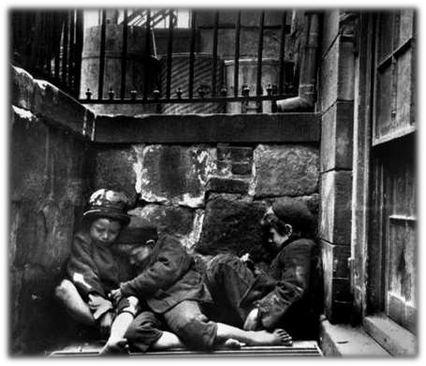
The Muckrakers
The Yellow-Press & Investigative Journalism
Origins
  Henry Lloyd’s Wealth Against Commonwealth
(1894) – fully exposed the corruption and greed of the oil monopoly – didn’t offer solutions
Magazines & Books
  McClure’s, Collier’s, Cosmopolitan
  Writers:
    Jacob Riis (How the Other Half Lives, 1890)
    Frank Norris (The Octopus, 1901)
    Ida Tarbell (History of Standard Oil, 1902)
    Lincoln Steffens (Shame of the Cities, 1904)
    David Phillips (Treason of the Senate, 1906)
    Upton Sinclair (The Jungle, 1906)

Slide 8

The commercial spirit is the spirit of profit, not patriotism; of credit, not honor; of individual gain, not
national prosperity; of trade and dickering, not principle. “My business is sacred,” says the business man in his heart. “Whatever prospers my business, is good; it must be. Whatever hinders it, is wrong; it must be. ...If our political leaders are to be always a lot of political merchants, they will supply any demand we may create. All we have to do is to establish a steady demand for good government.
Why? Because if the honest voter cared no more for his party than the politician and the grafter, then the honest vote would govern, and that would be bad—for graft. It is idiotic, this devotion to a machine that is used to take our sovereignty from us.
If we would leave parties to the politicians, and would vote not for the party, not even for men, but for the city, and the State, and the nation, we should rule parties, and cities, and States, and nation. If we would vote in mass on the more promising ticket, or, if the two are equally bad, would throw out the party that is in, and wait till the next election and then throw out the other party that is in—then, I say, the commercial politician would feel a demand for good government and he would supply it. That process would take a generation or more to complete, for the politicians now really do not know what good government is. But it has taken as long to develop bad government, and the politicians know what that is. ...If the demand were steady, they, being so commercial, would “deliver the goods.”
--Lincoln Steffens, the Shame of the Cities, 1904

Slide 9
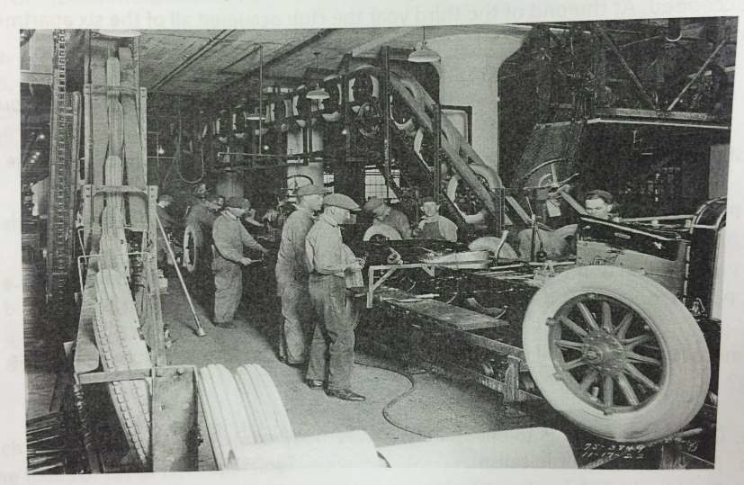

Slide 10

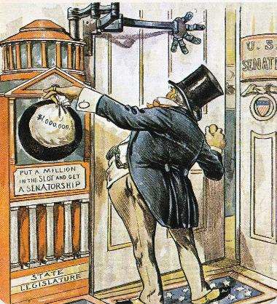

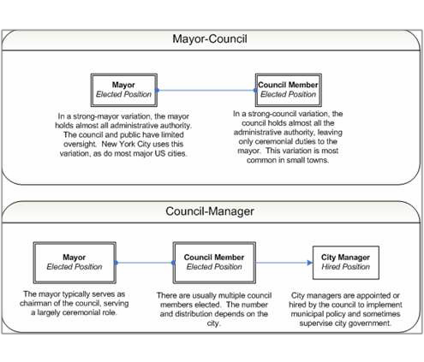
















Political Reforms (Municipal & State)
Voter Participation
  Australian Ballot – secret ballot
  Direct Primaries
  Direct Election of Senators
    30 States by 1912
o 17th Amendment (1913)
  Initiative, Referendum, and Recall
Municipal Reform- no private
  Controlling Public Utilities
  Commissions and City Managers
    Model of Galveston - vote

Slide 11



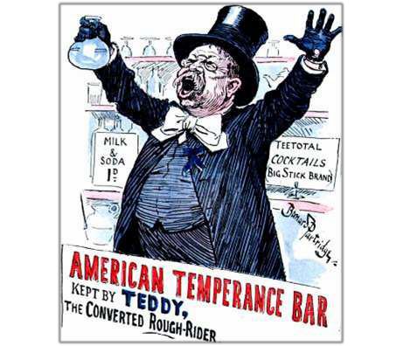

























Social Reform (State)
Temperance and Prohibition
  By 1915: 2/3 of states prohibited sale
Social Welfare
  Educational reform
  Penal & juvenile detention reform
  Improved conditions in tenements and factories
Labor
  National Child Labor Committee
  Compulsory School Attendance Laws
  Workday
    Lochner v. New York (1905) – 10-hour
  Muller v. Oregon (1908) – health of women/shorten hours
  Working Conditions & Safety
    Triangle Shirtwaist Fire (1911)

Slide 12

"To be sure, much of progressvism was exclusionary. Yet we can now recognize not a singular political persuasion, but rather a truly plural set of progressivisms; with workers, African Amenicans, women, and even Native Americans- along with a diverse and contentious set of middling folk- taking up the language and ideas of what was once conceived of as an almost entirely white, male, middle class movement. As for the dreams of democracy· from the period: despite the frequent blindness of the
those who e'mbodied them, they remain bold, diverse, and daring. It is for this reason that democratic
poliUcal theorists...have looked so longingly at the active citizenship of the Pr ogr,essrve Er a,, ·se eki ng ways
to r,e kind re the democratic impulses of a century ago"
Robert D. Johnson, "The Possibilities of Politics." 2011

Slide 13

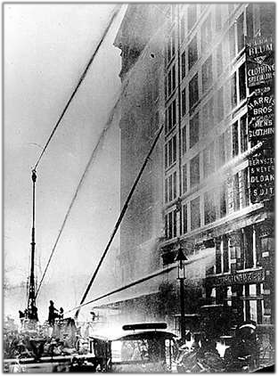
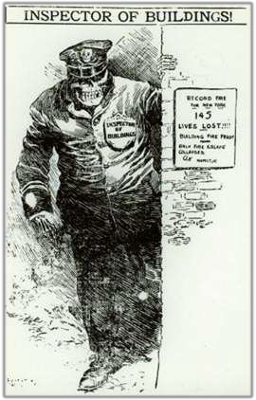
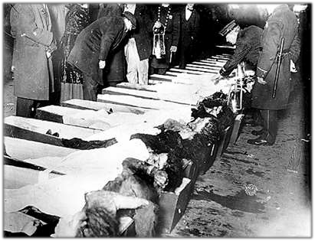
The Triangle Shirtwaist Fire

Slide 14





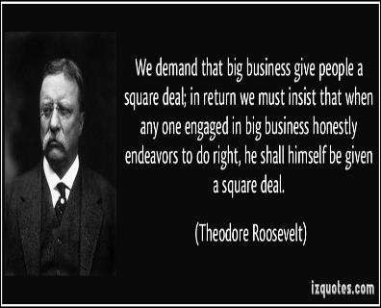


Roosevelt’s
“Square Deal”

Slide 15





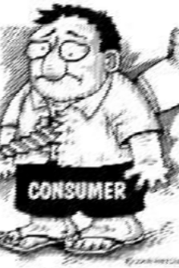

Roosevelt’s “Three C’s”
Control of Corporations
Consumer
Protection
Conservation of
Natural Resources

Slide 16

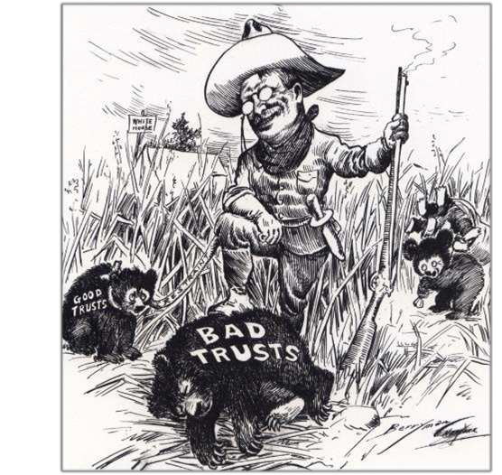
National Reform
Labor
  Anthracite Coal Strike & Arbitration (1902) - result: 10% wage increase/9 hour workday for miners
  Department of Commerce and Labor (1903)
Trust-Busting
  Northern Securities (1904)- combo of railroads – broke up the monopoly
  Standard Oil
  “Good” vs. “Bad” Trusts – bad – harmed public & limited competition – good – through efficiency low prices dominated a market.
Railroad Regulation
  ICC Expansion
    Elkins Act (1903) – strengthen power of ICC – stop rebates
    Hepburn Act (1906) – ICC fix rates for railroads

Slide 17

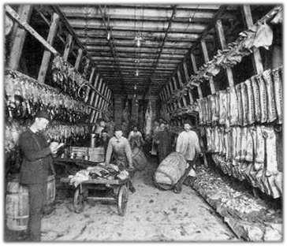










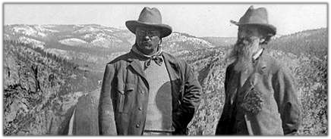



National Reform
Consumer Protection
  Impact of The Jungle
    Pure Food and Drug Act (1906)
    Meat Inspection Act (1906)
Conservation
  Increased Scope of Forest Reserve Act
  Newlands Reclamation Act (1902) – irrigation
  National Conservation Commission
    Gifford Pinchot (U.S. Forest
    Service)

Slide 18

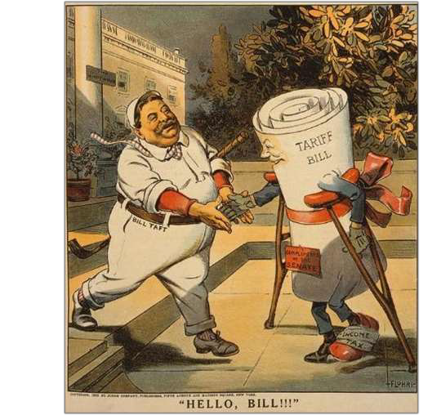




















Taft’s Presidency
Trust-Busting
  Over 90 suits brought under Sherman
Anti-trust Act
    Including U.S. Steel
ICC Expansion
  Mann-Elkins Act (1910) – oversee other public companies (water, telegraph)
Economic Changes
  Payne-Aldrich Tariff (1909) – raised the tariff on most imports – angered Progressives
  16th Amendment (1913) – income tax – applied to wealthy
  Dollar Diplomacy - pro-imperialist; guarantees loans to foreign companies

Slide 19

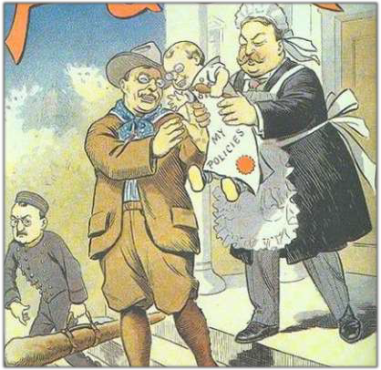
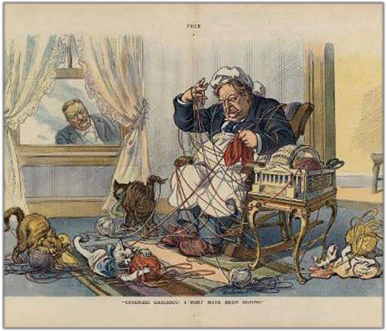
Before & After: Teddy & Taft

Slide 20

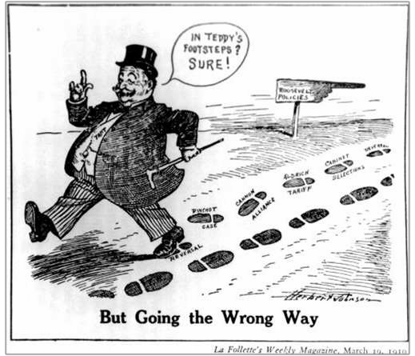












A Republican
Rift
The Tariff
  Upset Progressives
Ballinger-Pinchot Controversy
  Sec. Interior sells land in Alaska and Taft fires Pinchot
Congress vs. Presidency
  Taft supports Joe Cannon (R- Speaker) – no reduction in his powers
Midterms (1910)
  Conservatives vs. Progressives
    Split progressive party – 1912 election will result in Democrat in office

Slide 21


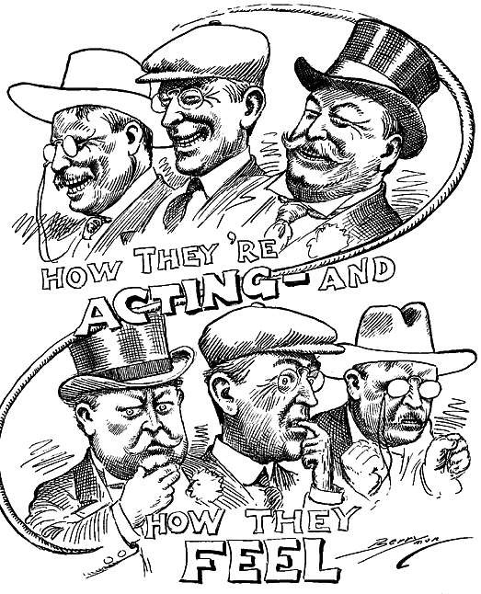












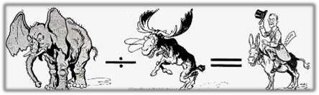
The Election of
1912
Candidates:
  Taft (Republican)
  Roosevelt (Progressive “Bull Moose”)
  Wilson (Democrat)
  Debs (Socialist)
Campaign
  Roosevelt’s “New Nationalism” – more govt regulation in business
  Wilson’s “New Freedom” – limit big business & government
Results:
  Wilson wins w/only 42%

Slide 22

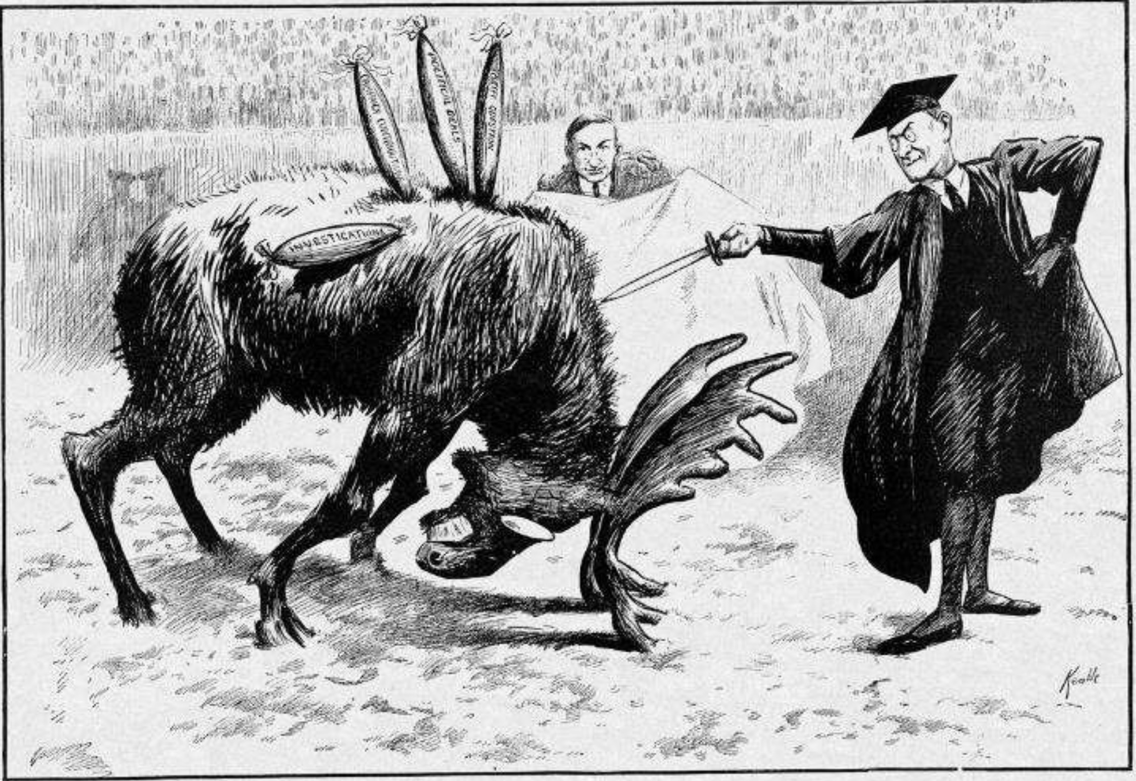

'l'J:m FlNISl:JlNG TOUCH
mu r.i, E. ,r . K

Slide 23

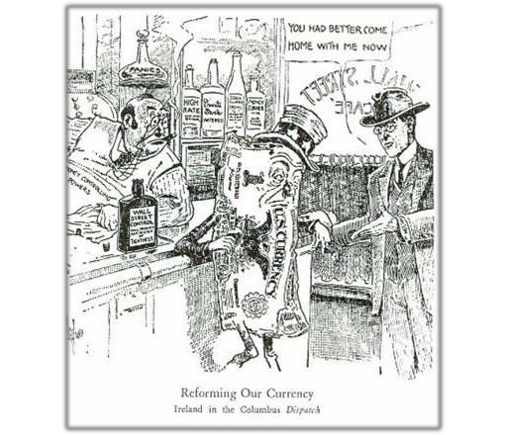

























Wilson’s Moral Diplomacy
Background:
“Schoolmaster” of Politics
Stubborn, inflexible
Second Democrat since war and first southerner.
Tariff Reduction
  Underwood Tariff (1913)
    Graduated income tax
Banking Reform
  Federal Reserve Act (1914) – dollar bills in circulation
Business Regulation (1914)
  Clayton Anti-trust Act – “Magna Carta of Labor”
  Federal Trade Commission – fair trade; banks not covered
Other Reforms
  Federal Farm Loan Act (1916)- low interest rate
  Keating-Owen Child Labor Act (1916)
    Ruled unconstitutional (Hammer v. Dagenhart, 1918) – under age 14 illegal
  Workingmen’s Compensation Act (1916)

Slide 24

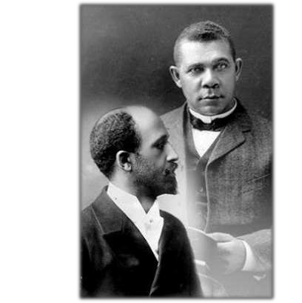




African Americans in the Progressive Era
Washington vs. DuBois
  Economic Gains Toward Equality
    Atlanta Exposition, Tuskegee, Up From Slavery
  Civil Rights: Social, Economic, and Political Equality
    Talented Tenth, The Souls of Black Folk
The “Great Migration”
  Push factors: Jim Crow, crop destruction
  Pull Factors: Industrial jobs, World War I
Civil Rights Organizations
  Niagara Movement – DuBois (1905) – protest and action to bring equality
  NAACP – 1908 – protect from discrimination
  National Urban League (1911) – hope those migrating from South
  Ida B Wells – anti-lynching

Slide 25

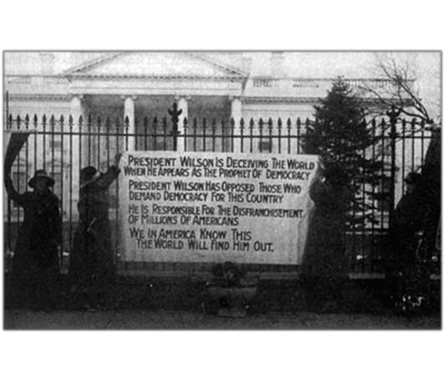


















Women and the Progressive Movement
The Campaign for Suffrage
  NAWSA (1900)
    Carrie Chapman Catt
  Militant Suffragists
    Alice Paul – National Women’s Party
    Pickets, Parades, Hunger Strikes
  Passage of the 19th Amendment (1920)
Other Issues
  Birth-control
    American Birth Control League (Margaret Sanger, 1921)
  Reforming marriage, divorce, and property laws

Slide 26

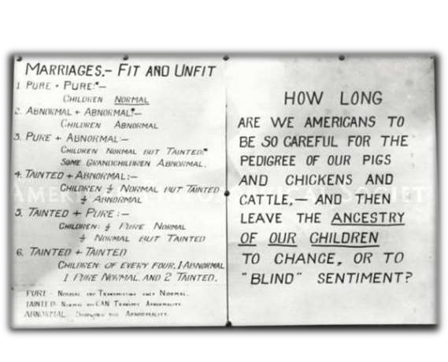


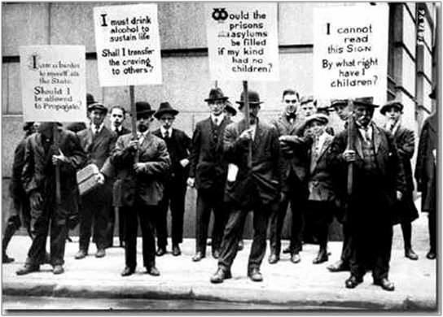


















Regressive Progressives
Eugenics
  Darwinism
  Charles Davenport
  “Some people are born to be a
burden on the rest”
    Forced sterilization
  “Fitter Family” Contests
Nativism
  Gentlemen’s Agreement (1908)
  Literacy Test for Immigrants (1917)
    passed over Wilson’s veto

Slide 27

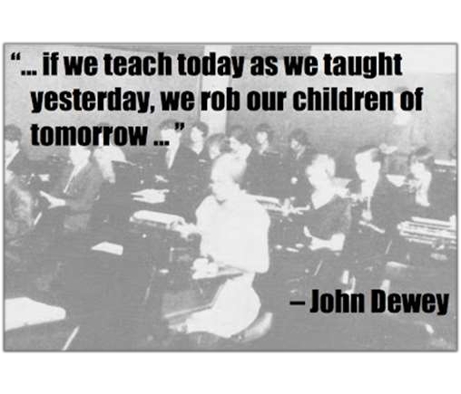






















Impact of the Progressive Era
Local & State Reform
Increase in Democratic Process
Era of Consumer Protection &
Workers’ Rights
Fear & Nativism Remain
Social and Socio-economic problems remain
Limited to no change in the
educational system
  new areas were added: trade and fitness
  new types of schools: Montessori
  core curriculum largely remained

