Slide 1
United States Policy, Economy,
and Culture during the 1970’s
Notes:
Disco Stu (animated): http://bunkerpop.mx/bunker-cine/apoco-no-quieren-unos-zapatos-con-pescadito-como-los-de-disco-stu/

Slide 2
Essential Questions
Analyze the continuities and changes that occurred in U.S foreign policy during the the 1970’s. To what extent did policy change, to what extent did it stay the same?
Analyze the effectiveness of social movements in addressing major problems and inequalities, and assess the ability of these movements to affect political change during the 1970’s.

Slide 3
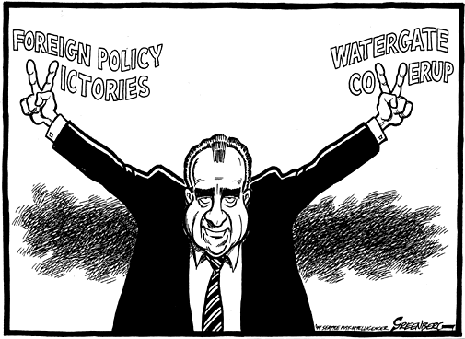
Richard M. Nixon
Background:
Yorba Linda, CA
Quaker
Navy, World War II
Congressman & Senator
Vice President
The “Imperial Presidency”
International relations > domestic policy
Foreign policy reduces CW tensions
Notes:
Cartoon: http://www.greenberg-art.com/.Toons/.Toons,%20Obits/NixonObit.html

Slide 4
Foreign Policy
Vietnamization and Détente

Slide 5
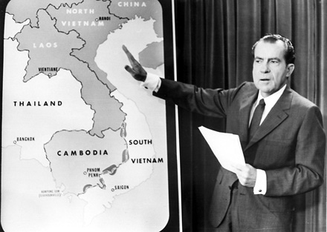
Vietnam
“Peace with Honor”
Reduce involvement without defeat
“Vietnamization”
Withdrawal:
540,000 (1969) → 30,000 (1972)
Nixon Doctrine
Support in Asia, without troops
Money, weapons, training
Notes:
Image: http://dkobner.blogspot.com/2011/12/two-policies-in-vietnam-americanization.html

Slide 6
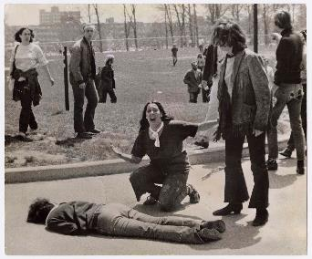
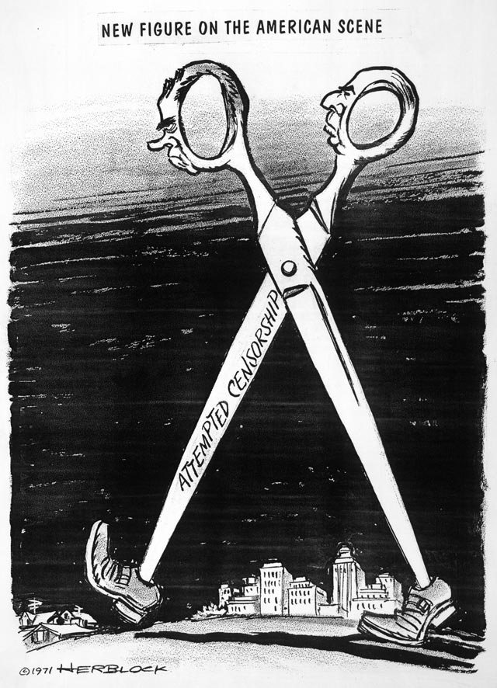
Opposition to Nixon’s War Policies
Laotian and Cambodian Campaigns
US forces invade Cambodia to destroy Vietnamese Communist bases
Protest on college campuses
Kent State Massacre (1970)
Jackson State
US Senate voted to repeal the Gulf of Tonkin Resolution – House did not vote.
Public Revelations:
My Lai Massacre (1968) – women & children
Pentagon Papers (Daniel Ellsberg, 1971, DofD analyst)
NY Times v. United States
Notes:
Cartoon: http://voiceseducation.org/node/345

Slide 7
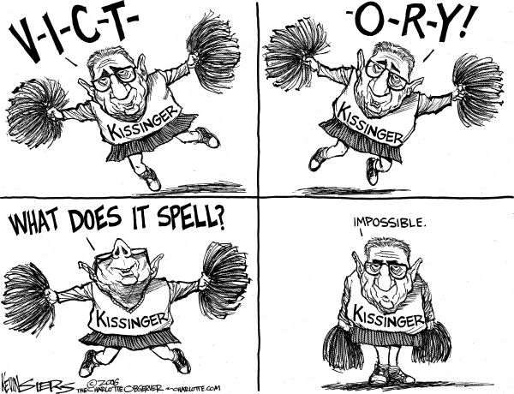
Ending the Conflict
Kissinger: “Peace is at hand” - premature
No deal met
Bombing of North Vietnam (1972)
Force an agreement
Paris Accords (1973)
Armistice
Withdrawal – the last of its troops
Return of POW’s – 500
Not the real end – fighting continued between North & South; thousands of enemy troops left in the South
Over a million died likely
Results:
58,000 deaths
$118 Billion
Inflation
Notes:
Kissinger Cartoon: http://thecomicnews.com/edtoons/archive/2006/1122/kissinger/01.shtml

Slide 8
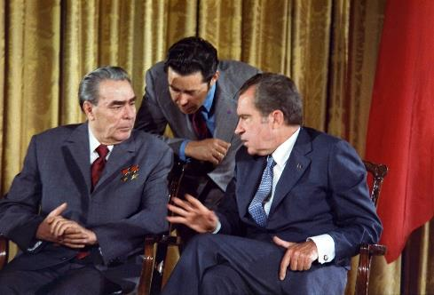
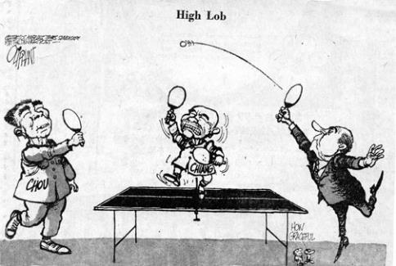
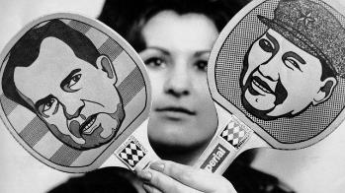
Détente with China and the Soviet Union
Visit to China -
Travel ban lifted
“Ping-pong” diplomacy
Nixon meets w/Zhou Enlai & Mao Zedong (1972)
Arms Control with the Soviet Union
SALT I (1969-1972) – freeze on ballistic missiles carrying nuclear warheads
Visits U.S.S.R. (1972)
Anti-Ballistic Missiles Treaty
Arms limitations – brought about détente – reduction of Cold War tensions
Notes:
Ping-Pong Diplomacy: http://www.tabletenniscoaching.com/taxonomy/term/91
Breznev’s Visit to Washington, 1973: http://en.wikipedia.org/wiki/D%C3%A9tente

Slide 9
Domestic Policy
Nixon and the Rise of Conservatism

Slide 10
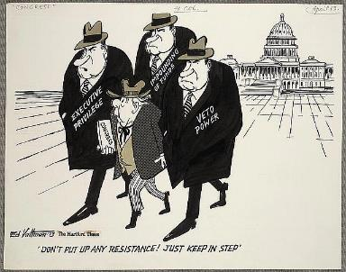
The New Federalism – revenue sharing
Democrats hold majority in both houses
Nixon laid the foundation for a shift in public opinion toward conservatism
Goal: shift responsibility of welfare back to the states
Manifestations:
Family Assistance Plan
Reduce welfare → defeated by Congress
Revenue sharing & Block grants
$30 billion to states
Impoundment of Funds
Congress said presidents duty to carry out the laws of Congress
Notes:
Cartoon: http://www.loc.gov/rr/print/swann/valtman/presentation.html

Slide 11
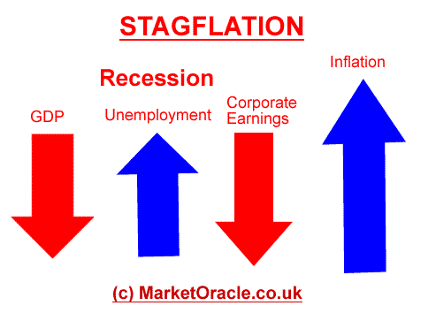
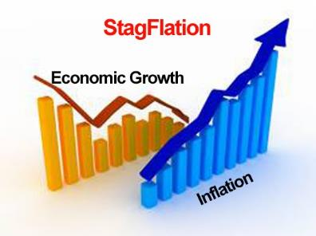
Nixon’s Economic Policies
Stagflation
Stagnation + inflation
Attempts to cut spending unsuccessful
Deficit spending
90 day wage and price freeze (1971)
10% surtax on imported goods
Removed gold standard
Improved balance of trade
Recession Ends (1972)
Increases Social Security w/COLA
Congress adds Title IX(CRA-64)
Includes sex discrimination (schools)
Sports programs equal for girls
Notes:
Stagflation: http://www.darkgovernment.com/news/stagflation/
http://www.321gold.com/editorials/schoon/schoon092012.html

Slide 12
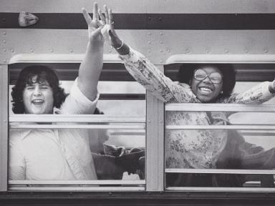
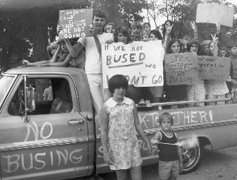
Conservatism
A New Coalition
The “Silent Majority”
Appeal to disaffected, conservative democrats – antiwar protestors, black militants, busing, youth counterculture excesses
Disagreed with the liberal approach of their party
The “Southern Strategy”
Slow down desegregation
Appeal to Southern Democrats
Swann v. Charlotte-Mecklenburg (1971) – busing upheld
The Burger Court – more conservative but decisions angered the most conservative
Roe v. Wade (1973) – abortion legal
U.S. v. Nixon (1974) – ordered the turning over of Watergate tapes
Notes:
Image 1, school busing: http://www.delawareonline.com/picture-gallery/news/education/2014/05/16/looking-back-busing-in-wilmington/9201879/
Image 2, protest: http://www.vahistorical.org/collections-and-resources/virginia-history-explorer/civil-rights-movement-virginia/school-busing

Slide 13
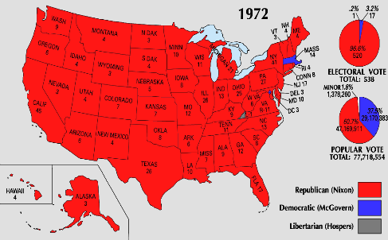
The Election of 1972
Republican Advantages
Foreign policy success in China & USSR
Removal of George Wallace
Democratic nominee from ND
Democrats
Indecision, mismanagement
McGovern = very liberal, antiwar, antiestablishment
Results:
Nixon Landslide: 61% popular = carried every state except MA
Political realignment: Sunbelt and suburbs
Notes:
Life Magazine Cover: https://lostlaurel.wordpress.com/2012/05/15/laurel-shopping-center-george-wallace-40-years-later/
Electoral Map: http://hermelink-nixon.blogspot.com/2010/04/election-of-1972-second-term.html

Slide 14
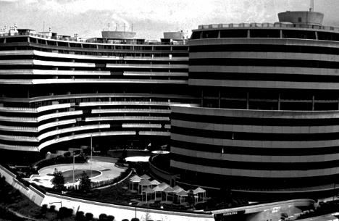
Watergate
The Scandal that Changed the Presidency and the Role of Media
Notes:
Watergate: http://www.esquire.com/blogs/politics/watergate-40-years-later-9747335

Slide 15
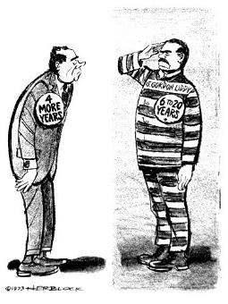
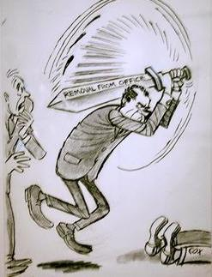
White House Abuses
The Break-in (June, 1972)
CREEP – Committee to RE-elect the President
Nixon’s “Dirty Tricks”
Wiretaps to stop leaks
“Plumbers” – discredit opponents and stop leaks
“Enemies List” – enemies of Nixon and/or the Vietnam War
All the President’s Men
Haldeman, Ehrlichman, and Dean
Washington Post
Woodward & Bernstein
Other Scandals
ITT Case – V.P. Agnew’s Resignation due to bribes taken when governor of Maryland
Replaced by Gerald Ford
“Saturday Night Massacre” (Oct. 1973)
Two AG’s resign, Solicitor General (Bork) fires Cox
Notes:
Liddy Cartoon: http://www.dailykos.com/story/2013/05/10/1207661/-U-S-since-1865-Watergate-in-Cartoons-Herblock-s
Saturday Night Massacre: http://www.statecollege.com/news/columns/to-herblock-and-to-spring-flowers-postcard-from-washington,682171/

Slide 16
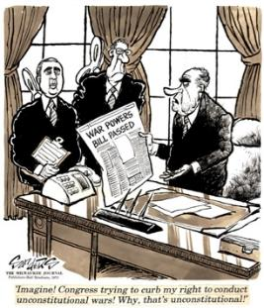
Other Developments - 1973
War Powers Act
Retaliation for Cambodian bombing 3500 secret bombing raids
Limit the power of the president over the military - President must report to Congress any troop commitments within 48 hours
60 day limit to commitment w/out Congressional consent
Has largely been ignored by every subsequent president
October War and Oil Embargo
Yom Kippur War – Syrians and Egyptians launched attack on Israel in an attempt to recover lands lost in 6-day war of 1967
U.S. sends $2 billion in arms to Israel
OPEC retaliates → embargo to Israel’s supporters
Results:
Oil shortage, inflation, introduction of Japanese cars, collapse of auto industry, national speed limit (55 mph), long lines at gas stations

Slide 17
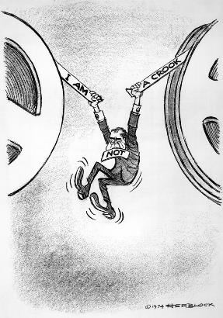
Resignation of the President
Impeachment Proceedings (1974)
The Tapes:
Transcripts (redacted) released
U.S. v. Nixon (July)
The “smoking gun” – 18 ½ mins erased
Articles of Impeachment:
Obstruction of justice
Abuse of power
Contempt of Congress
Nixon Resigns (August 9, 1974)
Pardoned by Ford

Slide 18
Key Questions: Nixon
How did Nixon’s Vietnam policies differ from Johnsons?
Evaluate the degree to which detente fostered change and continuity in the policy of containment (China and Russia)
How did the Warren Court extend liberal values through judicial decisions?
Evaluate the impact of political scandals on the lack of public confidence in government in the 1970’s
Describe the growing divide between liberals and conservatives in the 1970’s

Slide 19
The Ford Interlude
The Administration of the First Non-elected President (1974-1977)

Slide 20
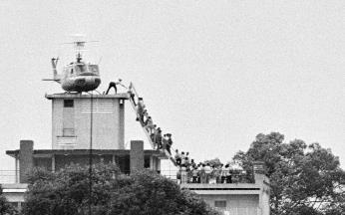
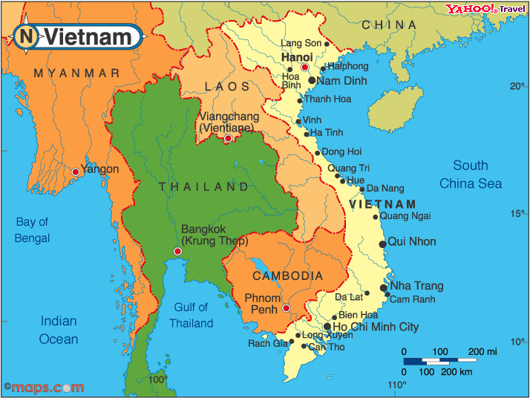
The Ford Administration 1974 - 1977
Investigating the CIA
Attempting to expose assassination plots
Salvador Allende (Chile) – Marxist President
Ford appoints George H.W. Bush to head CIA
Ford unable to get additional funds for South Vietnamese
Southeast Asia Policy
Fall of Saigon (April, 1975) – evacuated 150,000 Vietnamese
Genocide in Cambodia – 1 million
10 million refugees to America
Economic growth of the rest of SE Asia – Singapore, Thailand, and Malaysia did not fall to communism
Some argue that our support of South Vietnam was not a waster because it bought time for other nations of Asia.
Notes:
Fall of Saigon: http://www.thedailybeast.com/articles/2014/04/30/remembering-the-fall-of-saigon-and-vietnam-s-mass-boat-people-exodus.html

Slide 21
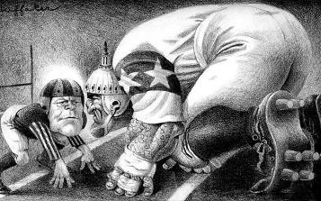
Ford Administration (con.)
Domestic & Economic Policy
The “WIN” Campaign
Whip inflation now
The Veto (39)
The Bicentennial (1976)
Notes:
Cartoon: http://www.huffakerart.com/illustration/big/Gerald%20Ford.html

Slide 22
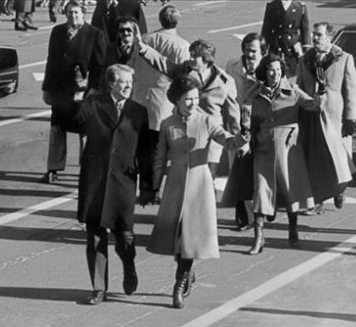
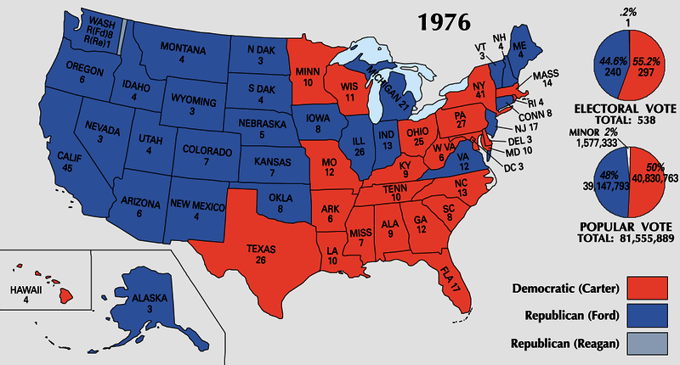
The Election of 1976
Ford vs. Carter
Low Turnout (53%)
Desire to move away from “politics as usual.”
Electoral: 240 to 297
Notes:
Ford Pin: http://www.vahistorical.org/sites/default/files/uploads/VHE_Campaigns_IL.2012.2.43.4.jpg
Map: http://i0.wp.com/www.philipcaruso-story.com/wp-content/uploads/2015/04/Election-of-1976.png
Carter’s “Presidential Strut”: http://archive.13wmaz.com/news/article/212316/318/Presidential-Strut-is-Now-Iconic-Inaugural-Moment

Slide 23
The Carter Administration
America at the End of the 1970’s

Slide 24
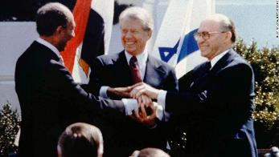
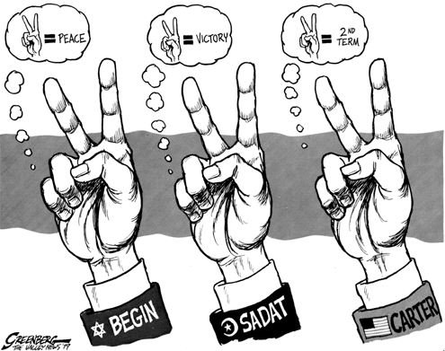
Foreign Policy & Human Rights
Human Rights
Guided policies w/South Africa and Latin America
Cut off US aid to Argentina and Chile because of human rights violations
Panama Canal
Nationalization by 2000
Americans saw this as a “giveaway”
Camp David Accords (1978)
Peace settlement between Egypt & Israel
Egypt first Arab nation to recognize Israel
Notes:
Camp David Accords Image & Facts: http://www.cnn.com/2013/08/23/world/meast/camp-david-accords-fast-facts/
Cartoon: http://www.greenberg-art.com/.Toons/.Toons,%20political/CampDavid.html

Slide 25
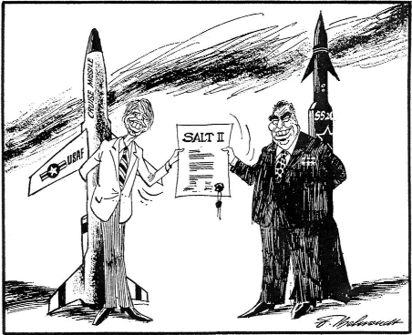
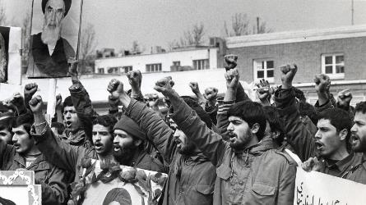
Foreign Policy Limitations
Iran Hostage Crisis (1979)
Rise of the Ayatollah Khomeini
2nd Oil Shortage
Seizure of Embassy in Teheran (Nov. 4, 1979)
Operation Eagle Claw (April, 1980) – helicopters broke down
Hostages not freed until January 20, 1981
Cold War
Continuance of Détente
Recognizes PRC (1979)
SALT II (1979)- limiting the size of nuclear delivery system
Soviet-Afghan War (December, 1979)
US embargo on exports to USSR
Boycott 1980 Olympic games
Move to an arms buildup
Notes:
Image and Review of Argo: http://www.ctvnews.ca/w5/argo-iran-hostage-crisis-film-fiddles-with-the-facts-1.1167994
Cartoon: http://www.cvce.eu/en/obj/cartoon_by_behrendt_on_the_salt_ii_disarmament_agreement_4_may_1979-en-09e3b4d4-0b02-4b54-8ab6-afc0ef4c9246.html

Slide 26
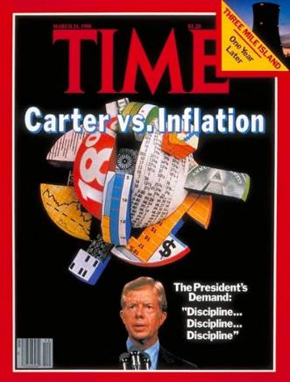
Domestic Policy
Dealing with Inflation
13%
Volcker (Fed) pushed interest rates to 20%
Impact on the auto industry – laid off tens of thousands of workers
Federal deficit to $60 billion (1980)
Loss of Popularity
“Malaise” Speech – moral & spiritual crisis of the American People
Approval: 23%
Notes:
Image: http://topics.time.com/economy/covers/

Slide 27
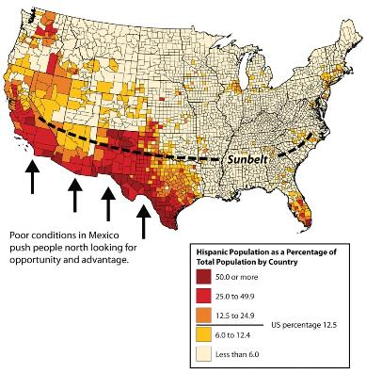
American Society in Transition
Rise of the Sunbelt & Senior Citizens
Changing Demographics
Increase in minorities and cultural pluralism
Growth of Immigration
Largest segments: Latin America & Asia
Undocumented Immigrants
Est. 12 million by mid-70’s
Notes:
Map & Historical Population Analysis: http://2012books.lardbucket.org/books/regional-geography-of-the-world-globalization-people-and-places/s07-north-america.html

Slide 28
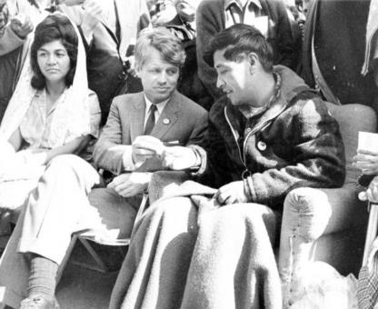
Demands for Minority Rights: Latinos
Hispanic Americans
Cesar Chavez, the UFW, and the Delano Boycott & March (1966)
Collective bargaining for farm workers (1975)
Educational Reforms
Bilingual schools
Notes:
Image and Chavez Bio: http://www.biography.com/news/cesar-chavez-biography-facts
UFW website on the Delano March: http://www.ufw.org/_board.php?mode=view&b_code=60_video&b_no=16344&page=1&field=&key=&n=1

Slide 29
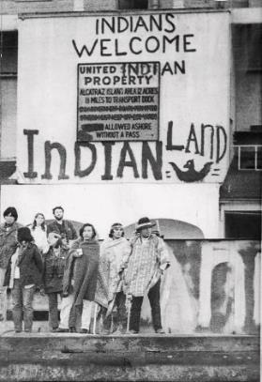
Demands for Minority Rights: Native Americans
American Indian Movement (AIM-1968)
Occupation Movement
Wounded Knee & Alcatraz
Indian Self-Determination Act of 1975
Tribally Controlled Community College Assistance Act of 1978
Notes:
Occupation of Alcatraz: http://jewishcurrents.org/tag/american-indian-movement

Slide 30
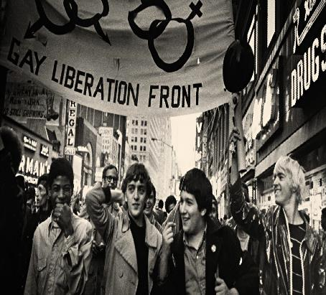
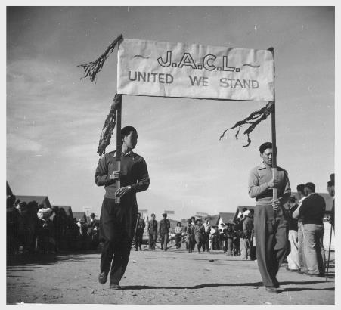
Demands for Minority Rights (con.)
Asian Americans
Fastest growing ethnic minority
Emphasis on education
Discrimination
Gay Liberation Movement
Stonewall Riot (1969)
1970s – no longer a mental illness – dropped the ban on hiring
“Don’t Ask, Don’t Tell” (1993)
Movement for LGBT Rights
Notes:
JACL Parade: http://content.cdlib.org/ark:/13030/ft2d5nb0c3/
Legacy of the Stonewall Riots (PBS Video): http://video.pbs.org/video/2365073798/

Slide 31
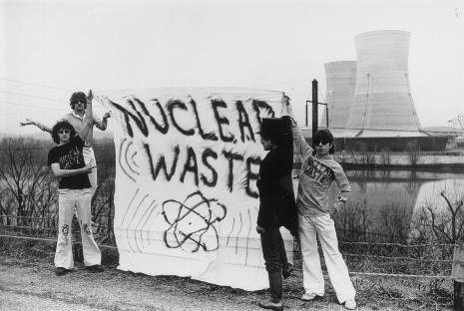
The Environmental Movement
Increased Awareness
Rachel Carson’s Silent Spring (1962)
Earth Day (1970)
Major Oil Spills
Santa Barbara (1969)
Exxon Valdez (1989)
Nuclear Disasters
Three Mile Island (1979)
Chernobyl (1986)
Pollution and Dumping
Love Canal (NY)
Notes:
Three Mile Island Protest: http://mashable.com/2014/07/15/nuclear-disasters-before-after/#NSRpiN99_5qW

Slide 32
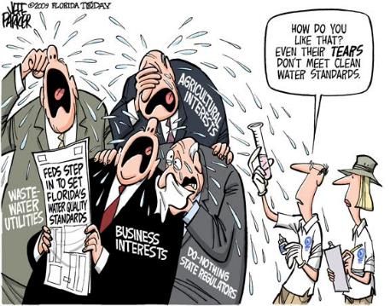
Protective Legislation
Environment:
Clean Air Act & the EPA (1970)
Clean Water Act (1972)
Endangered Species Act (1973)
Consumer Protection
Ralph Nader’s Unsafe at Any Speed (1965)
Automobile regulations: seat belts, weight distribution, and design
Freedom of Information Act (1967)
OSHA (1971)
Consumer Products Safety Act (1972)
Notes:
Simpsons’ Movie Intro Image: http://s177.photobucket.com/user/diskoboy1974/media/cap008.jpg.html
Cartoon: http://archive.floridatoday.com/content/blogs/jparker/2009/12/1211-cartoon-cry-us-river.shtml

Slide 33
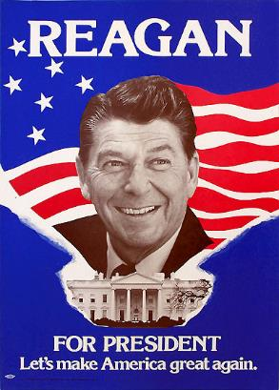
Conservative Backlash
Conservative Reaction to “liberal” policies
Causes:
Rise of Religious Right
Response to SCOTUS decisions
Reaction to New Deal and Great Society Programs
Notes:
Synthesis to Trump campaign: http://www.businessinsider.com/donald-trump-trademarked-make-america-great-again-2015-5

