Slide 1
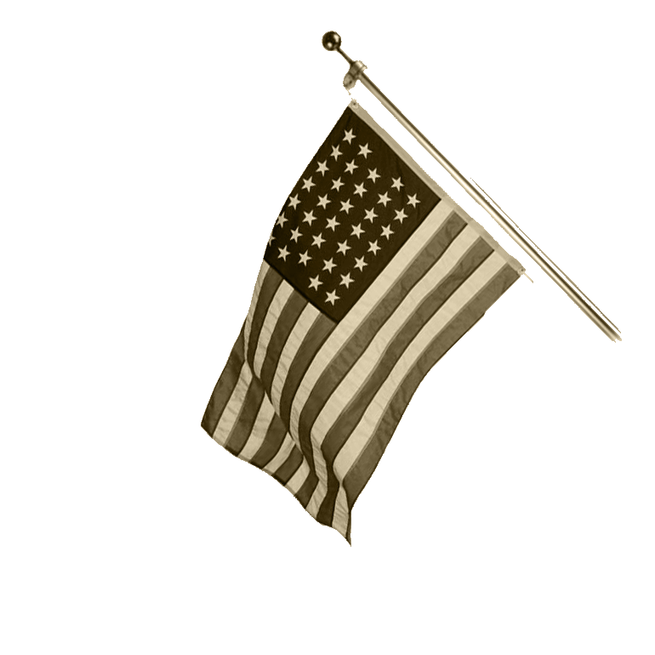
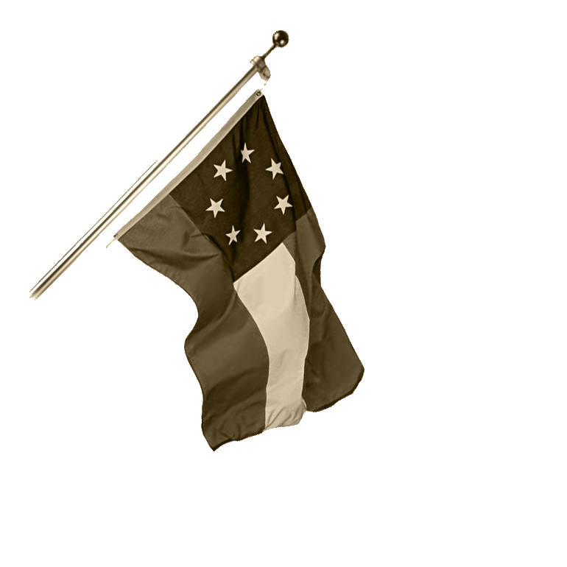
The Civil War
1861-1865
Notes:
Features (in notes sections):
Suggested Clips for viewing from major films
Links to descriptions of images
A General tracker to undermine the perception that the entire Civil War was fought between Robert E. Lee and Ulysses S. Grant

Slide 2
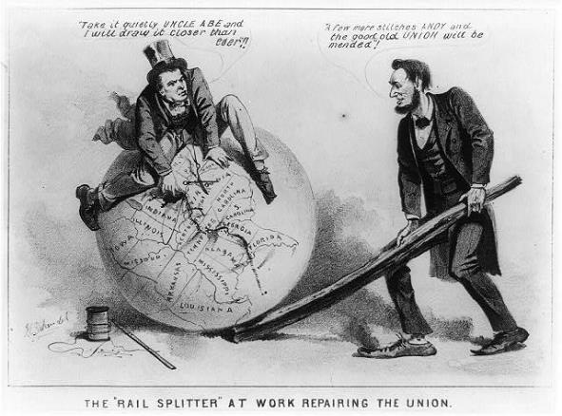
Essential Question
To what extent did the role of the federal government change both during, and as a result of, the Civil War.
Notes:
LOC image: http://www.loc.gov/pictures/item/2008661827/

Slide 3
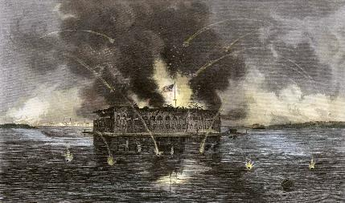
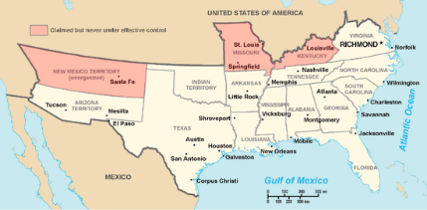
The War Begins
Fort Sumter (April 12, 1861)
  Use of Executive Power
    “Commander-in-Chief”
      75,000 volunteers
      War spending
      Suspended habeas corpus
      All without Congressional consent
The Upper South Secedes
  VA, NC, TN, AR
    Capital moves to Richmond
The Border States
  DE, MD, MO, KY… later: WV
  Martial law in Missouri
Notes:
Fort Sumter: http://www.learnnc.org/lp/editions/nchist-civilwar/4637
CSA Map: http://upload.wikimedia.org/wikipedia/commons/thumb/2/27/Map_of_CSA_4.png/550px-Map_of_CSA_4.png

Slide 4
Wartime Advantages
 | NORTH | SOUTH
MILTARY | High population Strong navy Spirit of adventure | Defensive Experienced Leadership High troop morale
ECONOMIC | 85% of factories 70% of railroads 65% of farmland | European reliance on cotton*
POLITICAL | Preserve Union Strong central government | Fighting for independence

Slide 5
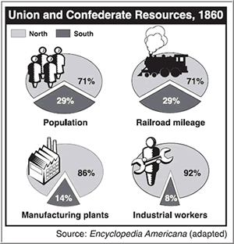
North vs. South -
By the Numbers
 | NORTHERN STATES | SOUTHERN STATES
Agriculture
Corn (bushels) | 446 million | 280 million
Wheat (bushels) | 132 million | 31 million
Oats (bushels) | 150 million | 20 million
Cotton (bales) | 4 thousand | 5 million
Tobacco (pounds) | 229 million | 199 million
Rice (pounds) | 50 thousand | 187 million
Finance
Bank Deposits | $207 million | $47 million
Specie | $56 million | $27 million
Livestock
Horses | 4.2 million | 1.7 million
Donkeys and Mules | 300 thousand | 800 thousand
Milk Cows | 5.7 million | 2.7 million
Beef Cattle | 6.6 million | 7 million
Sheep | 16 million | 5 million
Swine | 16.3 million | 15.5 million
Manufacturing
Number of Factories | 110.1 thousand | 20.6 thousand
Number of Workers | 1.17 million | 111 thousand
Value of Products | $1.62 billion | $155 million
Population | 21.5 million | 9 million
Railroad Mileage | 21.7 thousand | 9 thousand
Notes:
Graphic: http://www.econedlink.org/lessons/index.php?lid=729&type=educator
Chart source: Cayton, et el. America: Pathways to the Present. 2005. from The American Heritage Picture History of the Civil War.

Slide 6
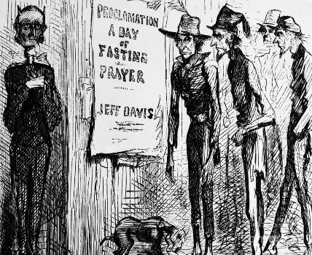
The Confederate States of America
A Confederacy?
  Purpose of gov’t vs. implementation during war.
  Wartime Centralization at the state level
Economy
  Nationalization of at the railroads
  Promotion of industrialization
  Extreme inflation
Notes:
http://fineartamerica.com/featured/confederate-fasting-1863-granger.html

Slide 7
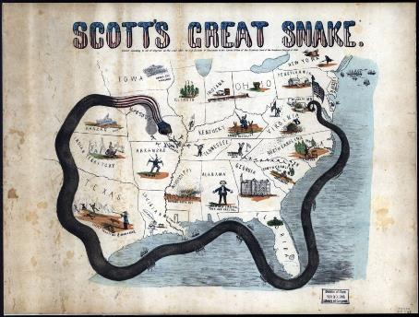
First Years of War (1861-1862)
Early volunteers enlisted for only 90 days.
First Bull Run (Manassas, July, 1861)
  30,000 U troops attack in VA
  “Stonewall” Jackson – forces retreat
  War would be longer than expected
Union Strategy
  Blockade Southern ports (Anaconda Plan)
  Take control of Mississippi
  Raise and train 500,000 man army to conquer Richmond
Notes:
http://www.learnnc.org/lp/editions/nchist-civilwar/5460

Slide 8
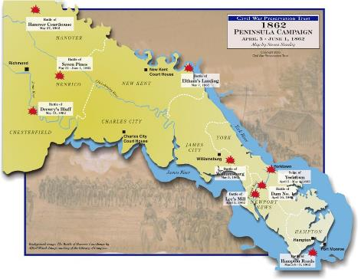
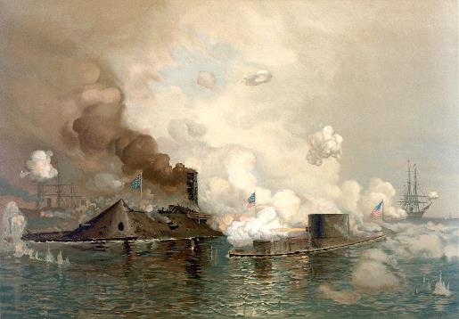
The Peninsula Campaign
Army of the Potomac
  Failures @ Yorktown, Seven Pines, & the Seven Days’ Battle
  Ironclads
    Monitor vs. Merrimac (CSS Virginia) – ironclad ships
      Hampton Roads (March, 1862)
    Impact – revolution in naval warfare, iron replacing wood
  McClellan Fired, replaced by John Pope
Major General Tracker:
Army of the Potomac
McClellan (fired – Seven Days’)
Pope
Army of Northern Virginia
Johnston (killed – Seven Pines)
Robert E. Lee
Notes:
Map: http://www.civilwar.org/maps/peninsula-campaign/peninsulacampaignmap.html
Battle of Hampton Roads: http://upload.wikimedia.org/wikipedia/commons/1/18/The_Monitor_and_Merrimac.jpg
Suggested Video: Burns, Civil War - Ironclads

Slide 9
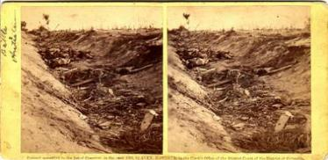
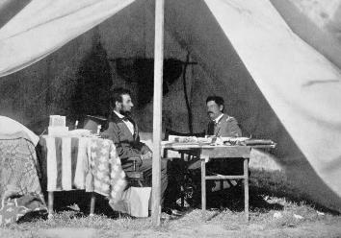
Northern Virginia and Maryland Campaigns
Second Bull Run (August, 1862)
  Lee - Pope forced to withdraw to protect Washington
Antietam (Sharpsburg – September, 1862)
  Single bloodiest day of the war – 22,000 dead or injured
  Value of cigars
  Impact of Burnside – aggressive leader – reckless – worse consequences
  Photography of Matthew Brady
  Lincoln seizes as opportunity to issue Emancipation Proclamation – awaiting a victory
Major General Tracker:
Army of the Potomac
McClellan (fired – Seven Days’)
Pope (fired – 2nd Bull Run)
McClellan (reinstated, fired – Antietam)
Burnside
Army of Northern Virginia
Johnston (killed – Seven Pines)
Lee
Notes:
Suggested film clips: Gods and Generals – Second Manassas. Glory – Antietam & Hospital scene
Matthew Brady, bloody lane photograph: http://www.civilwarphotography.org/index.php/3-d-photographs-exhibit/74
Brady photograph of Lincoln and McClellan: http://www.ohiohistoryhost.org/ohiomemory/archives/1575

Slide 10
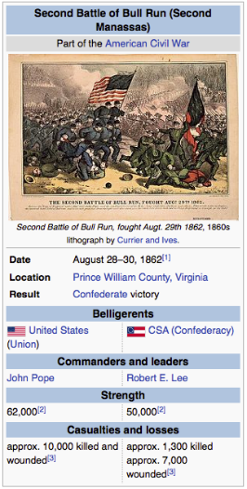
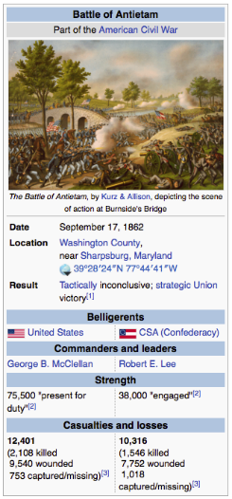
Results:
2nd Bull Run
&
Antietam
Notes:
Bull Run: http://en.wikipedia.org/wiki/Second_Battle_of_Bull_Run
Antietam: http://en.wikipedia.org/wiki/Battle_of_Antietam

Slide 11
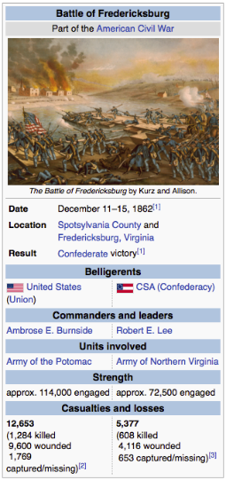
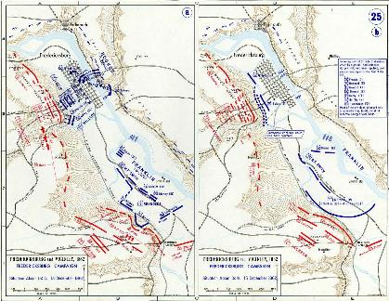
Fredericksburg
Burnside leads full frontal assault on Confederate position at convergence of Rapidan and Rappahannock
Major General Tracker:
Army of the Potomac
McClellan (fired – Seven Days’)
Pope (fired – 2nd Bull Run)
McClellan (reinstated, fired – Antietam)
Burnside (fired – Fredericksburg)
Hooker
Army of Northern Virginia
Johnston (killed – Seven Pines)
Lee
Notes:
Clip suggestion: Gods and Generals – Fredericksburg erupts
Maps: http://www.civilwar.illinoisgenweb.org/battles/fredmap2.html
Results: http://en.wikipedia.org/wiki/Battle_of_Fredericksburg

Slide 12
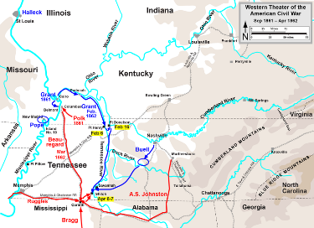
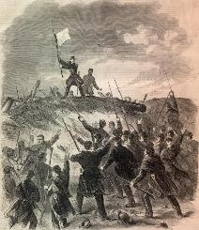
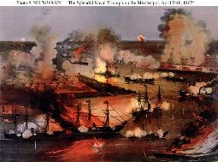
The Western Campaign
Ulysses S. Grant – trying to control the Mississippi
  Forts Henry and Donelson (1862) – branches of the Mississippi
    “Unconditional Surrender” – 14000 Confederates taken prisoner
  Shiloh (1862) -23000 dead or wounded
Once the Mississippi River was under Union Control: David Farragut (Navy)
  New Orleans (April, 1862)
  Heads to Vicksburg
Notes:
Image – Unconditional surrender @ Donelson: http://civilwardailygazette.com/2012/02/16/the-strange-and-unconditional-surrender-of-fort-donelson/
Map of western campaign: http://ryanhill1.wikispaces.com/Battle-of-Shiloh
Battle of New Orleans: https://familysearch.org/learn/wiki/en/Louisiana_Military_Records

Slide 13
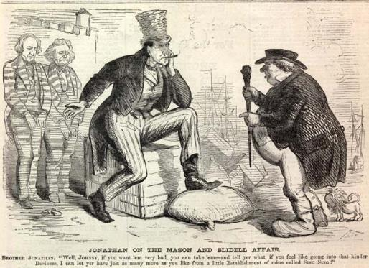
Foreign Affairs and Diplomacy
Courting European Powers
  Necessity for South
    “King Cotton” – to gain support of Britain and France
Trent Affair (1861) – Mason & Slidell
Confederate Raiders
  Privateers (British-built ironclads)
  The Alabama
    Captured at least 60 Union vessels
Failure of Cotton Diplomacy
  Southern blockade and later embargo led to cotton imported from India and Egypt
  England and France refused to formally recognize the CSA
Notes:
Image and description: http://www.sonofthesouth.net/uncle-sam/brother-jonathan.htm

Slide 14
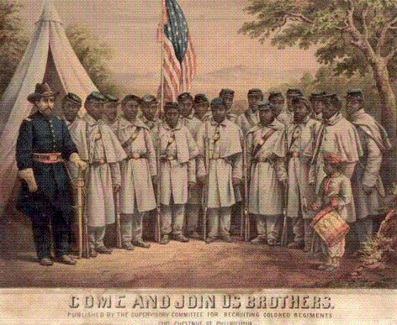
The End of Slavery (?)
Confiscation Acts (May, 1861-July, 1862)
  Slaves = “contraband”
The Emancipation Proclamation (September, 1862 – effective January 1, 1863)
  Effect on slavery = none
  Consequences:
    Enlarged purpose of war
      Kept England out
    Strengthened Confiscation Acts
    Allowed for enlistment of free blacks
      Over 200,000 serve
        Segregated
        Mostly non-combat, few exceptions (54th Mass.)
Thirteenth Amendment (Ratified December, 1865) – end of slavery
Notes:
Suggested film clip: Glory – Training/bayonets and assault on Ft. Wagner
Image: http://taylorpolites.blogspot.com/2011/09/do-you-think-ill-make-soldier.html
Link to experience of black soldiers: http://www.nps.gov/history/history/online_books/civil_war_series/2/sec19.htm

Slide 15
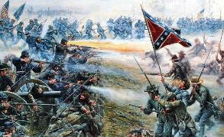
The Turning Tide of War (1863-1865)
Chancellorsville (May, 1863)
  Jackson killed by “friendly” fire
  Confederate victory
Vicksburg (May-July, 1863)
  Grant achieves surrender on July 4.
  Completes the “anaconda”
Gettysburg (July 1-3, 1863)
  First Southern offensive in North
  Accidental encounter leads to deadliest battle, 50,000 died/injured
Impact:
  Massive Southern casualties lead to decreased support
  Union has two major victories, both in terms of strategy and morale
  Gettysburg Address – admittance of this war being about equality and putting an end to slavery
Major General Tracker:
Army of the Potomac
McClellan (fired – Seven Days’)
Pope (fired – 2nd Bull Run)
McClellan (reinstated, fired – Antietam)
Burnside (fired – Fredericksburg)
Hooker (fired – Chancellorsville)
Meade (fired – Gettysburg)
Grant
Army of Northern Virginia
Johnston (killed – Seven Pines)
Lee
Notes:
Image from “True Story of Pickett’s Charge”: http://rare.us/story/gettysburg-at-150-the-story-of-picketts-charge/
Suggested clips: Gods and Generals – Surprise at Chancellorsville -- Gettysburg – For Virginia (Pickett) & Bayonets (Little Round Top & Chamberlain)

Slide 16
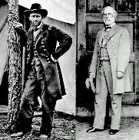
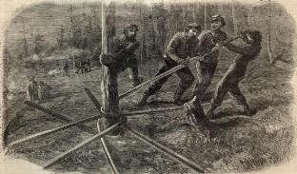
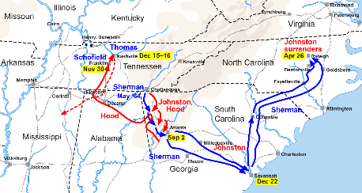
The Overland Campaign
Grant vs. Lee
  Wilderness (May, 1864)
    Grant heavily supplied
  Spotsylvania and Cold Harbor (May-June, 1864)
    Massive Casualties
  The Siege at Petersburg (June, 1864-April, 1865)
    Cut off Southern Railroads
Sherman’s March to the Sea (November-December, 1864)
  Chickamauga (loss-1863)→ Chattanooga (victory-1863)→Atlanta (victory, 1864)
  “Make Georgia Howl”
    Sherman “neckties”
  Savannah, GA = Christmas present
Notes:
Suggested Clip: Cold Mountain – The Crater (Petersburg)
Grant and Lee: http://en.wikipedia.org/wiki/Overland_Campaign
Sherman Necktie: http://georgy-konstantinovich-zhukov.tumblr.com/post/42965876469/peashooter85-general-shermans-neckties
March to the Sea map: http://en.wikipedia.org/wiki/William_Tecumseh_Sherman

Slide 17
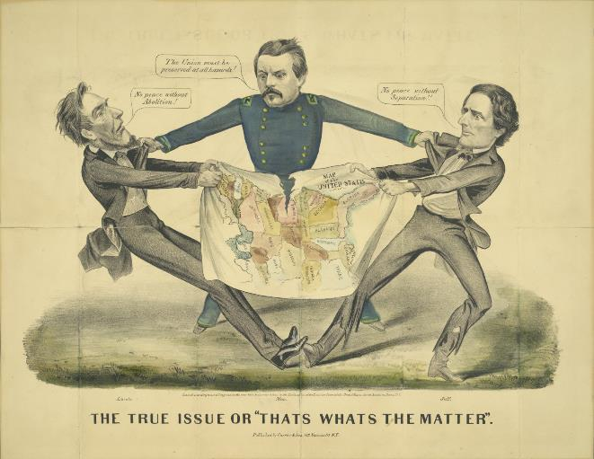
The Election of 1864
Primary Source Analysis:
C – Context
A – Audience
P – Purpose
P – Point of View
Notes:
Image: http://www.digitalgallery.emory.edu/luna/servlet/detail/CORNELL~9~1~78014~1708:The-True-Issue-or--Thats-Whats-the-

Slide 18
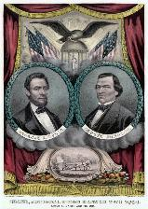
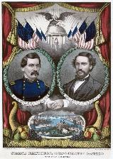
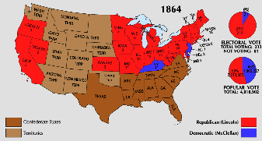
The Election of 1864
Abraham Lincoln
George McClellan
“Unionists”
Pro-war
New running mate – Andrew Johnson (Democrat)
Democrats want cease fire
“ditch-Lincoln” movement
Anti-emancipation
Results:
Lincoln gets push from victories @ Atlanta and Petersburg
Lincoln allows furlough for soldiers to vote
Notes:
Campaign Posters: http://en.wikipedia.org/wiki/United_States_presidential_election,_1864
Map:

Slide 19
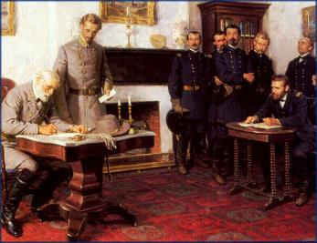
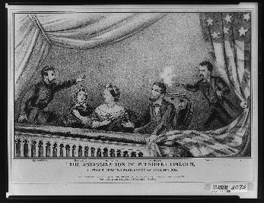
The End of the War
Fall of Richmond (April 3, 1865)
Lee’s Surrender at Appomattox (April 9, 1865)
Recapture of Fort Sumter (April 14, 1865)
Lincoln’s Assassination (April 14, 1865)
  Ford’s Theater
  John Wilkes Booth
  Attack on Sec. of State Seward
Johnston Surrenders to Sherman (NC – April 17, 1865)
Notes:
Appomattox Surrender & Description of Wilmer McLean: http://rixxblog.wordpress.com/2011/07/21/wilmer-mclean/
Lincoln’s Assassination: http://en.wikipedia.org/wiki/Lincoln_assassination_flags

Slide 20
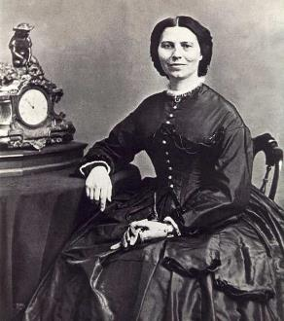
Effects of the War on Civilian Life
Societal, Economic, and Political changes of the
“War Between the States”
Notes:
Matthew Brady photograph of Clara Barton, founder of the Red Cross: http://en.wikipedia.org/wiki/Clara_Barton

Slide 21
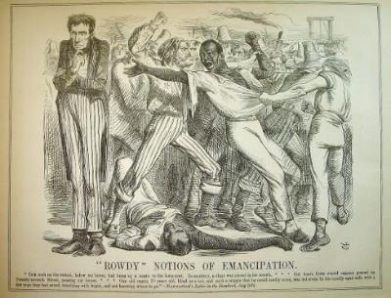
Political Change
Republican in office, Republicans in Congress
  Factionalized
    Radicals vs. Moderates
  Dissenters
    Copperheads – negotiated peace with treason
    Peace Democrats
Civil Liberties
  Suspension of habeas corpus in Maryland and Kentucky
    13,000 held without trial
  The Draft
    Conscription Act (March, 1863)
      All men 20-45
      Allowed for “substitutes” ($300)
    New York Draft Riots (July)- immigrants vs. freed African Americans.
Political Dominance of the North – supremacy of the federal government was an established fact.
Notes:
Lincoln and the draft riots cartoon w/description: http://historygallery.com/prints/PunchLincoln/1863riots/1863riots.htm
Suggested clip: Gangs of New York – The Draft (good depictions of William Tweed, Horace Greeley, reading of Irish names, and subsequent riots)

Slide 22
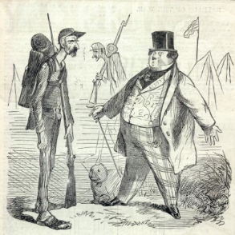
Economic Change
Financing the War
  North
    Selling of bonds ($2.6 billion)
    Income tax, excise taxes, and increased tariffs (Morrill, 1861)
    Issuance of Greenbacks – could not be traded in for gold – contributing to inflation
    Renewal of National Bank (1863)
Modernizing Northern Society
  Consolidation of industry
  Profiteers & New Industry
    War Financing (Cooke), Pork (Armour), Guns (Colt & Winchester), Wool and Linen see resurgence
Economic Expansion
  Homestead Act (1862) – promotes settlement in Great Plains – 160 acres to farm and live 5 years
  Morrill Land Grant Act (1862) – sale of federal land grants to maintain agricultural and technical colleges.
  Pacific Railway Act (1862) – authorized the building of a transcontinental railroad over a northern route in order to link the economies of east and west together.
Notes:
Image: source unknown

Slide 23
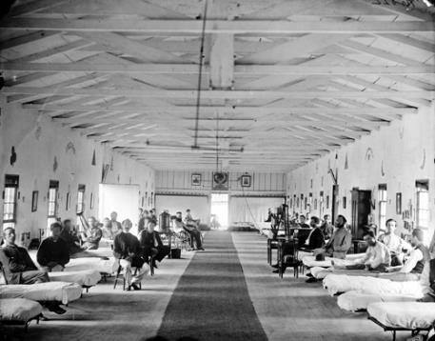
Social Change
Women at Work
  Added responsibilities
    Factory jobs (North)
    Farms and plantations (South)
  Nurses and Volunteers for war efforts
    Formation of the Red Cross (Clara Barton)
    Ambulance corps & The US Sanitary Commission
  Strengthened Women’s Rights Movement and, following the war, a renewed effort for suffrage
End of Slavery
  4 million freedmen (13th Amendment)
Notes:
Image of Civil War Hospital and description of Mary Ann Bickerdyke: http://www.legendsofamerica.com/ah-marybickerdyke.html

Slide 24
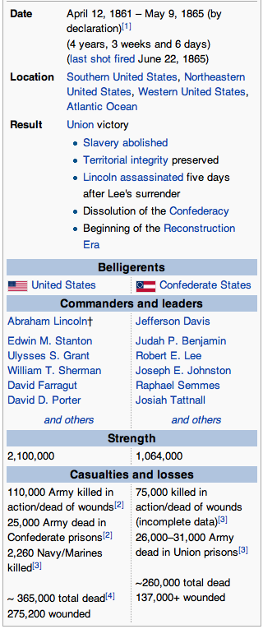

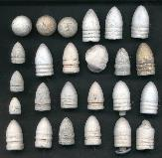
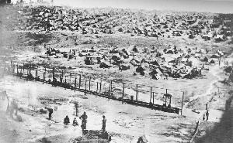
Impact of the War
New Technology
  Weapons
    Rifles and Carbines
      Bullets & Cartridges
    Artillery
      Shells and canisters
    Naval advances
      Ironclads & turrets
      Submarine
  Expansion of Railroads & Telegraphy
Costs
  $15 billion
  750,000 lives (est.)
Notes:
Bullets: http://www.metaldetectingintheusa.com/cwbullets.html
Burnside Carbine: http://www.thomaslegion.net/americancivilwar/civilwargunslistweapons.html
Andersonville Prison: http://usslave.blogspot.com/2012/08/ghosts-of-andersonvilles-prisoner-of.html
:

